Slide 1
CfP: Enhance access to sustainable transport for education and health care services UGA22008 and UGA22002
Information session 28th .07.2025
Notes:
William M or BB

Slide 2
Presentation outline
Introduction to WeLearn, Wecare and the Call for Proposals
Objectives of the call
Admissibility criteria
Actors
Actions
Costs
Application and selection procedure
Notes:
William M or BB

Slide 3
Call for Proposals
Guidelines, annexes, clarifications (Q&A) and all other communication:
www.enabel.be/grants
Call reference number: UGA22008-10144
Call Title: Enhance access to sustainable transport for education and health care services
Notes:
William M or BB

Slide 4
Enabel Country Portfolio Objectives
Overall Objective
General objectives
Young people and women in Uganda develop into active, economically independent citizens in a sustainable society that respects human rights and ensures quality basic services
Pillar 1
Young people, especially young women, acquire skills and find decent jobs or entrepreneurship opportunities in agriculture and the green and sustainable economy
Pillar 2
WeLearn & WeCare
The right to safe and quality education and health care is more transparently ensured, in particular for vulnerable groups including children, girls and women, and refugees
Notes:
William M or BB

Slide 5
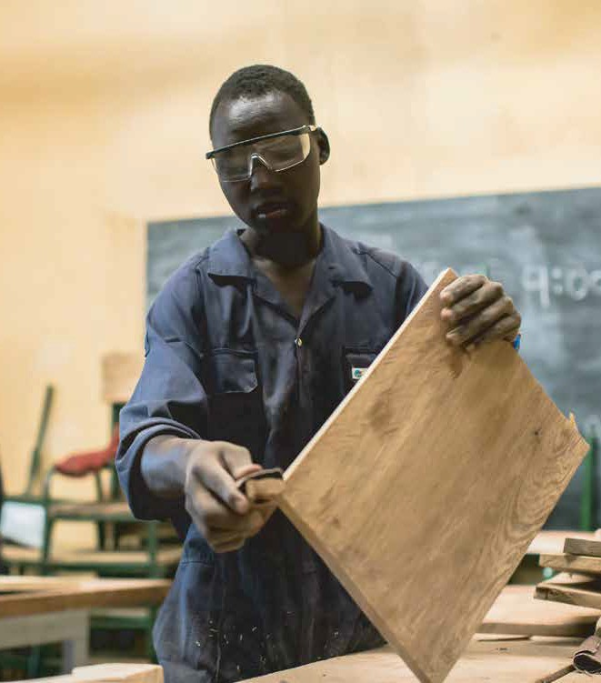
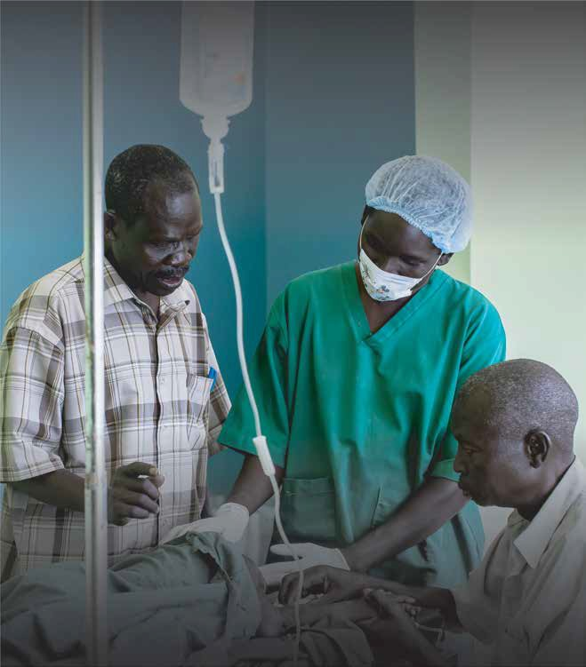
Pillar 2
Education, Health and Local Governance
Pillar 1
Skilling & Decent Jobs
Young people especially young women acquire skills and ﬁnd decent jobs, or entrepreneurship opportunities in
agriculture and the green and sustainable economy
The right to safe and quality education and health care is more transparently ensured in particular for vulnerable groups including children, girls and women, and refugees
Intervention
Period
Intervention | Period
Pillar 2
Intervention 3 – Boosting Equal Learning Opportunities (WeLearn) | 2023-2027
Intervention 4 – Caring for Mothers’ Lives (WeCare)
Intervention 5 – Training for Excellent Health Care (WeTrain4Health)
Pillar 1
Intervention 1 – Green and decent jobs for youth
(WeWork) - Rwenzori/Albertine Region
2023-2027
Intervention 2 – Green and decent jobs for youth
(WeWork) - Busoga Region
Notes:
Enabel country portfolio objectives William M or BB

Slide 6
1. Introduction
Enabel, the Belgian Agency for International Cooperation
Vision: Young people and women in Uganda develop into active, economically independent citizens in a sustainable society that respects human rights and ensures quality basic services.
Focus areas:
Employability | Employment & Entrepreneurship | Education | Health
Skills development that offers the prospect of decent and green jobs | Skilled people find decent and green jobs or start a successful business | Quality lower secondary education | Training of health personnel & improved capacity of health centres and hospitals
Notes:
William M or BB

Slide 7
Cn't Introduction
Pillar 2 interventions are funded by:
Belgian government
Education: WeLearn and WeTeach (EU funding)
Health: WeCare and WeTrain4Health

Slide 8
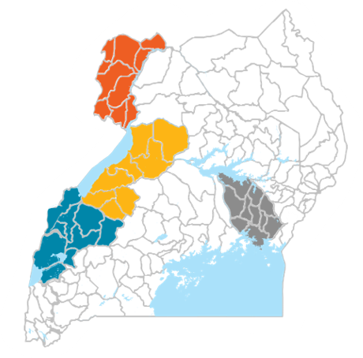
Geographical focus Pillar 2
Rwenzori region: Kasese, Kabarole & Kyegegwa
Albertine region: Hoima
Busoga region: Jinja and Kamuli
West Nile
Key
Busoga
Westnile
Albertine Rwenzori

Slide 9
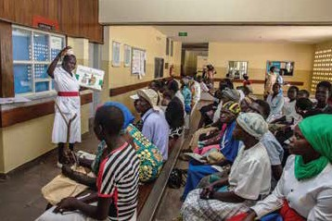
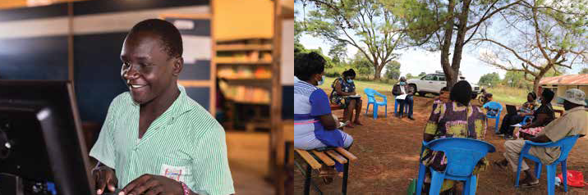
Pillar 2: Education, Health, Local Gov.
Results domain 2
Supply side, focus on duty-bearers
Results domain 1
Demand side, focus on right-holders
Results domain 3
Governance, with right-holders & duty-bearers
Enhanced participatory governance and shared accountability for education & health services
Increased demand for safe and quality secondary education and health care (with attention on SRHR)
Education
Increased supply of quality and inclusive secondary education
Health
Improved emergency referral and quality health services with a focus on SRHR
Notes:
William M or BB

Slide 10

(a) Caring for mother's lives-We Care
Every day, 16 mothers in Uganda die from childbirth-related complications.
Our Focus: Saving lives through a stronger health system
🧭 Our Approach
💬 Empower communities Encourage informed health-seeking behaviors through local dialogue and awareness.
🚑 Strengthen emergency response Improve ambulance systems, referral pathways, and response times.
⚕️ Upgrade care quality Focus on high-impact improvements in HCIVs and General Hospitals.
🤝 Enhance health governance Promote accountability and inclusive planning with local health actors.
Notes:
Bene

Slide 11



(b) Boosting equal learning opportunities -We Learn
Uganda faces one of the highest student dropout rates within the first 4 years of secondary school
💸 Make Education Affordable Reduce the financial burden on families to keep children in school.
Safe and Inclusive Learning Environments Improve school infrastructure, sanitation, and reduce violence.
Strengthen Local Government Capacity Promote accountability and transparency in school financing.
👩🏽‍🏫 Mentor School Leaders & Boards Enhance management and leadership for better school performance.
Engage Families and Communities Address socio-cultural barriers and harmful gender norms together.
Notes:
Liz

Slide 12
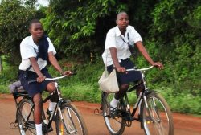
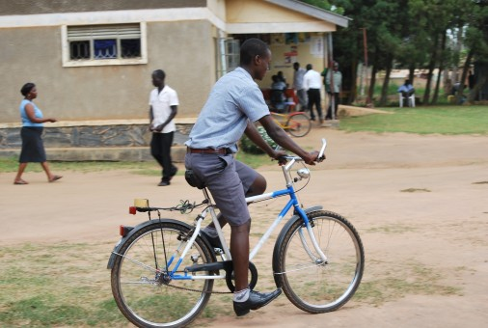
2. Call procedure
Call for Proposal 1 Phase without concept note
Notes:
BB

Slide 13

2. General Objective
The general objective of this Call for Proposals is: To enhance access to sustainable transport for education and health care services.
Notes:
Joseph

Slide 14
Specific objective(s) of the call are;
Results area 1- Education | To set up a holistic management system in schools to provide and maintain bicycles for students.
 | To improve school attendance rates, especially among female students, by addressing safety and mobility concerns.
 | To enhance the safety and security for girls commuting to school
Result area 2- Health | To increase the reach and effectiveness of Community Health Workers (CHWs) by providing them with bicycles to facilitate access to remote households.
Result area 3- Research | To evaluate the impact of the intervention on student performance and retention, and reach and effectiveness of Community Health Workers over the project period.
Notes:
Joseph

Slide 15
Focus Geographic areas of Implementation
Geographical area | Thematic priority (results areas)
Kamuli district | Education | Health | Research
Kyegegwa district | Education | n/a
Adjumani district | Education | n/a
Notes:
BB

Slide 16
Themes
Education | Promoting the use of bicycles at the household and school level as a cheap, safe, healthy and environmentally friendly mode of transport to travel to school
Health | Promoting the use of bicycles with Community Health Workers as a cheap, safe, healthy and environmentally friendly mode of transport to reach a wider area, and reach communities more frequently
Notes:
Joseph

Slide 17

Expected results
Expected results under Education (Result area 1)
Schools are able to manage and maintain the bicycles offered to beneficiary vulnerable students
Increased school attendance and reduced absenteeism among beneficiary vulnerable students.
Enhanced safety and security for girls commuting to school.
Expected results under Health (Result area 2)
CHWs equipped with bicycles can cover wider catchment areas and increase the number of household visits.
Expected results – cross-cutting (Result area 3)
Action research evaluating the impact of the intervention on student performance and retention and improved health service delivery and CHW motivation.
Notes:
Joseph

Slide 18
Target groups
Lot | Estimated number of direct beneficiaries
 | Education | Health
Kamuli District | 5 schools 250 students | 50 CHW
Kyegegwa district | 4 schools 200 students | n/a
Adjumani district | 5 schools 250 students | n/a
Notes:
Joseph

Slide 19
The institutions in which the activities should take place are;
Lot | Education | Health
Kamuli District | Bulopa secondary school St John Bosco senior secondary school St Paul Mbulamuti SS Namasagali College Luzinga SS | Kamuli General Hospital Namwendwa HCIV Nankandulo HCIV
Kyegegwa district | Kakabara SS Rwentuha Seed Kibuye SS Mpara SS | n/a
Adjumani district | Pagirinya Lewa Adjumani s.s Dzaipi SS Ofua Seed | n/a
Notes:
Joseph

Slide 20

Call volume and grant amounts
Total call volume is 350,000 EUR
Under the health component, 50,000 EUR
Under education component, 300,000 EUR
For education component, the amount should be distributed among the districts as follows:
Kamuli district: 30 %
Kyegegwa district: 30%
Adjumani district: 40%
Notes:
Joseph

Slide 21

3. Admissibility criteria – 3 levels
The actors: Admissible applicants
The actions: Admissible actions for grants
The costs: Admissible types of costs that may be included in grants
Notes:
Benedicte

Slide 22
3a. The actors: (lead) applicant
To be admissible for the grants, the applicant must satisfy the following conditions:
A. be a legal person;
and
B. be a non-profit private entity or a foundation; or
be a legal entity of private law for which profit maximization is not the priority objective
C. be a (local/national) non-governmental organization,
D. be established or represented in Uganda;
and
E. be directly responsible for the preparation and management of the action with the co-applicant(s) and not be acting as an intermediary
Notes:
Benedicte

Slide 23
3a. The actors: (lead) applicant
and;
The applicant should have a ‘’proven track record’’ of implementing bicycle projects with schools, health centers or communities. At least 2 projects of procuring quality bicycles at substantial numbers in Uganda during the last 2 years. Each project should show the supply of at least 200 bicycles
Co-applicant(s)
A co-applicant is not mandatory. If the applicant applies with a co-applicant, maximum 1 co-applicants
Notes:
Benedicte

Slide 24
3a. The actors: (lead) applicant
Exclusion grounds:
Annex VII grant agreement – Applicant’s declaration in application form completed and signed (Annex A guidelines)
Supporting documents (upon preselection – ):
Criminal record clearances from Interpol/Police clearance from the people signing the grant agreement
Social security clearance certificate
Tax clearance certificate
Notes:
Benedicte

Slide 25
3a. The actors: Co-applicant(s)
The co-applicant(s)
-shall participate in the definition and the implementation of the action, and the costs that they incur shall be eligible in the same way as those incurred by the applicant.
-the co-applicant(s) must satisfy the admissibility criteria which apply to the applicant itself.
-The co-applicants must sign the mandate statement in part B, section 2.6 of the grant application file.
-If the grants are awarded to them, any co-applicants will become the beneficiaries of the action, with the Contracting-Beneficiary.
Any application shall involve at least one organization based within the region where the activity will be implemented (acting either as lead or co-applicant).
Notes:
Benedicte

Slide 26

Questions?
Notes:
Liz or Robert to facilitate and capture the questions

Slide 27
3b. The actions
An action comprises a series of activities that are necessary to achieve the results and contribute to the specific(s) objective(s) pursued by the application
Duration
Geographical coverage; Covered
Sectors or themes
Target groups; Covered
Type of action and eligible activities
Notes:
Joseph

Slide 28
3b. The actions: Duration
The initial planned duration of an action may not be less than 18 months nor exceed 24 months.
Notes:
Joseph

Slide 29
3b. The actions – admissible
Types of activity admissible for financing under this Call for Proposals:
Under Education
Provide bicycles to schools and co-select beneficiary students
Provide training in bicycle maintenance for students (working e.g. with student clubs) and school staff
Set up a management system to maintain bicycles and monitor their use
Promote the use of bicycles for students – especially girls
Develop appropriate bicycle storage facilities at the schools
Under Health
Provide bicycles to Community Health Workers
Provide CHWs with skills for bicycle maintenance and healthcare delivery.
Notes:
Joseph

Slide 30
3b. The actions – admissible Cont'd....
Under Research
Conduct action research to assess the impact of the intervention
Under-cross-cutting issues: (Environmental awareness, Active citizenship / social engagement or Entrepreneurship)
Promotion campaigns to use bicycles as a safe, environmentally and healthy means of transport
Encourage entrepreneurship linked to bicycle (set up a bicycle repair shop, sell bicycle repair material / equipment)
Encourage entrepreneurship linked to community health
Set up sustainable services centers through the VTI
Notes:
Joseph

Slide 31
3b. The actions – NON admissible
The following types of action are not admissible:
actions consisting exclusively or primarily of sponsoring the participation of individuals in workshops, seminars, conferences and conventions.
actions consisting exclusively or primarily of financing individual scholarships.
Workshops and conferences for political, spiritual and social enhancement
Notes:
Joseph

Slide 32
3b. The actions: Sub-grants to sub-beneficiaries
Applicants cannot propose sub-grants to sub-beneficiaries to help achieve the objectives of the action.
Notes:
Joseph

Slide 33
3b. Number of applications
The applicant may not submit more than 01 application(s) under this Call for Proposals.
The applicant may not be at the same time a co-applicant in another application.
A co-applicant may submit more than 01 application(s) under this Call for Proposals.
A co-applicant may not be awarded more than 01 Grant Agreement(s) under this Call for Proposals.
Notes:
Joseph

Slide 34
Questions?
Notes:
Robert taking notes of questions and Liz facilitating

Slide 35
3c. Admissible/ Ineligible costs
1) Direct costs
Operational Costs
Management Costs (Direct Administration Costs).
2) Indirect Costs:
Structure Costs (Indirect Administration Costs)
Admissible / Eligible Costs:
Costs that Enabel can subsidize under any Grant Agreement
Two Types:
Directs Costs
Indirect Costs
Notes:
Lydia

Slide 36
3c. Admissible/ Eligible costs
ii) Management Costs:
Administration costs directly attributed to the implementation of the actions. This comprise the costs of management, monitoring, equipment, facilities and other costs directly related to the core activity.
Examples:
IT/Computer equipment(Laptops, printers, projectors, Camera etc.)
Furniture and fittings
Audit & Accounting fees
Salary of program staff + other direct staff
Etc.
Direct costs
i) Operational Costs
Activity costs necessary for achieving the results of the action. This comprises the costs of the core activities to be implemented.
Examples:
Training materials
Food for trainees
Transport costs for trainees or attend training workshop
Training fees
Etc.
Notes:
Lydia

Slide 37
3c. Admissible/Ineligible costs
Indirect Costs:
Structure Costs: Administration costs not directly attributed to the project, but are necessary for the implementation of the actions.
Max 7% of operational costs, and to be verified.
Examples:
Office rental
Utilities: electricity, water, etc. for project office
Salary of the Executive Director or + other support staff
Office telecommunication cost
Etc.
Notes:
Lydia

Slide 38
3c. Admissible/Eligible costs
Reserve for contingencies:
The budget may include a contingency reserve up to a maximum of 5% of the estimated eligible direct costs.
It may only be used with the prior written authorization of Enabel.
Notes:
Lydia

Slide 39
3c. Ineligible costs
Accounting entries not leading to payments
Provisions for liabilities and charges, losses, debts or possible future debts
Debts and debit interests
Doubtful debts
Currency exchange losses
Loans to third parties
Guarantees and securities;
Costs already financed by another grant
Invoices made out by other organizations for goods and services already subsidized
Subcontracting by means of service or consultancy contracts to personnel members, Board members or General Assembly members of the organization subsidized
Any sub-letting to oneself
Purchases of land or buildings;
Compensation for damage falling under the civil liability of the organization
Employment termination compensation for the term of notice not performed
Purchase of alcoholic beverages, tobacco and derived products thereof
Grants to sub-beneficiaries
Salary bonuses
Notes:
Lydia

Slide 40
3c. Budgeting
Budget Template
Annex-B_Budget-template_UGA22008-10144.xlsx
Notes:
Lydia

Slide 41
Questions?
Notes:
Lydia

Slide 42
4. Application
Use the complete Annex A Grant Application File. Do not use own templates & do not tweak the template
Submission in English only, handwritten Proposals notes will not be accepted.
In the Proposal, provide a Detailed budget and Logical framework
Errors or major inconsistencies concerning the points mentioned in the instructions of the form may result in rejection (e.g., content required, pages, …)
Enabel reserves the right to request clarification where the information provided does not enable it to carry out an objective evaluation
Elements defined in the proposal may not be modified by the applicant.
Notes:
Emmanuel

Slide 43
4. Annex A; proposal
Relevance of the action
Detailed description of the action & methodology
6 sections (description, strategic approach, methodology (who/what/when/how), action plan, risks & assumption, sustainability)
log frame
budget
Administrative data and information for lead and co-applicant(s)
The lead applicant’s experience for similar and other actions
Capacity to manage and perform actions (experience in the sectors)
Resources (financial data, source of financing, number of people employed)
The co-applicant(s)’ experience for similar and other actions
Hystory of cooperation with lead applicant
Capacity to manage and implement actions (experience in the sectors)
The associates (if any) - participate actively in the action, but are not eligible for grants and only qualify to receive daily allowances and travelling expenses)
Mandate for each co-applicants signed
Declaration for lead applicant signed
Notes:
Emmanuel

Slide 44
4. Application annexes
1. The Application declaration signed by the applicant
2. Statutes or articles of association of the lead applicant and any co-applicants.
3. An external audit report produced by an approved auditor, certifying the applicant's accounts relating to the last financial year available when the total amount of the requested grants exceeds EUR 200,000 (not applicable to public applicants). The audited report should not be older than or exceed 2023. Potential co-applicants are not required to submit an external audit report.
4. A copy of the applicant's most recent financial statements (income statement and balance sheet for the last closed financial year: should not be than 2023). Any co-applicants are not required to submit a copy of their financial statements.
5. The legal entity sheet (see Annex D of these guidelines) duly completed and signed by each of the applicants (ie the applicant and each of the possible co-applicants), accompanied by the supporting documents requested.
Notes:
Emmanuel

Slide 45

4. Application procedure
! Primary source of information
Guidelines, annexes, clarifications (Q&A) and all other communication & updates:
https://www.enabel.be/grants/
Select UGANDA – OPEN CALLS - FILTER
reference number UGA22008-10144
Notes:
Emmanuel

Slide 46
5. Application procedure
Remaining questions: uga_csc_grants@enabel.be
Subject: reference number + name
Questions can be submitted until 13/August
Answers will be published on https://www.enabel.be/grants/ latest by 21/August
Notes:
Emmanuel

Slide 47
5. Submission of proposals
Deadline for application: 02 September 2025 at 5pm.
!!! Online submission form – ‘Submit’: https://submit.link/3Zz
SUBMISSIONS BY EMAIL/POST → AUTOMATIC REJECTION
Notes:
Emmanuel

Slide 48
5. Submission of proposal
Proposals must be submitted through the following link: https://submit.link/3Zz
Proposals sent by other means (eg by fax or e-mail) or delivered to other addresses will be rejected.
Applicants must ensure that their files are complete. Incomplete files may be rejected.
Avoid last minute submission; System automatically closes when past deadline
Start working on a draft timely (you can always go back to your draft, it saves automatically)
Get documentation (annexes to the application file) ready on time; you cannot proceed to uploading application file before uploading the annexes)
Notes:
Emmanuel

Slide 49
5. Submission of Proposal
Timely
Complete (guide + declaration + annexes)
and following the procedure (use the template!)
Notes:
Emmanuel

Slide 50
5. Indicative timeline for the call;
 | Date | Time*
Information meeting | 28th/07/2025 | 11 :00 AM
Deadline for clarification requests to the contracting authority | 13 August 2025 | 5 PM
Last date on which clarifications are given by the contracting authority | 21 August 2025 | -
Proposal Submission deadline | 2d September 2025 | 5 PM
Request certificates and supporting documents relating to the grounds for exclusion (see 2.1.1 (2)) | 02 October 2025
Receipt of certificates and supporting documents relating to the grounds for exclusion | 17 October 2025
Organizational analysis of applicants whose proposal has been shortlisted. | 02 October 2025
Notification of the award decision and transmission of signed grant agreement | 30th October 2025
Signature of the Agreement by contracting beneficiary | 15th November 2025 | -
Notes:
Emmanuel

Slide 51

Questions?
Notes:
Facilitation by WeLearn or WeCare

