Slide 1
Call For Proposals UGA22008 Improving Citizen Participation and Accountability in Local Government Service Delivery Processes in Health and Education
Information session
Notes:
William M or BB

Slide 2
Presentation outline
Introduction to Wecare, We learn and the Call for Proposals
Objectives of the call
Admissibility criteria
Actors
Actions
Costs
Concept note application form
Application and selection procedure
Notes:
William M or BB

Slide 3
Call for Proposals
Guidelines, annexes, clarifications (Q&A) and all other communication:
www.enabel.be/grants
Call reference number: UGA22008-10100
Call Title: Improving Citizen Participation and Accountability in Local Government Service Delivery Processes in Health and Education
Notes:
William M or BB

Slide 4
Enabel Country Portfolio Objectives
Overall Objective
General objectives
Young people and women in Uganda develop into active, economically independent citizens in a sustainable society that respects human rights and ensures quality basic services
Pillar 1
Young people, especially young women, acquire skills and find decent jobs or entrepreneurship opportunities in agriculture and the green and sustainable economy
Pillar 2
WeLearn & WeCare
The right to safe and quality education and health care is more transparently ensured, in particular for vulnerable groups including children, girls and women, and refugees
Notes:
William M or BB

Slide 5


Pillar 2
Education, Health and Local Governance
Pillar 1
Skilling & Decent Jobs
Young people especially young women acquire skills and ﬁnd decent jobs, or entrepreneurship opportunities in
agriculture and the green and sustainable economy
The right to safe and quality education and health care is more transparently ensured in particular for vulnerable groups including children, girls and women, and refugees
Intervention
Period
Intervention | Period
Pillar 2
Intervention 3 – Boosting Equal Learning Opportunities (WeLearn) | 2023-2027
Intervention 4 – Caring for Mothers’ Lives (WeCare)
Intervention 5 – Training for Excellent Health Care (WeTrain4Health)
Pillar 1
Intervention 1 – Green and decent jobs for youth
(WeWork) - Rwenzori/Albertine Region
2023-2027
Intervention 2 – Green and decent jobs for youth
(WeWork) - Busoga Region
Notes:
Enabel country portfolio objectives William M or BB

Slide 6
1. Introduction
Enabel, the Belgian Agency for International Cooperation
Vision: Young people and women in Uganda develop into active, economically independent citizens in a sustainable society that respects human rights and ensures quality basic services.
Focus areas:
Employability | Employment & Entrepreneurship | Education | Health
Skills development that offers the prospect of decent and green jobs | Skilled people find decent and green jobs or start a successful business | Quality lower secondary education | Training of health personnel & improved capacity of health centres and hospitals
Notes:
William M or BB

Slide 7
Cn't Introduction
Pillar 2 interventions are funded by:
Belgian government
Education: WeLearn and WeTeach (EU funding)
Health: WeCare and WeTrain4Health

Slide 8
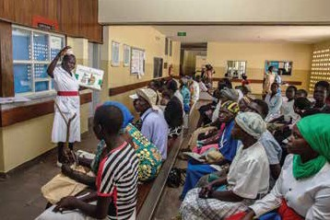
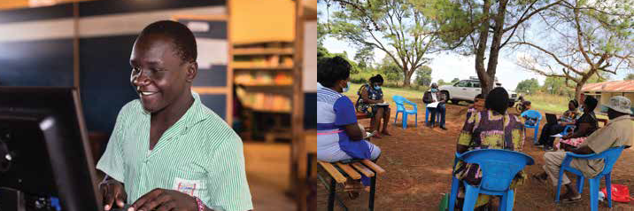
Pillar 2: Education, Health, Local Gov.
Results domain 2
Supply side, focus on duty-bearers
Results domain 1
Demand side, focus on right-holders
Results domain 3
Governance, with right-holders & duty-bearers
Enhanced participatory governance and shared accountability for education & health services
Increased demand for safe and quality secondary education and health care (with attention on SRHR)
Education
Increased supply of quality and inclusive secondary education
Health
Improved emergency referral and quality health services with a focus on SRHR
Notes:
William M or BB

Slide 9

(a) Caring for mother's lives-We Care
Every day, 16 mothers in Uganda die from childbirth-related complications.
Our Focus: Saving lives through a stronger health system
🧭 Our Approach
💬 Empower communities Encourage informed health-seeking behaviors through local dialogue and awareness.
🚑 Strengthen emergency response Improve ambulance systems, referral pathways, and response times.
⚕️ Upgrade care quality Focus on high-impact improvements in HCIVs and General Hospitals.
🤝 Enhance health governance Promote accountability and inclusive planning with local health actors.
Notes:
Bene

Slide 10



(b) Boosting equal learning opportunities -We Learn
Uganda faces one of the highest student dropout rates within the first 4 years of secondary school
💸 Make Education Affordable Reduce the financial burden on families to keep children in school.
Safe and Inclusive Learning Environments Improve school infrastructure, sanitation, and reduce violence.
Strengthen Local Government Capacity Promote accountability and transparency in school financing.
👩🏽‍🏫 Mentor School Leaders & Boards Enhance management and leadership for better school performance.
Engage Families and Communities Address socio-cultural barriers and harmful gender norms together.
Notes:
Liz

Slide 11
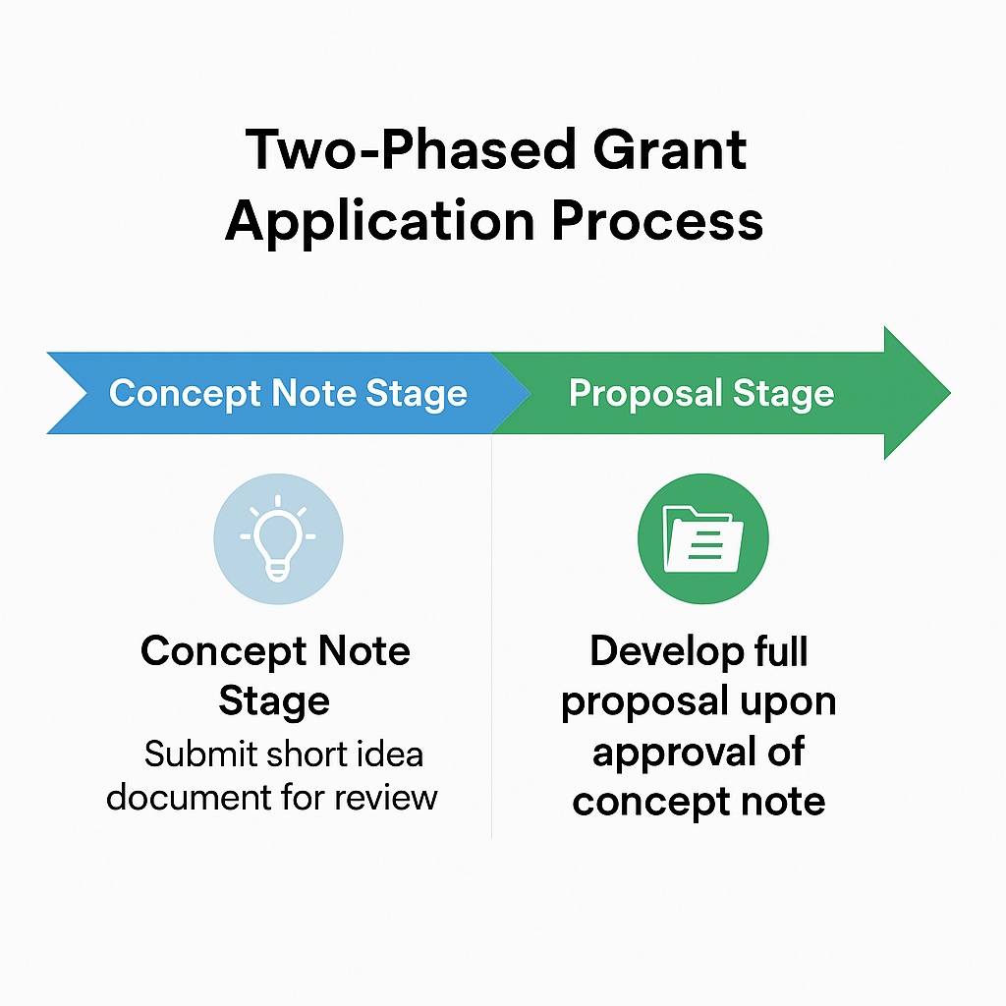
2. Call procedure
Notes:
BB

Slide 12
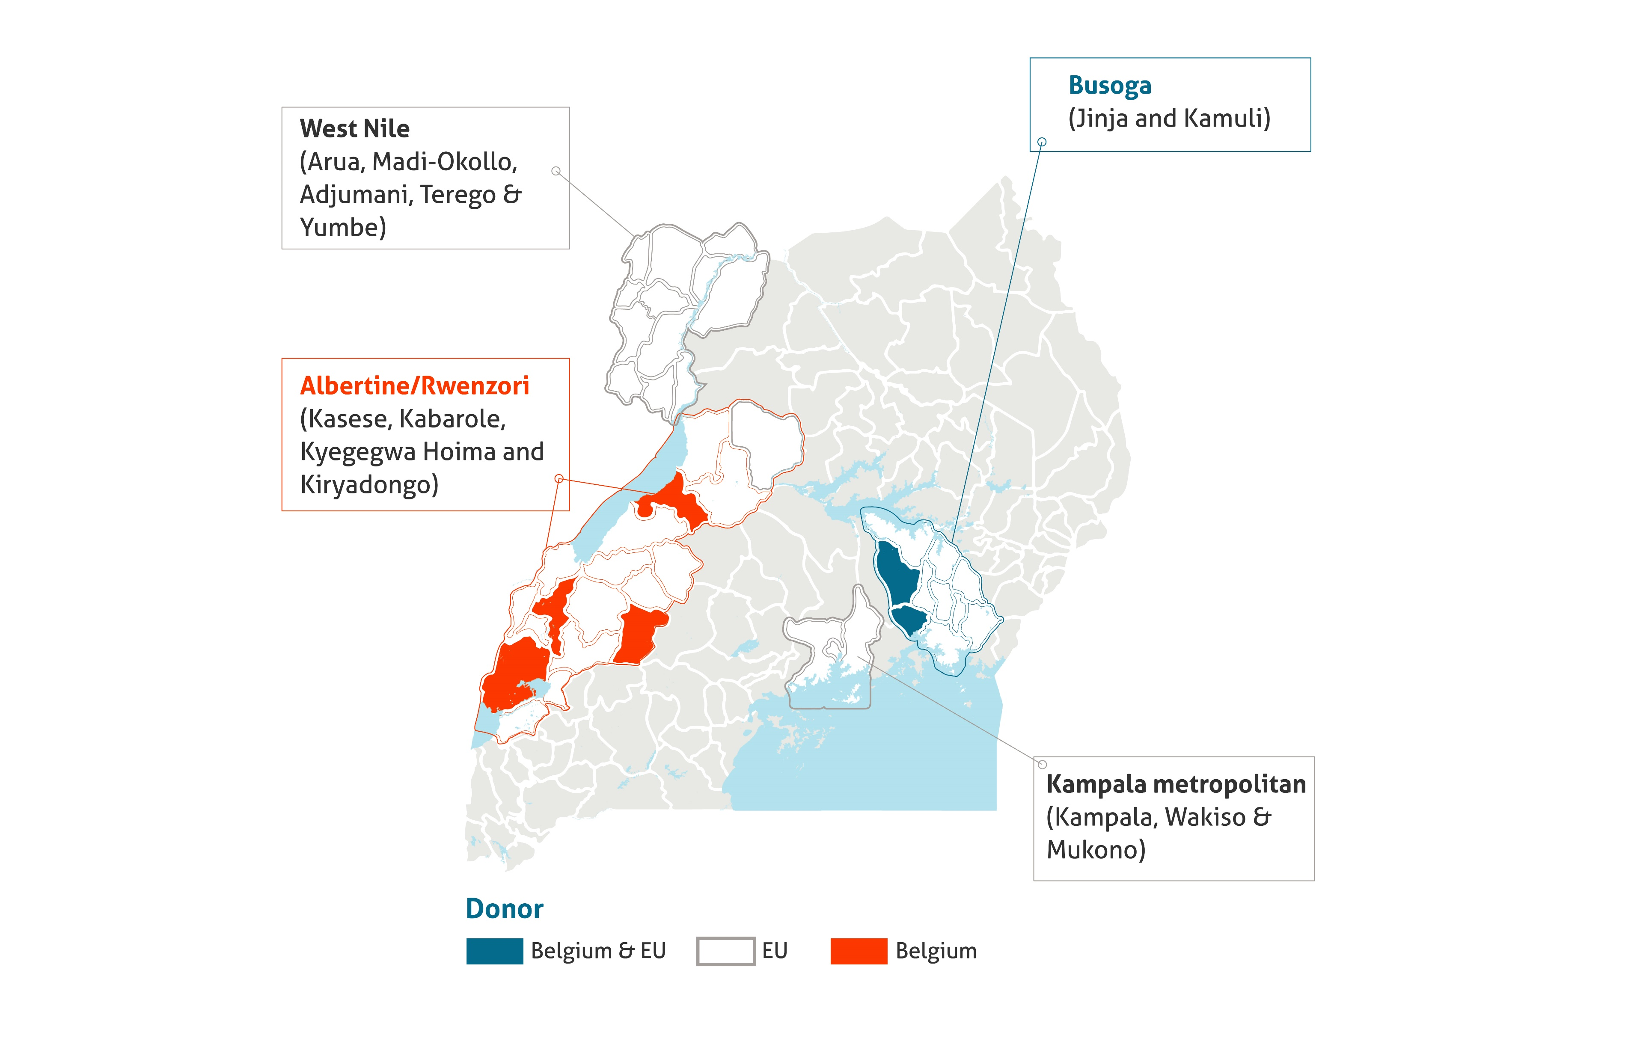
Focus area of implementation
Districts: Jinja, Kamuli, Kyegegwa, Kabarole and Kasese
Cities: Jinja and Fort Portal
Notes:
BB

Slide 13
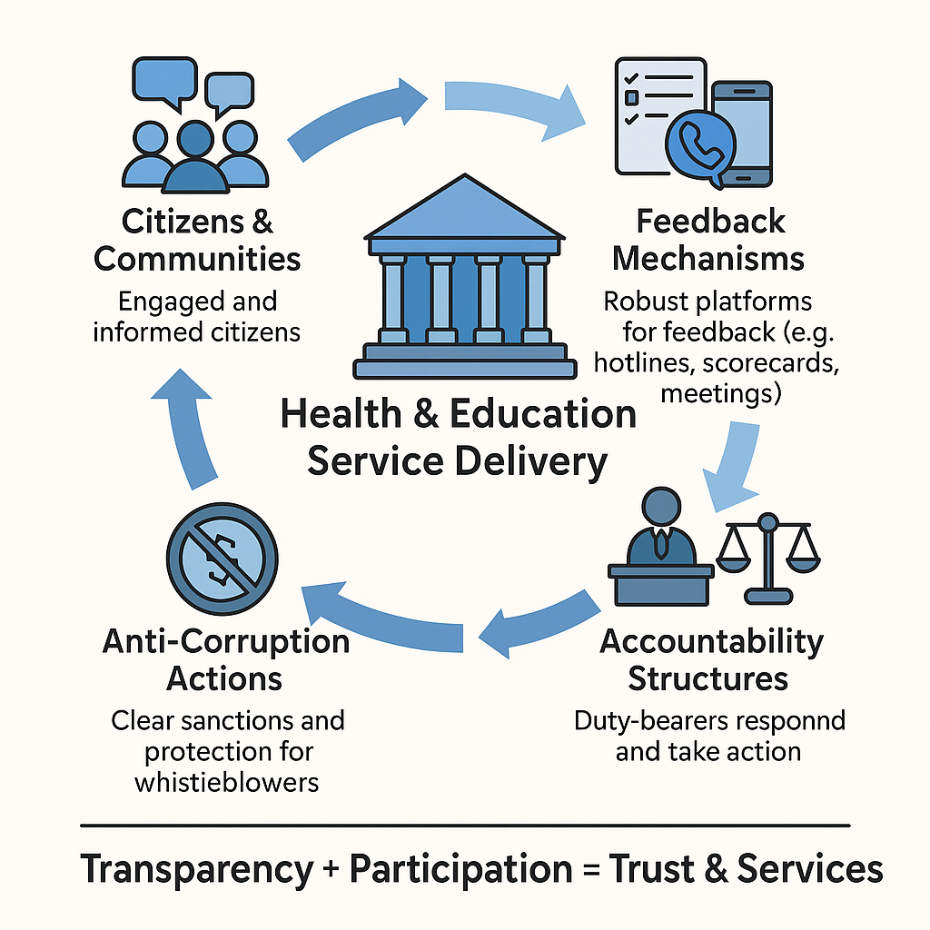
2. General Objective
To improve citizen participation, accountability and strengthen anti-corruption efforts in Local Government service delivery processes for health and education, incorporating robust mechanisms for citizen feedback to ensure transparency and responsiveness.
Notes:
Joseph

Slide 14
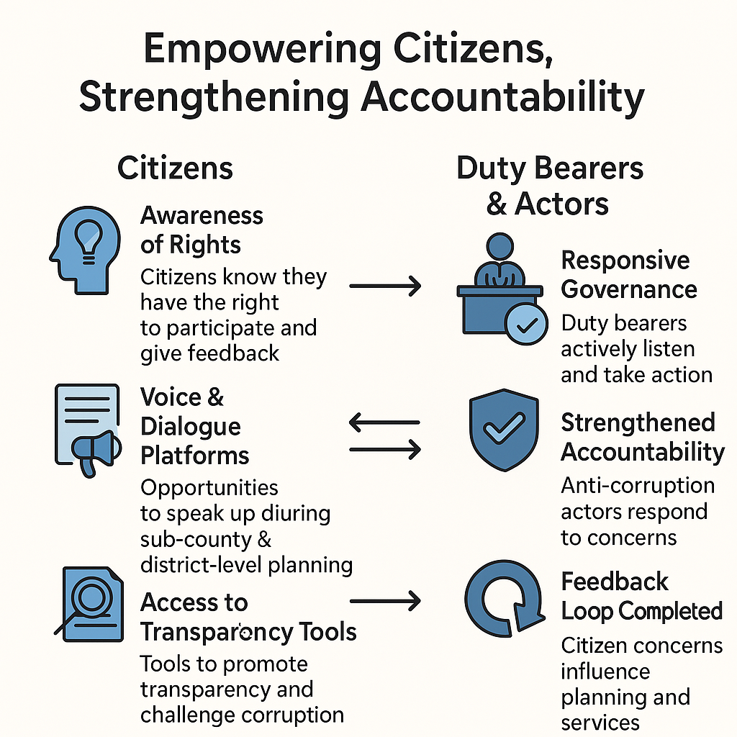
Specific objectives of the call
Citizens have increased awareness on their right to participate in and provide feedback on local government service delivery.
Provide citizens with opportunities to voice their concerns, engage in dialogue, and participate in sub-county and district-level planning for health and education.
Citizens have access to mechanism and approaches that promote transparency, demand accountability and challenge corruption in the delivery of health and education services.
Duty bearers, accountability and anti-corruption actors have increased their responsiveness to citizen demands.
Notes:
Joseph

Slide 15

Expected results
Increased civic awareness; i.e. Citizens are provided with information that empowers them to provide feedback and demand for accountability of service delivery in health and education.
Increased citizens’ participation in subcounty and district level planning to inform decision making at national and district levels and monitoring of health and education services delivery.
Citizens are provided with opportunities and spaces that empower them to provide feedback and demand for access to equitable and accountable service delivery in health and education.
Data on status and quality of service delivery for education and health is collected, analysed, and used to leverage policy discussions and actions for improvement at local, regional and national level.
Functional mechanisms for citizen engagement and feedback are established, and utilized to amplify citizens voice, gather feedback and act upon service delivery demands in health and education.
Capacity of CBOs/NGOs is strengthened to advocate for local communities, ensuring their concerns and priorities are addressed effectively.
Increased responsiveness of duty bearers, accountability and anti-corruption actors to citizens demands.
Notes:
Joseph

Slide 16
Target groups
The target beneficiaries of the project are:
Organized community structures in the five targeted districts and 2 cities. E.g. community monitors, monitoring systems etc.
The selected CBOs/NGOs operating in the 5 target districts and 2 cities.
Directly targeted duty bearers (in health and education sectors), accountability and anti-corruption structures (council and service delivery structures).
Leadership and governance structures in schools (PTAs/BOGs) and health facilities (HUMCs and Hospital boards).
The indirect beneficiaries are the
Residents, including citizens and refugees, in the 5 districts and 2 cities.
the health and education government officials/duty bearers and some indirectly targeted accountability and anti-corruption actors in the 5 target districts and 2 Cities at regional and national level.
The lower secondary schools and health facilities in the 5 target districts and 2 cities
Notes:
Joseph

Slide 17

Call volume and grant amounts
Total call volume is 305,000 EUR
Grant applications must fall within the call volume.
Grant applications must fall between minimum 275,000 and maximum 305,000 Euro
Notes:
Joseph

Slide 18

3. Admissibility criteria – 3 levels
The actors: Admissible applicants
The actions: Admissible actions for grants
The costs: Admissible types of costs that may be included in grants
Notes:
Benedicte

Slide 19
3a. The actors: (lead) applicant
To be admissible for the grants, the applicant must satisfy the following conditions:
A. be a legal person;
and
B. be a non-profit private entity or a foundation; or
be a legal entity of private law for which profit maximization is not the priority objective
C. be a (local/national) non-governmental organization,
D. be established or represented in Uganda;
and
E. be directly responsible for the preparation and management of the action with the co-applicant(s) and not be acting as an intermediary
and;
Notes:
Benedicte

Slide 20
3a. The actors: (lead) applicant
and;
Have 3 years of experience in the relevant thematic areas i.e.: governance and accountability projects, promotion of citizen engagement in accountability and anti-corruption
F. Have an active Bank Account for the past 12 months;
Notes:
Benedicte

Slide 21
3a. The actors: (lead) applicant
Exclusion grounds:
Annex VII grant agreement – Applicant’s declaration in application form completed and signed (Annex A guidelines)
Supporting documents (upon preselection – 2nd stage):
Criminal record clearances from Interpol/Police clearance from the people signing the grant agreement
Social security clearance certificate
Tax clearance certificate
Notes:
Benedicte

Slide 22
3a. The actors: Co-applicant(s)
The Lead applicant must act with one or a maximum of 2 co-applicant(s) in accordance with the requirements below.
The co-applicant(s)
-shall participate in the definition and the implementation of the action, and the costs that they incur shall be eligible in the same way as those incurred by the applicant.
-the co-applicant(s) must satisfy the admissibility criteria which apply to the applicant itself.
-The co-applicants must sign the mandate statement in part B, section 2.6 of the grant application file.
-If the grants are awarded to them, any co-applicants will become the beneficiaries of the action, with the Contracting-Beneficiary.
Any application shall involve at least one organization based within the region where the activity will be implemented (acting either as lead or co-applicant).
Notes:
Benedicte

Slide 23
The actors: Co-applicant(s)
The following persons are not co-applicants. They do not need to sign the “mandate” statement:
Associates
Participate actively in the action but are not eligible for grants and only qualify to receive daily allowances and travelling expenses.
To be specified in part B of the application form. They need not to sign the mandate in 2nd/proposal stage.
Contractors
These are contractors for services, works and equipment. These must be sourced through a procurement process using relevant procedures i.e. PPDA (public procurement law) for public entities and annex VIII of the Grant Agreement for private entities
Notes:
Benedicte

Slide 24

Questions?
Notes:
Liz or Robert to facilitate and capture the questions

Slide 25
3b. The actions
An action comprises a series of activities that are necessary to achieve the results and contribute to the specific(s) objective(s) pursued by the application
Duration
Geographical coverage
Sectors or themes
Target groups
Type of action and eligible activities
Notes:
Joseph

Slide 26
3b. The actions: Duration
The initial planned duration of an action may not be less than 18 months nor exceed 24 months.
Notes:
Joseph

Slide 27
3b. The actions: Geographical coverage
The actions must be implemented in the Rwenzori and Busoga sub-regions;
Covering 5 districts namely: Jinja, Kamuli, Kasese, Kabarole and Kyegegwa and 2 cities (Jinja and Fort Portal).
Notes:
Joseph

Slide 28
3b. The actions: Priority sectors
Citizens actively participating in policy formulation, implementation, monitoring/audit in the delivery of health and education public services at local government level. LG & CG policy linkages. Responsiveness of duty bearers, accountability and anti-corruption actors to citizens demands.
Notes:
Joseph

Slide 29
3b. The actions: Target beneficiaries
Organized community structures in the five targeted districts and 2 cities. E.g. community volunteers, monitoring systems etc.
The selected CBOs/NGOs operating in the 5 target districts and 2 cities.
Directly targeted duty bearers (in health and education sectors), accountability and anti-corruption structures (council and service delivery structures).
Leadership and governance structures in schools (PTAs/BOGs) and health facilities (HUMCs and Hospital boards).
Notes:
Joseph

Slide 30
3b. The actions – admissible
Continuous sensitization of citizens to inform citizens that their participation in local government service delivery is not only a legally enforceable right but also includes active mechanisms for feedback and redress if this right is violated (including in the delivery of services at local government level)
Sensitization of citizens on the roles of the different structures in the delivery of services at local government level with clear linkages on active citizen participation at all levels.
Support regular service delivery-related engagements between local governments and citizens to facilitate in particular consultations with and provide feedback to citizens.
Support Local Government authorities including duty bearers, accountability and anti-corruption actors to promote, create, expand and participate in platforms that not only facilitate citizen voice but also actively solicit and respond to feedback, thereby enhancing accountability.
Training of citizens and community-level leaders on their civic roles, advocacy and influencing decision-making that impacts their communities.
Notes:
Joseph

Slide 31
3b. The actions – admissible Cont'd....
Support citizen and CSO led advocacy on prudent public finance management of health and education in local and central governments budgets and plans.
Strengthen NGOs, CBOs or other community structures to enhance citizen access to information, citizen mentorship and active engagement in feedback mechanisms, particularly in education and health with subnational and national level policy advocacy linkages strengthened for impactful service delivery.
Strengthening citizens and CSOs participation in anti-corruption efforts and engagement with anti-corruption actors at Local government for increased social accountability in health and education.
Capacity building to key accountability and anti-corruption structures to execute their mandate in collaboration with citizens.
Resourcing of LG accountability and anti-corruption actors as well as selected duty bearers to become increasingly responsive towards Citizen demands.
Notes:
Joseph

Slide 32
3b. The actions – NON admissible
Actions consisting exclusively or primarily of sponsoring the participation of individuals in workshops, seminars, conferences and conventions;
Actions consisting exclusively or primarily of financing individual scholarships for studies or trainings;
Notes:
Joseph

Slide 33
3b. The actions: Admissible activities.. Cont..
Organize community events to educate all residents, including citizens and refugees, about their legally enforceable rights to participate in local government service delivery and the remedies available if these rights are violated.
Develop and distribute informational materials (radio/TV programs) to raise awareness about citizen participation and accountability mechanisms, ensuring inclusivity of vulnerable populations (amongst which, but not exclusive to: refugees, people from lower socio-economic background, women and girls).
Conduct sensitization sessions to inform residents, with special attention to the needs of vulnerable groups. about the roles of different local government structures and how they can participate effectively at all levels.
Use community leaders to disseminate information and encourage active citizen engagement in local governance, including refugees, and women/girls
Use community monitors to monitor service delivery, specifically in health and education
Facilitate community dialogues, and feedback sessions between local governments and residents to discuss service delivery issues, gather diverse inputs, and provide responsive feedback, including refugees, and women/girls.
Establish and support community-based monitoring systems approaches and structures to track service delivery performance, focusing on transparency, accountability and anti-corruption with special mechanisms for vulnerable and refugee populations.
Notes:
Joseph

Slide 34
3b. The actions: Admissible activities
Train, mentor and support citizens, community structures and CSOs on budget advocacy and engagement to increase financing of health and education in district and national budgets and plans and linking district with regional and national advocacy spaces for impact.
Support the establishment and expansion of platforms and participatory forums where citizens can voice their concerns and hold local authorities accountable, ensuring these spaces are accessible to and inclusive of vulnerable populations.
Conduct training programs for citizens and community leaders on their civic rights, roles and responsibilities, as well as how to conduct advocacy and to influence decision-making processes that affect their communities,
Retool/trainings for LG accountability and anti-corruption structures/actors (in council and service delivery centres) to better execute their mandate while engaging with citizens and enhancing their responsiveness to citizen demands.
Provide capacity building support to NGOs, CBOs, and other community structures to strengthen their ability to advocate for their rights and improve access to information.
Develop and implement strategies to improve citizen access to information, such as setting up information centres, hotlines, or digital platforms (e.g., mobile apps) for sharing information on local government services, that are user-friendly for vulnerable groups and available in local languages.
Designing and adopting innovative social accountability tools and approaches to support citizens and CSOs in influencing key public policy processes, monitoring services and demanding accountability; and challenging corruption for improved service delivery note: technological innovations are encouraged especially innovations already tested, successfully in use and ready for scaling up.
Notes:
Joseph

Slide 35
3b. The actions: Admissible activities.. Cont..
Conduct campaigns to educate citizens on how to access and use information to hold local authorities accountable, ensuring materials are accessible and relevant to refugees and other vulnerable groups.
Establish mechanisms for monitoring and evaluating the impact of sensitization, engagement, and empowerment activities to ensure they are achieving their intended outcomes, and meet the needs of all community members, including the most vulnerable.
Use feedback from citizens and stakeholders to continuously refine and improve the effectiveness of the proposed activities, ensuring responsive and adaptive engagement strategies.
Notes:
Joseph

Slide 36
3b. The actions: Sub-grants to sub-beneficiaries
Applicants cannot propose sub-grants to sub-beneficiaries to help achieve the objectives of the action.
Notes:
Joseph

Slide 37
3b. Number of applications
The applicant may not submit more than 01 application(s) under this Call for Proposals.
The applicant may not be at the same time a co-applicant in another application.
A co-applicant may submit more than 01 application(s) under this Call for Proposals.
A co-applicant may not be awarded more than 01 Grant Agreement(s) under this Call for Proposals.
Notes:
Joseph

Slide 38
Questions?
Notes:
Robert taking notes of questions and Liz facilitating

Slide 39
3c. Admissible/ Ineligible costs
1) Direct costs
Operational Costs
Management Costs (Direct Administration Costs).
2) Indirect Costs:
Structure Costs (Indirect Administration Costs)
Admissible / Eligible Costs:
Costs that Enabel can subsidize under any Grant Agreement
Two Types:
Directs Costs
Indirect Costs
Notes:
Lydia

Slide 40
3c. Admissible/ Eligible costs
ii) Management Costs:
Administration costs directly attributed to the implementation of the actions. This comprise the costs of management, monitoring, equipment, facilities and other costs directly related to the core activity.
Examples:
IT/Computer equipment(Laptops, printers, projectors, Camera etc.)
Furniture and fittings
Audit & Accounting fees
Salary of program staff + other direct staff
Etc.
Direct costs
i) Operational Costs
Activity costs necessary for achieving the results of the action. This comprises the costs of the core activities to be implemented.
Examples:
Training materials
Food for trainees
Transport costs for trainees or attend training workshop
Training fees
Etc.
Notes:
Lydia

Slide 41
3c. Admissible/Ineligible costs
Indirect Costs:
Structure Costs: Administration costs not directly attributed to the project, but are necessary for the implementation of the actions.
Max 7% of operational costs, and to be verified.
Examples:
Office rental
Utilities: electricity, water, etc. for project office
Salary of the Executive Director or + other support staff
Office telecommunication cost
Etc.
Notes:
Lydia

Slide 42
3c. Admissible/Eligible costs
Reserve for contingencies:
The budget may include a contingency reserve up to a maximum of 5% of the estimated eligible direct costs.
It may only be used with the prior written authorization of Enabel.
Notes:
Lydia

Slide 43
3c. Ineligible costs
Accounting entries not leading to payments
Provisions for liabilities and charges, losses, debts or possible future debts
Debts and debit interests
Doubtful debts
Currency exchange losses
Loans to third parties
Guarantees and securities;
Costs already financed by another grant
Invoices made out by other organizations for goods and services already subsidized
Subcontracting by means of service or consultancy contracts to personnel members, Board members or General Assembly members of the organization subsidized
Any sub-letting to oneself
Purchases of land or buildings;
Compensation for damage falling under the civil liability of the organization
Employment termination compensation for the term of notice not performed
Purchase of alcoholic beverages, tobacco and derived products thereof
Grants to sub-beneficiaries
Salary bonuses
Notes:
Lydia

Slide 44
3c. Budget estimation
S/NO | Category of expenses | Activity |  | Budget (in EUR)
1 | Operational costs
2 | Management costs
3 | Structure costs (maximum 7% of operational costs)
 | Total
Notes:
Lydia

Slide 45
Questions?
Notes:
Lydia

Slide 46
4. Concept note application
Use the complete Annex A Grant Application File, Part A. Do not use own templates & do not tweak the template
Submission in English only, handwritten concept notes will not be accepted.
In the concept note, provide only an estimate of the amount requested. Detailed budget (annex B) is only required in second stage (Amount requested in the proposal may not vary more than 20% in relation to the initial estimate)
Errors or major inconsistencies concerning the points mentioned in the instructions of the form may result in rejection (e.g., content required, pages, …)
Enabel reserves the right to request clarification where the information provided does not enable it to carry out an objective evaluation
Elements defined in the concept note may not be modified by the applicant in the proposal
Notes:
Emmanuel

Slide 47
4. Concept note application annexes
1. The concept note declaration signed by the applicant (Annex A, Part A)
2. Statutes or articles of association of the lead applicant and any co-applicants.
3. An external audit report produced by an approved auditor, certifying the applicant’s accounts for the last available financial year where the total grant amount requested is above EUR 200,000 (not applicable to public applicants). Any co-applicants are not required to submit an external audit report.
4. A copy of the applicant’s most recent financial statements (income statement and balance sheet for the last closed financial year). Any co-applicants are not required to provide a copy of their financial statements.
5. The legal entity file (see Annex D of these guidelines) duly completed and signed by the applicant and any co-applicant, along with any supporting documents requested
Notes:
Emmanuel

Slide 48

4. Application procedure
! Primary source of information
Guidelines, annexes, clarifications (Q&A) and all other communication & updates:
https://www.enabel.be/grants/
Select UGANDA – OPEN CALLS - FILTER
reference number 22008-100100
Notes:
Emmanuel

Slide 49
5. Application procedure
Remaining questions: uga_csc_grants@enabel.be
Subject: reference number + name
Notes:
Emmanuel

Slide 50
5. Submission concept notes
Deadline for application: 8th May 2025 at 5 PM
!!! Online submission form – ‘Submit’:
SUBMISSIONS BY EMAIL/POST → AUTOMATIC REJECTION
Notes:
Emmanuel

Slide 51
5. Submission concept notes
Online submission form – ‘Submit’ https://submit.link/3B3 :
Avoid last minute submission; System automatically closes when past deadline
Start working on a draft timely (you can always go back to your draft, it saves automatically)
Get documentation (annexes to the application file) ready on time; you cannot proceed to uploading application file before uploading the annexes)
Notes:
Emmanuel

Slide 52
5. Submission concept notes
Timely
Complete (guide + declaration + annexes)
and following the procedure (use the template!)
Notes:
Emmanuel

Slide 53
5. Indicative timeline – Concept notes
 | Date* | Time*
Launching the call for proposals | 7th April 2025 | N/A
Information meeting | 14 April 2025 | 11:00 am
Deadline for clarification requests to the contracting authority | 17 April 2025 | N/A
Last date on which clarifications are given by the contracting authority | 25 April 2025 | N/A
Submission deadline for concept notes | 8 May 2025 | 5:00 pm
Information of applicants on the opening, administrative checks and evaluation of concept notes (stage 1) | 23 May 2025 | N/A
Notes:
Emmanuel

Slide 54
5. Indicative timeline – Proposals
Invitations to submit the proposals | 23 May 2025 | N/A
Deadline for the submission of the proposals | 20 June 2025
Request certificates and supporting documents relating to the grounds for exclusion (see 2.1.1 (2)) | 4 July 2025 | -
Organizational analysis of applicants whose proposal has been shortlisted. | 10-11 July 2025 | -
Notification of the award decision and transmission of signed grant agreement | 28 July 2025 | -
Signature of the Agreement by contracting beneficiary | 4 August 2025 | -
Notes:
Emmanuel

Slide 55

Questions?
Notes:
Facilitation by WeLearn or WeCare

