Slide 1
Call For Proposals SKILLS DEVELOPMENT FOR INCREASED EMPLOYABILITY OF VULNERABLE YOUTH, WOMEN AND GIRLS IN BUSOGA REGION
Information session – Proposal stage
29th July 2024, Jinja

Slide 2
Presentation outline:
Introduction: Enabel & WeWork project overview
SDF Call for proposal overview
General feedback on concept notes
Full proposal template
M&E Logical framework template
Budget template
Next steps

Slide 3
1. Introduction
Enabel, the Belgian development Agency
Vision: Young people and women in Uganda develop into active, economically independent citizens in a sustainable society that respects human rights and ensures quality basic services.
Focus areas:
Employability | Employment & Entrepreneurship | Education | Health
Skills development that offers the prospect of decent and green jobs | Skilled people find decent and green jobs or start a successful business | Quality lower secondary education | Training of health personnel & improved capacity of health centres and hospitals

Slide 4
1. Cn't Introduction
Interventions are funded by:
Belgian government
Employability and Employment: Green and decent jobs for youth “WeWork”
Education: WeLearn
Health: WeCare and WeTrain4Health
and the EU
Employability and Employment: Green and decent jobs for youth “WeWork”
Business: SB4U and SBHR
Gender: G4DU

Slide 5
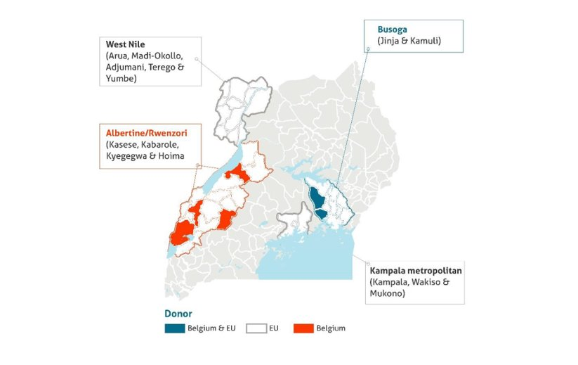
1. Cn't Introduction

Slide 6
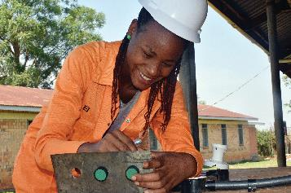
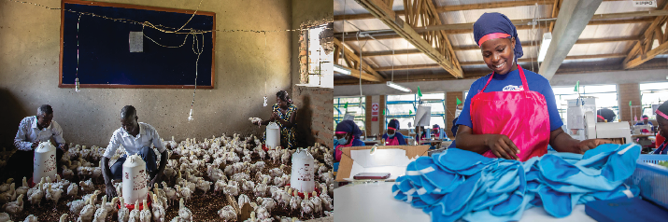
1. WeWork: Green and Decent Jobs for Youth
Results domain 1
Results domain 2
Results domain 3
Improved employability of young people (especially women) through skilling and employment services
Increased gainful self- employment opportunities
through entrepreneurship
Increased productivity &
sustainability of existing
businesses
Focus on agriculture and the green economy

Slide 7
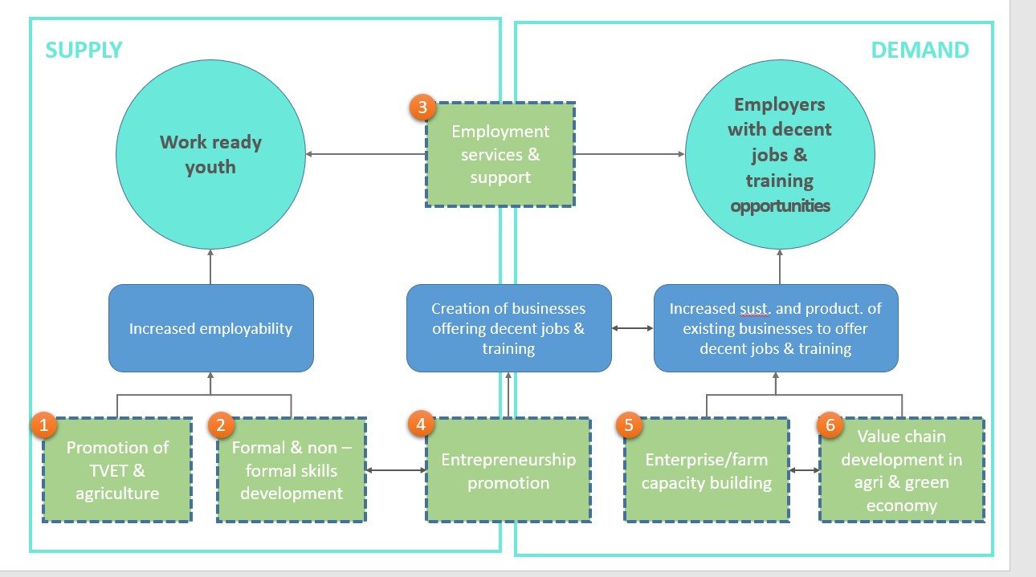

Slide 8
2. SDF CfP overview
Guidelines, annexes, clarifications (Q&A) and all other communication:
https://www.enabel.be/grants/
Call reference number: UGA22007-10045
Call Title: SKILLS DEVELOPMENT FOR INCREASED EMPLOYABILITY OF VULNERABLE YOUTH, WOMEN AND GIRLS IN BUSOGA REGION

Slide 9
2. Call Objectives
General objective
Improve livelihoods of 2000 vulnerable youth through enhanced access to quality, demand-driven skills development and employment support services
Specific objectives
The provision of skills development is more equitable, qualitative, innovative, and labour market-driven for increased employment opportunities

Slide 10
2. Call procedure
2 phased procedure
- Concept note stage
- Proposal stage

Slide 11
2. CfP selection process
Deadline for submission was 4th June 2024, 5:00pm
89 concepts were received for both Lots 1&2
5th June – 12th July, Enabel carried out, administrative and admissibility checks and technical evaluation
11 were late so they were disqualified
78 subjected to admissibility check
43 passed admissibility check and qualified for technical evaluation
19 scored min 30/50 (and 6/10 on Q12)
16 shortlisted concept notes invited for 2nd stage (absorbing 300% of total call volume)

Slide 12
2. Objective of the Full proposal info meeting
Ensuring that applicants have access to and know the processes and tools to be used for the proposal development.
Ensuring that applicants and their co-applicants understand the nature of relationship in this CfP right from the start.

Slide 13
3. General feedback on CN
Use of wrong template
Modification of template e.g. adding own sections.
Outside location of Lead and co-applicant
Amount requested outside range
Late submission
Not clear on quality of training
Not clear on holistic training approach. Make clear logical integration, not just mentioning.
Vulnerability criteria
Transversal themes need to be integrated in the activities e.g. environment.

Slide 14
3. General feedback on CN
Strengthening of partnership between training provider and private sector not clear.
WBL approach not elaborate e.g. selection of WBL providers, how will applicants monitor and assure quality? Supervision of the trainees during the period? etc.
Non-financial capacity building of private sector not clear e.g. certifying WBL in case of ToT), mentoring on transferring skills, safe workplace, etc.
Reminder: Financial compensation for private sector for WBL, mentorship, apprenticeships is limited and only allowed in terms of daily allowances and travel expenses.
Post-training support approach needs clarification. ‘Linkages’ to private sector and provision of start-up kits is too vague. How are applicants going to ensure graduates will become employed? Support needs to be clear, comprehensive and needs to be min 6 months.
Clarify the link between Lead –and Co-applicant and detail the division of roles + aspect of capacity building
Activities in the narrative, action plan, budget, the Logframe should align (= same number, same title, same content).

Slide 15
4. Proposal template
Annex A of the guidelines: PART B PROPOSAL
Description of the action: 6 sections + logframe + budget
The applicants’ experience for similar and other actions
Co-applicant(s)’ experience for similar and other actions
Administrative data on lead and co-applicant
Mandate for each co-applicant signed
Associates
Declaration for lead applicant signed

Slide 16
4. Proposal: description of action
Description of the action: 6 sections
Do not change proposed activities – only more details
Needs analysis & project
Coherence and logical flow
Activity description in proposal = activity plan = logframe = budget
How are you going to organize activities (implementation methodology: who / what / when / how)
Post-training support to ensure sustainability e.g., start-up kits

Slide 17
4. Proposal: description of action
Description of the action: 6 sections
Approach to identify WBL providers or mention all already identified relevant WBL providers
How are you going to assure quality
How are you going to ensure graduates will be employed
integration of technology/digital economy // environmental conservation/ green economy // promotion of decent work // social inclusion and gender equity // synergies with other ongoing programmes

Slide 18
4. Proposal: description of action
Complementary between lead and co-applicants + capacity building component
Partnerships with the following actors:
Private sector actor(s)
Local government
Local community
Public institution(s) and other development partners

Slide 19
4. Proposal: Administrative information
Lead:
Capacity to manage and perform actions (experience in sector)
Resources
Financial data
Sources of financing
Number of people employed
Co-applicant:
History of cooperation with applicant
Capacity to manage and implement actions (experience in sector)

Slide 20
4. Proposal template: Associates
Participate actively in the action, but are not eligible for grants and only qualify to receive daily allowances and travelling expenses.
To be specified in part B of the application form. They need not to sign the mandate in proposal stage.

Slide 21

4a. Proposal template

Slide 22
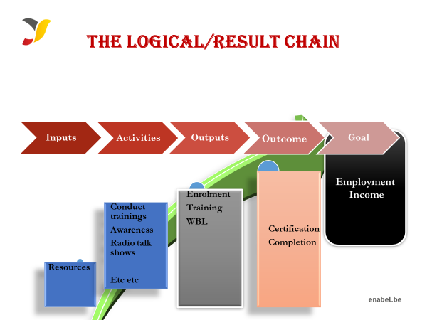
4a. Proposal template: M&E

Slide 23
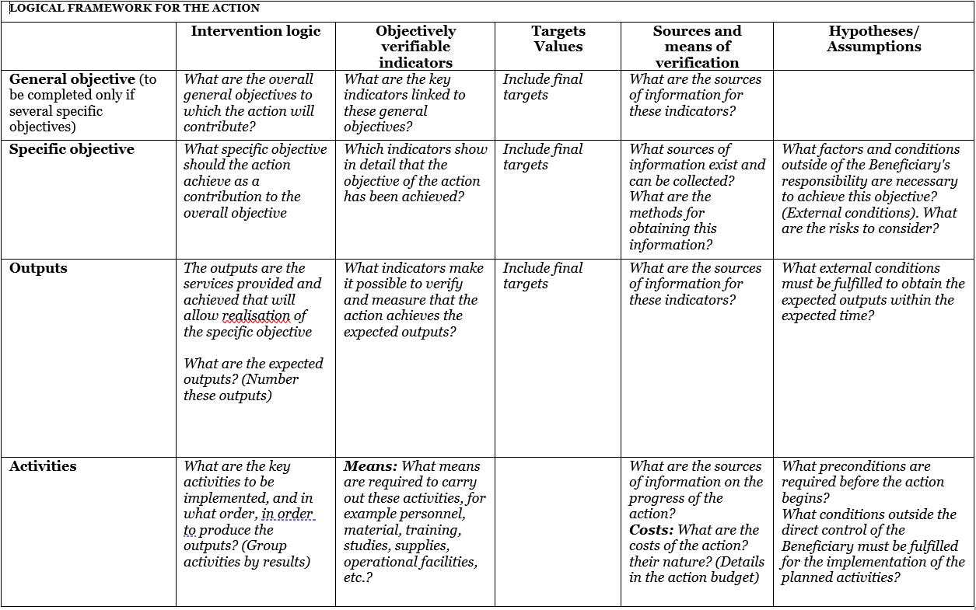
4a. Proposal template: M&E
Use Annex C: Logframe template and explain logic

Slide 24
 | Intervention logic | Objectively verifiable indicators | Sources and means of verification | Hypotheses/Assumption
General objective (Impact) | To contribute to increased employment opportunities for youth, women and girls in the tourism and hospitality industry through increased access to skills development | 65% of the graduates are employed (Self and wage employment) six months after the training | Tracer Studies | NA
Specific Objectives (Outcomes) | SO1: To equip 150 youth (50% female) with vocational skills in selected trades by 2024; | 80% of the trainees are certified by DIT | DIT certificates | Timely release of funds Political stability
 | SO2: To equip 150 youth (50% female) with entrepreneurship and other complementary soft skills | 80% of the trainees succesfully complete the training | Data base Certificates of completion Activity reports
 | SO3: To support the establishment of at least 5 new youth-led group businesses by 2024 | 70% of the Graduates utilising the startup kits 6 month after graduation | Database Certificates of completion Activity reports
Expected Results (Outputs) | RA 1.1: 150 youth (50% female) equipped with non-formal vocational skills in tour guiding etc etc | Number trainees Assessed by DIT Number of trainees trained Number of beneficiaries enrolled | Admission list Attendance list DIT assessement List | Trainees are committed to complete the training
 | RA 2.1: 150 youth (50%females) are equipped with entrepreneurship and life skills | Number trainees Assessed by DIT Number of trainees trained Number of beneficiaries enrolled | Attendance lists, and group business plans | ocial, economic political environment
 | RA 3.1: Beneficiaries are linked to financial service providers; | Number of beneficiaries linked to financial services | Attendance lists for linkage meetings | Willingness of Financial service providers
Activities | A1.1.1 Conduct a one-day project inception meeting | Inputs Venue, meals, transport, and stationery | 2,990,000 | Favorable Security situation in the country, timely release of funds from Enabel, trainees’ commitment; and favorable SOP reguarding the COVID-19 situation in the county.
 | A1.1.2: Conduct mobilization and selection 150 project beneficiaries | Radio jingles, fuel, SDA, stationery & refreshments | 1,938,000
 | A1.1.4 Training 150 vulnerable youth in selected trades | Training equipment, materials, protective gear,, lunch, transport subsidy | 153,839,000
 | A2.1.1: | Typesetting & printing | 4,200,000
 | A2.1.2: | Consultant, stationery, lunch, fuel, & mobilization | 38,264,000
 | A3.1.1: Provide start-up kits | Fuel & stationery | 1,278,000

Slide 25
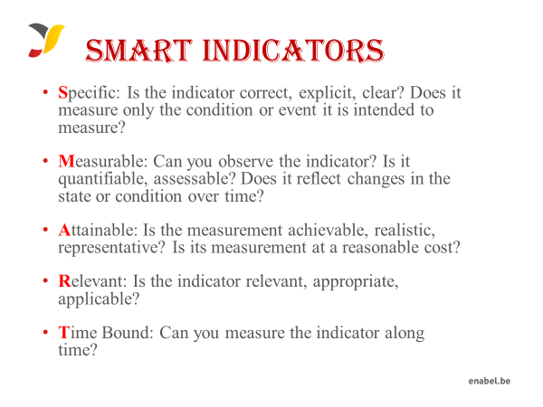
4a. Proposal template: M&E

Slide 26
4a. Proposal template: M&E

Slide 27
4b. Proposal template: Budget
The budget need to be coherent with the activities in the narrative & action plan
NUMBERING: Activity 1 in the narrative planning need to be transferred to a budget line for activity 1
CODING: Codes correspond with the Logframe
A-Specific Objective, 1 Result number one,1 Activity Number one under result no One.A.1.1.1 3rd level relates to sub activities e.g. A1.1.1, A1.1.2
TIMING: if you plan activity 1 in quarter 1 only, then you will only foresee a budget in quarter 1 for that activity

Slide 28
4b. Proposal template: Budget
Budget min 150,000 – max 500,000 euro
On a daily basis you will work with UGX, but the official max grant amount is in euro which you cannot exceed, so follow up of execution in euro is needed.
Enabel provides a guidance to use an FX rate of UGX 4000: 1 EUR. However, this is not mandatory, and applicants may use another FX rate of their choice from other reliable sources.
Exchange rate losses are ineligible costs and should be covered by the grantees themselves (e.g. through structure costs). Additionally, since the purpose of the grant is not to make money, any gains (exchange or interest) made on the funds received from Enabel must be re-used for the activities after Enabel approval.

Slide 29
4b. Proposal template: Budget
The budget is broken down in 3 cost components as below;
1. Operational costs (actual activity costs)
2. Management costs (costs to support the management team)
3. Structure costs ( 7% max of eligible operational costs)
The above costs should all be eligible costs for Enabel to accept them when reporting therefore, need to budget wisely.

Slide 30
4b. Proposal template: Budget
1° Operational costs: necessary and indispensable cost for achieving the objectives and results of the action, including the cost for achieving verifiable deliverables
Ex : fees for instructors, consultancy fees, fuel for transporting, workshop costs, training materials, food for trainees, fees for trainees etc.
2° Management costs: identified costs related to management, supervision, coordination, monitoring, control, evaluation and financial audit which specifically originate in the implementation of the action or the justification of the Grant
Ex : Salary for staff, Mid-term evaluation, special audit costs
3° Structure costs: costs related to the achievement of the social purpose of the beneficiary, which cannot be separated or charged to the budget of this action even though they are affected by the implementation of the action. They are a max of 7% of the eligible operational costs.
Ex: supporting staff (procurement), water & electricity & internet of the office etc.

Slide 31
4b. Proposal template: Budget
What are the rules concerning structure costs?
The percentage (max.7%) must be justified before signature of the Grant Agreement and correspond to the general structure costs of the grantee
It’s a lump-sum and maximum 7% of operational costs
Once the % has been set and confirmed by the analysis of the grantee’s accounts, no supporting document have to be provided by the grantee. In the reporting, it just appears as a separate line at the end (+ 7%).

Slide 32
4b. Proposal template: Budget
Ineligible costs:
Expenses that are incurred before or after the duration of this grant agreement
Expenses that cannot be identified, verified and are not included in the grantee's accounts
Expenses not in line with applicable legal fiscal and social provisions
Expenses that are not reasonable, justified, not respecting the principle of good financial management, in particular concerning cost efficiency and effectiveness
Expenses not in line with the action plan, not necessary to achieve the results

Slide 33
4b. Proposal template: Budget
Budget proposal may not differ more than 20% from the initial concept note budget and must remain within the minimum and maximum amounts
Modification between results leading to a variation not greater than 15% of amounts initially planned.
Modification between activities of the same result leading to a variation not greater than 25% of the amounts initially planned.
Changes between operational costs (A) and management costs (B) are not allowed without an amendment.
Changes to structure costs (C) are not allowed.

Slide 34
Ineligible costs
Accounting entries not leading to payments
Provisions for liabilities and charges, losses, debts or possible future debts
Debts and debit interests
Doubtful debts
Currency exchange losses
Loans to third parties
Guarantees and securities;
Costs already financed by another grant
Invoices made out by other organisations for goods and services already subsidized
Subcontracting by means of service or consultancy contracts to personnel members, Board members or General Assembly members of the organisation subsidized
Any sub-letting to oneself
Purchases of land or buildings;
Compensation for damage falling under the civil liability of the organisation
Employment termination compensation for the term of notice not performed
Purchase of alcoholic beverages, tobacco and derived products thereof
Grants to sub-beneficiaries

Slide 35
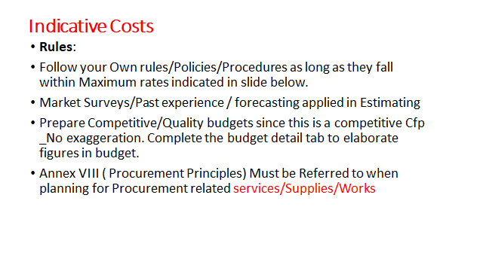

Slide 36
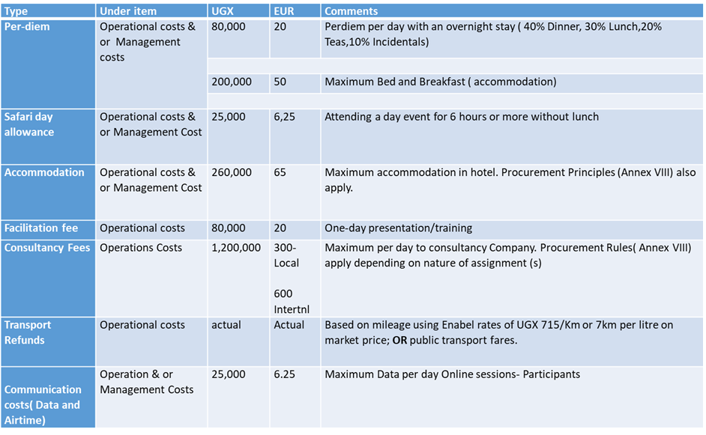
Indicative Costs

Slide 37
4b. Proposal template: Budget
Budget presentation in Excel (Annex B of the grant agreement) – Review of Template

Slide 38
4b. Proposal template: Budget

Slide 39
5. Next steps – PART 1
Activity | Indicative date | Time
Invitations to submit the proposals | 19-Jul-24
Deadline for clarification requests to the contracting authority | 30-July-24 | 5:00 pm
Response to clarification requests are given by the contracting authority | 8-Aug-24 | 5:00 pm
Deadline for the submission of the proposals | 19-Aug-24 | 5:00 pm
Opening, administrative and admissibility checks of proposals | 20-Aug-24* | N/A
Technical evaluation of proposals | 20-Sept-24* | N/A

Slide 40
5. Next steps – PART 1
Clarification requests
Deadline 30 July, 2024, 5:00 pm (21 days before submission deadline)
Requirements:
sdf.grants@enabel.be only
Subject line with reference number call for proposals: UGA22007-10045 + full name applicant
Clarifications will be published by Enabel on https://www.enabel.be/content/enabel-grants with final update by 14th August 2024, at 5:00 pm

Slide 41
5. Next steps – PART 1
Submission full proposal
Deadline 19th August, 2024, 5:00 pm
Required documents (!):
ANNEX A, PART B = proposal application form – pdf format
ANNEX B = Budget – Excel format(!)
ANNEX C = Logical Framework – pdf format
Download all templates from https://www.enabel.be/content/enabel-grants

Slide 42
5. Next steps – PART 1
Applications must be submitted in electronic version, one PDF file containing grant application documents and annexes – except for the budget (annex B) which is to be sent in a protected Excel format – and sent to this email: sdf.grants@enabel.be. Enabel will send a confirmation upon receipt of the submission.
The email subject line must bear the Call for Proposals reference number, Call for Proposals title and full names/address of the applicant
Applications sent by other means (for example by fax, post, courier) or sent to other e-mail addresses will be rejected.
Applicants must ensure that their application is complete. Incomplete applications may be rejected.

Slide 43
5. Next steps – PART 1
Send timely and do not wait until the last moment ! Any submission after 5 PM is not allowed
All templates (A, B and C) have to be fully completed and the template itself cannot be modified
Any error or inconsistency in the proposal (eg in the budget calculation) may lead to rejection of the application
Only the proposal (annex A), budget (B) and Logframe ( C) will be evaluated. It is therefore very important that these contain ALL the relevant information regarding the action.
No supplementary annex must be sent!

Slide 44
5. Next steps – PART 1
Concept note may not be modified by the applicant in the proposal (no substantial change to key activities/approaches)
Requested funds may not differ more than 20% from the initial estimate/requested contribution and within minimum/maximum amounts

Slide 45
5. Next steps – PART 2
Request certificates and supporting documents relating to the grounds for exclusion (see 2.1.1 (2)) | TBD on technical evaluation* | 5:00 pm
Receipt of certificates and supporting documents relating to the grounds for exclusion | xx* (15 days since request) | 5:00 pm
Onsite organizational analysis of the successful applicants after technical evaluation | TBD on technical evaluation* | N/A-
Selection Committee meeting | xx, 2024* | N/A
Legal check and grant signature | xx, 2024* | N/A
Start grant implementation | xx 2024* | N/A

Slide 46
5. Next steps – PART 2
After technical evaluation:
Ranking
Pre-selection of highest ranked that absorb call volume
Reserve list of those that come below in the ranking and passed technical evaluation

Slide 47
5. Next steps – PART 2
Pre-selected applicants will be invited to submit – time = 15 days
Criminal record clearance (Interpol) certificate for the main authorized representatives of your organization (e.g. chairman of the board of directors AND the executive director) those that will sign the grant agreement – Can take 2 weeks, ask timely!!
Tax clearance certificate from Uganda Revenue Authority (URA)
NSSF Clearance Certificate
Documents cannot be older than 2 years

Slide 48
5. Next steps – PART 2
Organisational assessments
Assessment to confirm whether applicant has the capacity to implement the proposed activities. The purpose is to verify general characteristics, technical capacities, control environment, financial management, audit, procurements and context.
Done by consultant & Enabel
Visits of half a day to 1 day
Can be organized on short notice – be prepared

Slide 49
End

