Slide 1
Call For Proposals Skills development for increased employability of vulnerable youth, women and girls in Rwenzori/Albertine region
Information sessions – proposal stage

Slide 2
Presentation outline
Introduction & objectives
Concept Note selection process summary
General CN (stage 1) feedback
Proposal template
Annex A; part B, proposal
M&E logical framework, Indicators
Discussion on budgeting (Budget template)
Next steps

Slide 3
2. Objective of the proposal orientation meeting
Share common missing or wrong elements in the Concept Notes in the previous stage (General feedback)
Refresher on the process and tools for full proposal development; templates, procedures, timelines relevant for phase 2.
Respond to any questions and concerns regarding the CfP.

Slide 4
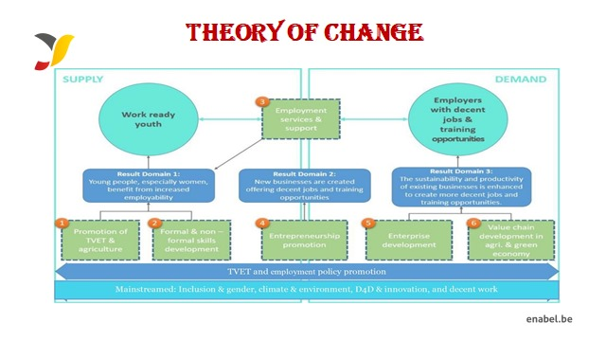
WeWork

Slide 5
2. Objectives of the call
Guidelines, annexes, clarifications (Q&A) and all other communication:
https://www.enabel.be/grants/
Call reference number: UGA22005-10036
Call Title: SKILLS DEVELOPMENT FOR INCREASED EMPLOYABILITY OF VULNERABLE YOUTH, WOMEN AND GIRLS IN RWENZORI/ALBERTINE REGION

Slide 6
2. Call Objectives
General objective
Improve livelihoods of 2000 vulnerable youth through enhanced access to quality, demand-driven skills development and employment support services
Specific objectives
The provision of skills development is more equitable, qualitative, innovative, and labour market-driven for increased employment opportunities

Slide 7
2. Call Objectives
2 phased procedure
- Concept note stage
- Proposal stage

Slide 8
2. CN (stage 1) selection process
Deadline for submission was 4th June 2024
5th – 18th of June, Enabel carried out, administrative and admissibility checks and technical evaluation
98 concepts were received in AR (over 160 in total)
12 were late so they were disqualified
47 passed admissibility check and qualified for technical evaluation
21 scored min 30/50 (and 6/10 on Q12).
15 shortlisted concept notes invited for 2nd stage (absorbing 300% of total call volume)

Slide 9
3. General feedback on CN
Mandatory activities not sufficiently incorporated:
Labour market analysis
Social inclusion strategies: PWDs, breast feeding mothers, selection criteria, etc.
Assessment and certification (DIT/national/international certification).
Integration of OSH standards and measures (materials + protective wear).
Engagement of private sector in all stages to enhance employability and employment prospects
Capacity building of co-applicant(s) based on an Organizational Capacity Assessment
Provision of employment support/Business start-up support, tailored to specific employment/business needs (sustainable approach)
Minimum 6 months extensive and innovative post-training employment support/business startup support services

Slide 10
3. General Feedback ct’d
Training approach not clear: clarity on training, WBL, & post training aspects & schedules
Quality assurance mechanisms, cohort arrangements. Who handles the training?, who handles C&G/DIT certification especially where both the lead and co-applicants are NGOs. Is assessment budgeted for and considered in the activity plan? Involvement of PS in training, how and where the training will be conducted? (community Vs school based)
WBL approach not well specified.
How WBL providers will be selected?, How will applicants monitor and assure quality?, Who will supervise the trainees during the period?, What is the role of MCP’s during WBL​?
Private sector engagement (stakeholders) not clear:
Selection, motivation, & non-financial capacity building of the PS/MCPs; certification, mentoring, skills transfer, ATP delivery, safe workplace, etc. ​
Reminder: financial compensation is limited and only allowed in terms of daily allowances and travel expenses. Despite this, how will you ensure strong and sustainable PS engagement at all stages?

Slide 11
3. General Feedback ct’d
Budget not well aligned:
Management cost > 30%, structure cost > 7% of the operation cost, unit cost; Start-up kits costs which should be less than 15%. Unit cost not being realistic. Mix up of management activities in operational budget section and vice versa.
Post-training support approach not comprehensive:
‘Linkages’ to private sector/financial institution, provision of business startup support is too vague (not sustainable), transition to wage employment/business, and access to value chains, local market, business networks, and roles of lead and co are not very clear.
Activity Inconsistencies: Different activities in the narrative, action plan, budget, the log frame should align (= same number, same title, same content). Division of roles between the lead and co applicant, inception and closure phase.
Trade selection: (how did they decide to select, what’s the value addition – why specifically is that trade, for those selecting multiple trades, what are the connections and evidences on capacity and expertise)

Slide 12
3. General Feedback ct’d
Community and environmental resilience not clear. Transversal themes such as environmental protection and sustainability not always integrated in the activities.
External stakeholders not elaborate.
Implementation in various regions: (how are they going to manage it; evidence on the capacity; connections amongst value chain and labor market actors in those districts)
Ineligible activities included in the concept: Cash assistance for start-ups, start up capital
Target beneficiaries not clear: selection criteria, segregation between refugees and host community, women & men etc.
Critical innovations missing: digital economy; integration of environmental conservation/green economy; decent work; social inclusion, entrepreneurship promotion, tracking of the graduates, sustainability business start-up support and start-up kits sustainability approaches & utilisation.

Slide 13
4. Proposal template
Annex A of the guidelines: PART B PROPOSAL
Description of the action: 6 sections + logframe + budget
The applicants’ experience for similar and other actions
Co-applicant(s)’ experience for similar and other actions
Administrative data on lead and co-applicant
Mandate for each co-applicant signed
Associates
Declaration for lead applicant signed

Slide 14
Proposal: description of action
Description of the action: 6 sections – description, strategic approach, methodology, action plan, risks & assumptions, sustainability -> follow guide on information requested
Do not change proposed activities – only more details
Needs analysis & project
Coherence and logical flow
Activity description in proposal = activity plan = logframe = budget
How are you going to organize activities (implementation methodology: who / what / when / how)

Slide 15
Proposal: description of action
Approach to identify WBL providers or mention all already identified relevant WBL providers
How are you going to assure quality and alignment between training and WBL
Post-training support to ensure sustainability e.g., start-up kits​
How are you going to ensure graduates will be employed
integration of technology/digital economy // environmental conservation/ green economy // promotion of decent work // social inclusion and gender equity // synergies with other ongoing programmes

Slide 16
Proposal: description of action
Complementary between lead and co-applicants + capacity building component
Partnerships with the following actors:
Private sector actor(s)
Local government
Local community
Public institution(s) and other development partners

Slide 17
Administrative information
Lead:
Capacity to manage and perform actions (experience in sector)
Resources
Financial data
Sources of financing
Number of people employed
Co-applicant:
History of cooperation with applicant
Capacity to manage and implement actions (experience in sector)

Slide 18
Associates
Participate actively in the action, but are not eligible for grants and only qualify to receive daily allowances and travelling expenses.
To be specified in part B of the application form. They need not to sign the mandate in proposal stage.

Slide 19
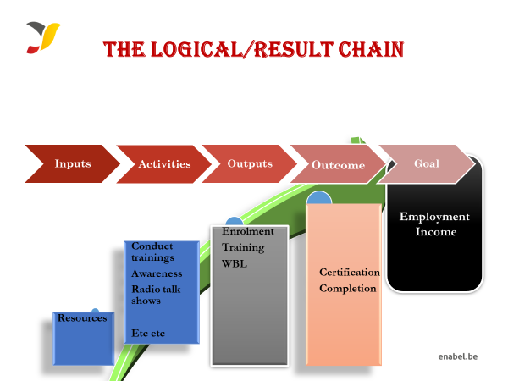
4a: Proposal template: M&E

Slide 20
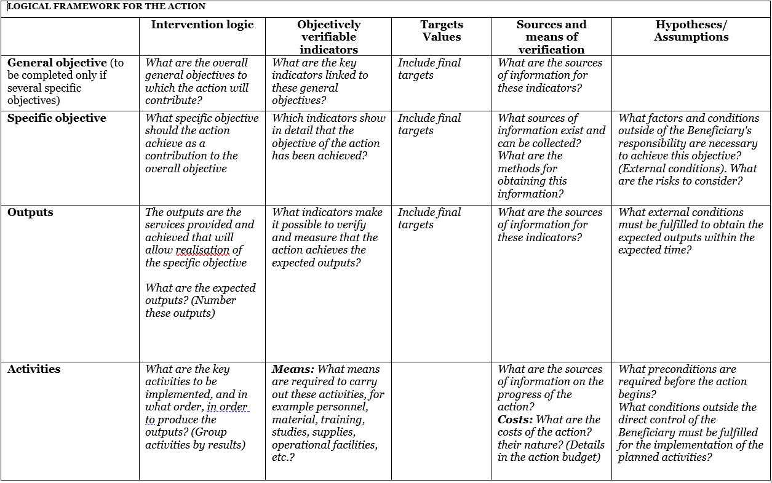
4a: Proposal template: M&E
Use Annex C: logframe template and explain logic
Notes:
GO: livelihoods
SO: certification & employment

Slide 21
 | Intervention logic | Objectively verifiable indicators | Sources and means of verification | Hypotheses/Assumption
General objective (Impact) | To contribute to increased employment opportunities for youth, women and girls in the tourism and hospitality industry through increased access to skills development | 65% of the graduates are employed (Self and wage employment) six months after the training | Tracer Studies | NA
Specific Objectives (Outcomes) | SO1: To equip 150 youth (50% female) with vocational skills in selected trades by 2024; | 80% of the trainees are certified by DIT | DIT certificates | Timely release of funds Political stability
 | SO2: To equip 150 youth (50% female) with entrepreneurship and other complementary soft skills | 80% of the trainees succesfully complete the training | Data base Certificates of completion Activity reports
 | SO3: To support the establishment of at least 5 new youth-led group businesses by 2024 | 70% of the Graduates utilising the startup kits 6 month after graduation | Database Certificates of completion Activity reports
Expected Results (Outputs) | RA 1.1: 150 youth (50% female) equipped with non-formal vocational skills in tour guiding etc etc | Number trainees Assessed by DIT Number of trainees trained Number of beneficiaries enrolled | Admission list Attendance list DIT assessement List | Trainees are committed to complete the training
 | RA 2.1: 150 youth (50%females) are equipped with entrepreneurship and life skills | Number trainees Assessed by DIT Number of trainees trained Number of beneficiaries enrolled | Attendance lists, and group business plans | ocial, economic political environment
 | RA 3.1: Beneficiaries are linked to financial service providers; | Number of beneficiaries linked to financial services | Attendance lists for linkage meetings | Willingness of Financial service providers
Activities | A1.1.1 Conduct a one-day project inception meeting | Inputs Venue, meals, transport, and stationery | 2,990,000 | Favorable Security situation in the country, timely release of funds from Enabel, trainees’ commitment; and favorable SOP reguarding the COVID-19 situation in the county.
 | A1.1.2: Conduct mobilization and selection 150 project beneficiaries | Radio jingles, fuel, SDA, stationery & refreshments | 1,938,000
 | A1.1.4 Training 150 vulnerable youth in selected trades | Training equipment, materials, protective gear,, lunch, transport subsidy | 153,839,000
 | A2.1.1: | Typesetting & printing | 4,200,000
 | A2.1.2: | Consultant, stationery, lunch, fuel, & mobilization | 38,264,000
 | A3.1.1: Provide start-up kits | Fuel & stationery | 1,278,000

Slide 22
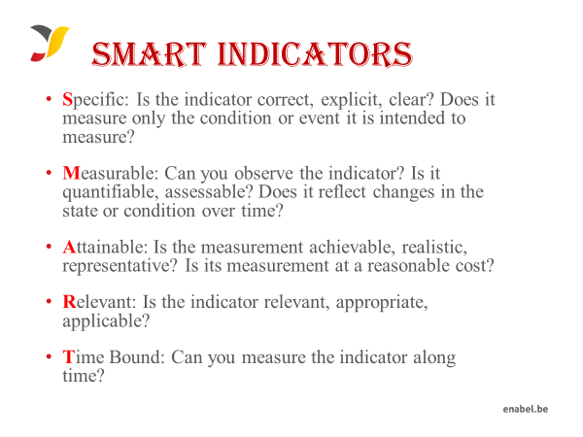
4a: Proposal template M&E

Slide 23

4a: Proposal template M&E

Slide 24
4b: Proposal template budget
The budget need to be coherent with the activities in the narrative & action plan
NUMBERING: Activity 1 in the narrative planning need to be transferred to a budget line for activity 1
TIMING: if you plan activity 1 in quarter 1 only, then you will only foresee a budget in quarter 1 for that activity
CODING: Codes correspond with the Logframe: Specific Objective, 01 Result number one,01 Activity Number one under result no One.A0101.3rd level relates to sub activities e.g A010101,A010102
Budget min 150,000 – max 500,000 euro

Slide 25
4b: Proposal template budget
On a daily basis you will work with UGX, but the official max grant amount is in euro which you cannot exceed, so follow up of execution in euro is needed.
FX rate of UGX 4000: 1 EUR (grantees can use their own exchange rate (based on a reliable source) to estimate the budget)
Exchange rate losses are ineligible costs and should be covered by the grantees themselves (e.g. through structure costs). Additionally, since the purpose of the grant is not to make money, any gains (exchange or interest) made on the funds received from Enabel must be re-used for the activities after Enabel approval.

Slide 26
4b: Proposal template budget
The budget is broken down in 3 cost components as below;
1. Operational costs (actual activity costs) + general means cost
2. Management costs (costs to support the management team)
3. Structure costs ( 7% max of eligible operational costs)

Slide 27
4b: Proposal template budget
1° Operational costs: necessary and indispensable cost for achieving the objectives and results of the action, including the cost for achieving verifiable deliverables
Ex : fees for instructors, consultancy fees, fuel for transporting, workshop costs, training materials, food for trainees, fees for trainees etc.
2° Management costs: identified costs related to management, supervision, coordination, monitoring, control, evaluation and financial audit which specifically originate in the implementation of the action or the justification of the Grant
Ex : Salary for staff, Mid-term evaluation, special audit costs
3° Structure costs: costs related to the achievement of the social purpose of the beneficiary, which cannot be separated or charged to the budget of this action even though they are affected by the implementation of the action. They are a max of 7% of the eligible operational costs.
Ex: supporting staff (those that cannot be justified under management costs through timesheets e.g., procurement), water & electricity & internet of the office etc.

Slide 28
4b: Proposal template budget
What are the rules concerning structure costs?
The percentage (max.7%) must be justified before signature of the Grant Agreement and correspond to the general structure costs of the grantee
It’s a lump-sum and maximum 7% of operational costs
Once the % has been set and confirmed by the analysis of the grantee’s accounts, no supporting document have to be provided by the grantee. In the reporting, it just appears as a separate line at the end (+ 7%).

Slide 29
4b: Proposal template budget
Ineligible costs:
Expenses that are included in the ineligible list (see guidelines)
Expenses that are incurred before or after the duration of this grant agreement
Expenses that cannot be identified, verified and are not included in the grantee's accounts
Expenses not in line with applicable legal fiscal and social provisions
Expenses that are not reasonable, justified, not respecting the principle of good financial management, in particular concerning cost efficiency and effectiveness
Expenses not in line with the action plan, not necessary to achieve the results
No contributions in kind are considered

Slide 30
Ineligible costs in guidelines
Accounting entries not leading to payments
Provisions for liabilities and charges, losses, debts or possible future debts
Debts and debit interests
Doubtful debts
Currency exchange losses
Loans to third parties
Guarantees and securities;
Costs already financed by another grant
Invoices made out by other organisations for goods and services already subsidized
10. Subcontracting by means of service or consultancy contracts to personnel members, ​
Board members or General Assembly members of the organisation subsidized ​
11. Any sub-letting to oneself ​
12. Purchases of land or buildings; ​
13. Compensation for damage falling under the civil liability of the organisation ​
14. Employment termination compensation for the term of notice not performed ​
15. Purchase of alcoholic beverages, tobacco and derived products thereof ​
16. Grants to sub-beneficiaries

Slide 31
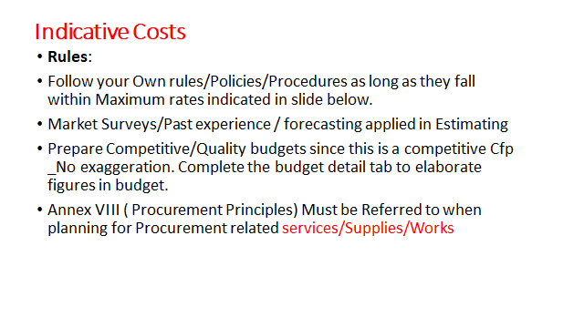
.

Slide 32
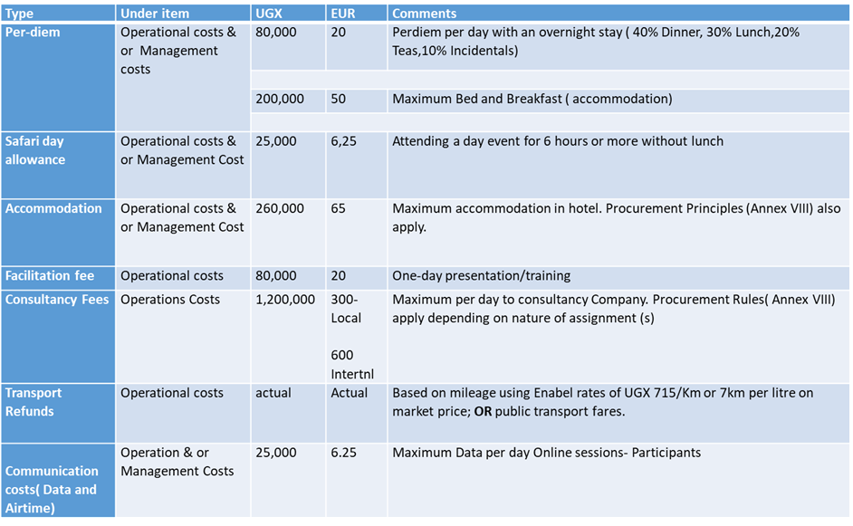
Indicative Costs

Slide 33
4b: Proposal template budget
Budget proposal may not differ more than 20% from the initial concept note budget and must remain within the minimum and maximum amounts
Modification between results leading to a variation not greater than 15% of amounts initially planned.
Modification between activities of the same result leading to a variation not greater than 25% of the amounts initially planned.
Changes between operational costs (A) and management costs (B) are not allowed without an amendment.
Changes to structure costs (C) are not allowed.

Slide 34
4b: Proposal template budget
Budget presentation in excel (Annex B of the grant agreement)

Slide 35
4b: Proposal template budget

Slide 36
5. Next steps
Deadline for clarification requests to the contracting authority | 29-July-24 | 5:00 pm
Response to clarification requests are given by the contracting authority | 8-August-24 | 5:00 pm
Deadline for the submission of the proposals | 19-August-2024 | 5:00 pm
Opening, administrative and admissibility checks of proposals | 20-August-2024 | N/A
Technical evaluation of proposals | 20-September-2024 | N/A

Slide 37
5. Next steps
Clarification requests
Deadline 29-July, 2024, 5 PM (21 days before submission deadline)
Requirements:
sdf.grants@enabel.be only
Subject line with reference number call for proposals: (UGA22005-10036) + full name applicant
Clarifications will be published by Enabel on https://www.enabel.be/content/enabel-grants with final update by 8-August-24 at 5 PM

Slide 38
5. Next steps
Submission full proposal
Deadline 19 August 2024, 2024, 5 PM
Required documents (!):
ANNEX A, PART B = proposal application form – pdf format
ANNEX B = Budget – Excel format(!)
ANNEX C = Logical Framework – pdf format
Download all templates from https://www.enabel.be/content/enabel-grants

Slide 39
5. Next steps
Applications must be submitted in electronic version, one PDF file containing grant application documents and annexes – except for the budget (annex B) which is to be sent in a protected Excel format – and sent to this email: sdf.grants@enabel.be. Enabel will send a confirmation upon receipt of the submission.
The email subject line must bear the Call for Proposals reference number, Call for Proposals title and full names/address of the applicant
Applications sent by other means (for example by fax, post, courier) or sent to other e-mail addresses will be rejected.
Applicants must ensure that their application is complete. Incomplete applications may be rejected.

Slide 40
5. Next steps
Send timely and do not wait until the last moment ! Any submission after 5 PM is not allowed
All templates (A, B and C) have to be fully completed and the template itself cannot be modified
Any error or inconsistency in the proposal (eg in the budget calculation) may lead to rejection of the application
Only the proposal (annex A), budget (B) and logframe (C) will be evaluated. It is therefore very important that these contain ALL the relevant information regarding the action.
No supplementary annex must be sent

Slide 41
5. Next steps
Concept note may not be modified by the applicant in the proposal (no substantial change to key activities/approaches)
Requested funds may not differ more than 20% from the initial estimate/requested contribution and within minimum/maximum amounts

Slide 42
5. Next steps – PART 2
Request certificates and supporting documents relating to the grounds for exclusion (see 2.1.1 (2)) | TBD on technical evaluation* | 5:00 pm
Receipt of certificates and supporting documents relating to the grounds for exclusion | 8-October, 2024* (15 days since request) | 5:00 pm
Onsite organizational analysis of the successful applicants after technical evaluation | TBD on technical evaluation* | N/A-
Selection Committee meeting (physical pitching of pitching of provisionally selected candidates) | 29-31/OCT/2024 | N/A
Legal check and grant signature | 12-Nov-2024 | N/A
Start grant implementation | 12-Nov-2024 | N/A

Slide 43
5. Next steps – PART 2
After technical evaluation:
Ranking
Pre-selection of highest ranked that absorb call volume
Reserve list of those that come below in the ranking and passed technical evaluation

Slide 44
5. Next steps – PART 2
Pre-selected applicants will be invited to submit – time = 15 days
Criminal record clearance (Interpol) certificate for the main authorized representatives of your organization (e.g. chairman of the board of directors AND the executive director) those that will sign the grant agreement – Can take 2 weeks, ask timely!!
Tax clearance certificate from Uganda Revenue Authority (URA)
NSSF Clearance Certificate
Documents cannot be older than 2 years

Slide 45
5. Next steps – PART 2
Organisational assessments
Assessment to confirm whether applicant has the capacity to implement the proposed activities. The purpose is to verify general characteristics, technical capacities, control environment, financial management, audit, procurements and context.
Done by consultant & Enabel
Visits of half a day to 1 day
Can be organized on short notice – be prepared

Slide 46
End

