Slide 1
Call For Proposals UGA 22007-10113 - Skills development for increased employability of vulnerable youth, women and girls in the sustainable tourism and hospitality sector in Busoga region
Information session

Slide 2
Presentation outline
Introduction
Objectives of the call
Admissibility criteria
Proposal template
Annex A: Application form
Annex C: Logical framework
Annex B: Budget
Application procedure/next steps

Slide 3
1. Introduction
Enabel, the Belgian development Agency
Vision: Young people and women in Uganda develop into active, economically independent citizens in a sustainable society that respects human rights and ensures quality basic services.
Focus areas:
Employability | Employment & Entrepreneurship | Education | Health
Skills development that offers the prospect of decent and green jobs | Skilled people find decent and green jobs or start a successful business | Quality lower secondary education | Training of health personnel & improved capacity of health centres and hospitals

Slide 4
1. Cn't Introduction
Interventions are funded by:
Belgian government
Employability and Employment: Green and decent jobs for youth “WeWork”
Education: WeLearn
Health: WeCare and WeTrain4Health
and the EU
Employability and Employment: Green and decent jobs for youth “WeWork”
Business: SB4U and SBHR
Gender: G4DU

Slide 5
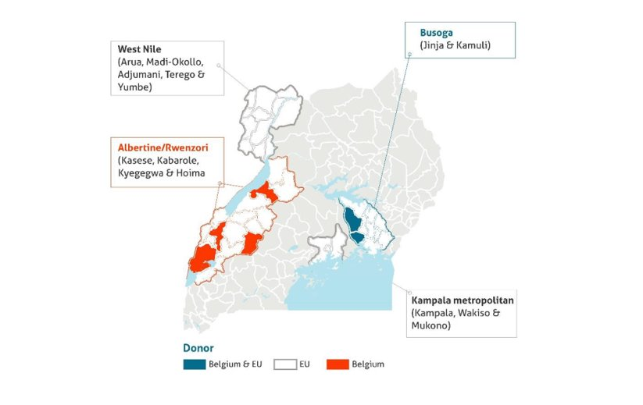
1. Cn't Introduction - WeWork

Slide 6
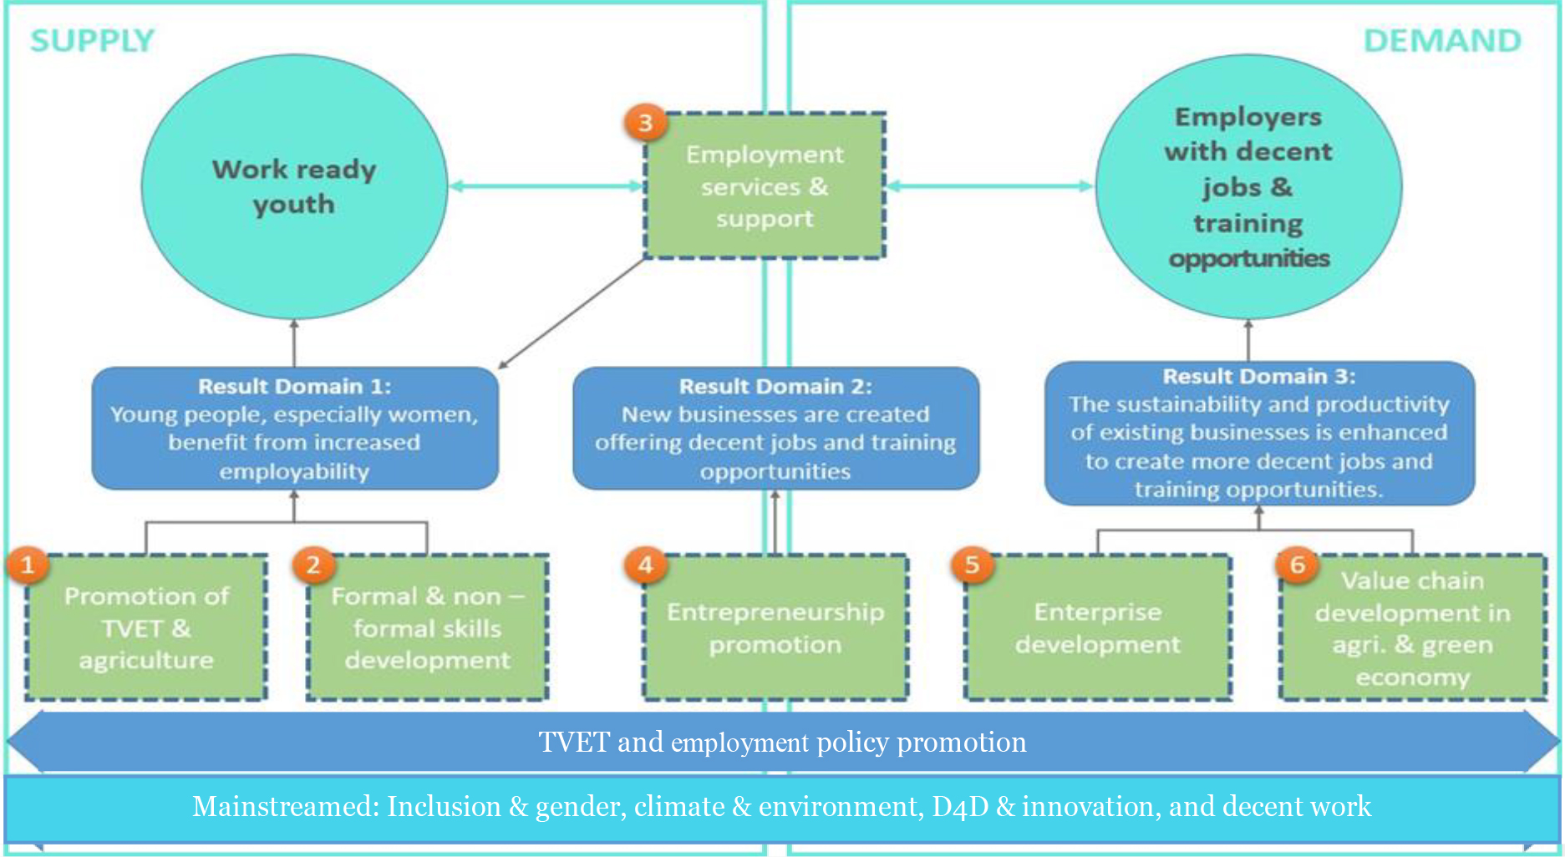

Slide 7
2. Objectives of the call
Guidelines, annexes, clarifications (Q&A) and all other communication:
https://www.enabel.be/grants/
Call reference number: UGA22008-10113
Call Title: SKILLS DEVELOPMENT FOR INCREASED EMPLOYABILITY OF VULNERABLE YOUTH, WOMEN AND GIRLS IN THE SUSTAINABLE TOURISM AND HOSPITALITY SECTOR IN BUSOGA REGION

Slide 8
2. Objectives of the call
SDF basket:
Quality non-formal skills development
Meaningful involvement of the (local) private sector in design, implementation and/or assessment of trainings
Holistic approach to skills development by integrating career guidance, 21st century skills development, work-based learning, social inclusion strategies
Intensive and innovative post-training employment support services

Slide 9
2. Objectives of the call
1. Introduction & objectives - RECAP of the CfPs
General objective
Improve livelihoods of vulnerable youth in Busoga region through enhanced access to quality, demand-driven skills development and employment opportunities in the sustainable tourism and hospitality sector.
Specific objective
Vulnerable youth in the Busoga region acquire market-relevant skills and are successfully integrated into gainful employment or self-employment opportunities within the sustainable tourism and hospitality sector.

Slide 10
2. Objectives of the call
1. Introduction & objectives - RECAP of the CfPs
500 vulnerable youth are equipped with quality, labour market relevant skills
500 vulnerable youth have enhanced access to wage and self-employment through post-training support services
Good practices in skills development are identified, documented and supported to scale up
Sustainable and effective partnerships between training providers and private sector actors in skills development are promoted

Slide 11
2. Objectives of the call
1. Introduction & objectives - RECAP of the CfPs
Sustainability of livelihoods established through the actions will be assessed using the following criteria:
Minimum of 3 consecutive months with stable income;
Stable income refers to individual monthly wage of at least 214,000 UGX (in case of paid employment) or an individual monthly net business income of at least 235,000 UGX (in case of self-employment)

Slide 12
2. Objectives of the call
Sector focus:
The sustainable tourism and hospitality value chain takes full account of its current and future economic, social and environmental impacts, addressing the needs of visitors, the industry, the environment and host communities
The Call for Proposals focuses on occupations within the following segments of the tourism value chain:
Sustainable attractions and experiences, including tour guiding, nature interpretation, eco-tourism, adventure tourism, and community-based and cultural tourism (e.g. crafts, cultural heritage, storytelling, and traditional performances);
Sustainable accommodation, such as eco-lodges, homestays, and community-run guesthouses;
Food and beverage services, including organic and locally sourced food production for tourism establishments, catering services for visitors and tourism facilities by youth community groups, restaurants, pubs, bakeries, and on-farm (agri-tourism).

Slide 13
2. Objectives of the call
Target groups:
Vulnerable youth refers to (a combination of) different categories of youth (young women, youth with disabilities, youth with chronic diseases, youth in poverty, youth Not in Employment, Education or Training, etc.)
Low or non-skilled and face barriers to access employment and socio-economic integration.
At least 80% of the targeted beneficiaries must be youth between the ages of 15 and 35 years.
At least 50% of the targeted beneficiaries must be women and girls.

Slide 14
2. Objectives of the call
Total call volume is 500,000 EUR
Grant applications must fall between minimum 250,000 and maximum 500,000 Euro
Reasonable and efficient unit cost, to take into account holistic approach + intensive post training support

Slide 15
3. Admissibility criteria
The actors: Eligible applicants
The actions: Admissible actions for grants
The costs: Acceptable types of costs that may be included in grants

Slide 16
3a. The actors: lead applicant
Legal entity
Be a private not for profit entity or foundation or be a legal entity of private law for which profit maximization is not the priority objective;
Basic documents (statutes, mission, vision, business plan, ...) of the business clearly demonstrate the business pursues social goals
There is transparency on profit distribution and more than half of the profit is on average reinvested in the business
The business reports externally on the achievement of the social goal(s) it is pursuing
Be established or represented in Uganda;
Any legal entities whose articles of association were created in another country must be registered in Uganda

Slide 17
3a. The actors: lead applicant
National or international NGO, Civil Society or Community-Based Organization, Foundation, Business Membership organisation or a non-profit business development service provider with demonstrated experience in managing quality skills development initiatives and economic empowerment of vulnerable youth and women in the sustainable tourism and hospitality sector
2 years experience in skills development, employment promotion, business development support services, social and economic empowerment of vulnerable youth and women, and community integration with a focus on the sustainable tourism and hospitality sector
Active Bank Account for the past 12 months
In-house financial management capacity

Slide 18
3a. The actors: lead applicant
Exclusion grounds:
Annex VII grant agreement – Applicant’s declaration in application form completed and signed (Annex A guidelines)
Supporting documents (upon preselection – 2nd stage):
Criminal record clearances from Interpol
NSSF clearance certificate
Tax clearance certificate

Slide 19
3a. The actors: the applicant and co-applicant(s)
The applicant may act with maximum two co-applicant(s) in accordance with the requirements below
The partnership between Lead and co-applicants is to optimize cumulation of complementary expertise.
The selected applicant becomes the contracting-beneficiary and is the main point of contact for the contracting authority. It shall represent its co-applicant and act in their name. It shall design and coordinate implementation of the action.
The co-applicant shall participate in the implementation of the action and the costs that they incur shall be eligible in the same way as those incurred by the lead applicant.

Slide 20
3a. The actors: co-applicants (if applicable)
Legal entity
Be a public entity or private not for profit or legal entity of private law for which profit maximization is not the priority objective
Established or represented in Uganda
Be any of the following types of organization:
Accredited public or private non-profit technical and/or vocational skills training provider
Business Membership Organisation/Association
Non-profit Business Development Services (BDS) provider
A cooperative or social enterprise for which profit maximization is not the priority objective;
NGO, Civil Society or Community-Based Organization, Foundation
Have 2 years demonstrated work experience in participating in quality skills development and/or employment promotion initiatives within the sustainable tourism and hospitality sector.
Be registered with relevant authorities and comply with Ugandan legal regulations
Have an operational governance structure and an active bank account for the past 12 months

Slide 21
3a. The actors – Summary types
Organisation type | Lead applicant | Co-applicant
National or international Non-Governmental Organizations (NGOs), Foundations, or Community-Based Organizations (CBOs) | Yes | Yes
Public vocational and/or technical training institutions | No | Yes
Private (not-for-profit) vocational and/or technical training institutions | No | Yes
Non-profit Business Development Services (BDS) provider | Yes | Yes
Business Membership Organizations or associations | Yes | Yes
Cooperatives or social enterprises for which profit maximization is not the priority objective | No | Yes

Slide 22
3a. The actors – Physical presence
Selected applicants are required to be based in the Busoga region during implementation of the action, either through
An existing office of the applicant
Or an existing office of any co-applicant
Or present concrete plans to ensure physical presence -> clear plan to be elaborated in application form!

Slide 23
3a. The actors: Associates
Participate actively in the action but are not eligible for grants and only qualify to receive daily allowances and travelling expenses.
To be specified in part B of the application form. They need not to sign the mandate in proposal stage.

Slide 24
3a. The actors: Contractors
These are contractors for services, works and equipment. These must be sourced through a procurement process using relevant procedures i.e. PPDA (public procurement law) for public entities and annex VIII of the Grant Agreement for private entities

Slide 25
3b. The actions
Duration
Location
Target beneficiaries
Priority sectors and themes
Type of action and eligible activities

Slide 26
3b. The actions: Duration
Action/GA : minimum 18 to maximum 24 months
Training programmes: minimum 6 to maximum 8 months, including minimum 40% WBL
Minimum 6 months post-training employment support for successful graduates

Slide 27
3b. The actions: Location
The actions must be implemented in Uganda, Busoga region in at least one of the following districts:
Kamuli
Jinja
The actions may not be implemented in other districts
Target groups/youth must reside in the target districts
Majority of activities take place in target districts

Slide 28
3b. The actions: Target beneficiaries
Vulnerable populations residing in the eligible districts
(different vulnerability categories, to be demonstrated in application)
At least 80% youth between the ages of 15 and 35 years
At least 50% women and girls

Slide 29
3b. The actions: Sustainable tourism and hospitality value chain
Sustainable tourism and hospitality = taking into account of its current and future economic, social and environmental impacts
Actions address skill gaps and promote employment opportunities for youth in leisure and business tourism, while contributing to the conservation and restoration of the natural environment and cultural heritage, and inclusion of the local community

Slide 30
3b. The actions: Priority Themes
To integrate:
Environmental conservation or skills for the green economy
Gender roles and reproductive health awareness
Entrepreneurial skills
Digital literacy or skills for the digital economy
Financial literacy
Other soft skills for enhanced employability: Work-readiness, conflict management, behavior/attitude skills, etc…

Slide 31
3b. The actions: mandatory activities
Outreach and awareness or sensitization strategies
Social inclusion strategies
Non-formal, short-term skills training programmes in the targeted sectors with a duration of minimum 6 to maximum 8 months
Assessment and certification, adhering to national standards for non-formal training (UVTAB)
Integration of Occupational Health and Safety standards and measures (including materials + protective wear)
Integration of soft skills training and entrepreneurship skills training

Slide 32
3b. The actions: mandatory activities
Involvement of private sector in design, implementation and/or assessment of trainings and minimum 40% of the training duration allocated to Work-Based Learning
Engagement of private sector role models and expertise in mentoring and training
Provision of start-up kits, tailored to specific business needs or business plans developed by successful graduates and/or groups opting for self-employment (mandatory for only self-employment track)
6 months extensive and innovative post-training employment support services

Slide 33
3b. The actions: Admissible activities
See guidelines, non-exhaustive
Provision of start-up kits, tailored to specific business needs or business plans developed by targeted youth
Maximum 15% of the budget
to provide a strategy on how the kits will effectively promote sustainable business development and not distort the local ecosystem and market

Slide 34
3b. The actions: Other admissible actions
Training, studies, workshops, etc
Training materials
Promotion of social or gender inclusion (e.g., transport arrangements, facilities and procedures that constitute safe learning and work environments, day-care services, counselling or psychosocial support,…)
Capacity building local partners
(Pre-training) career guidance, coaching
Toolkits for WBL
Job fairs, networking or matchmaking activities
…

Slide 35
3b. Number of applications
The applicant may not submit more than one (1) application per lot under this Call for Proposals.
The applicant may not be awarded more than one (1) Grant Agreement per lot under this Call for Proposals.
The applicant may not be at the same time a co-applicant in another application
A co-applicant may not be awarded more than one (1) Grant Agreement under this Call for Proposals

Slide 36

3. Admissibility criteria

Slide 37
4. Proposal evaluation
Financial/operational capacity
Relevance of proposed methodology/strategic approaches
Effectiveness & Feasibility
Sustainability
Budget
ANNEX F: PROPOSAL VERIFICATION AND EVALUATION GRID

Slide 38
4a. Annex A: application form
Detailed description of the action & methodology
6 sections (Relevance (call + needs), description, methodology (who/what/when/how), action plan, risks & assumption, sustainability)
log frame
budget
Administrative data and information for lead and (if applicable) co-applicant(s)
The lead applicant’s experience for similar and other actions
Capacity to manage and perform actions (experience in the sectors)
Resources (financial data, source of financing, number of people employed)
The co-applicant(s)’ experience for similar and other actions
History of cooperation with lead applicant
Capacity to manage and implement actions (experience in the sectors)
The associates (if any) - participate actively in the action, but are not eligible for grants and only qualify to receive daily allowances and travelling expenses)
Mandate for each co-applicant and associates signed
Declaration for lead applicant signed

Slide 39
! Attention points !
Detail/elaborate approaches/methodology to engage private sector throughout the program (e.g., training curriculum development, training, WBL, post-training support). How will they be involved, incentivised and monitored? How will quality assurance aspects be ensured?
Clarify clearly strategies to promote sustainability in post-training support - Distribution strategy of start-up kits, networks and linkages, etc.
Clarify clearly strategies related to access to markets and finance
Highlight social inclusion strategies throughout the program: recruitment, training, WBL and post-training support
Ensure logical flow between activities (eg. training & WBL) & structuring between different phases (e.g., inception, baseline, implementation, end-line)

Slide 40
! Attention points !
Ensure 100% alignment of structure between narrative, activity plan, budget & logframe
Incorporate technical aspects demonstrating the potential to contribute to sustainable adoption of good practices and contribute to environmental conservation
Clarify clearly the role and complementarity of (and/or engagement with) each stakeholder in implementation:
Applicant, co-applicant(s), any associate
External stakeholders: community, local govt, private sector

Slide 41
4. Proposal a) Annex A: application form

Slide 42
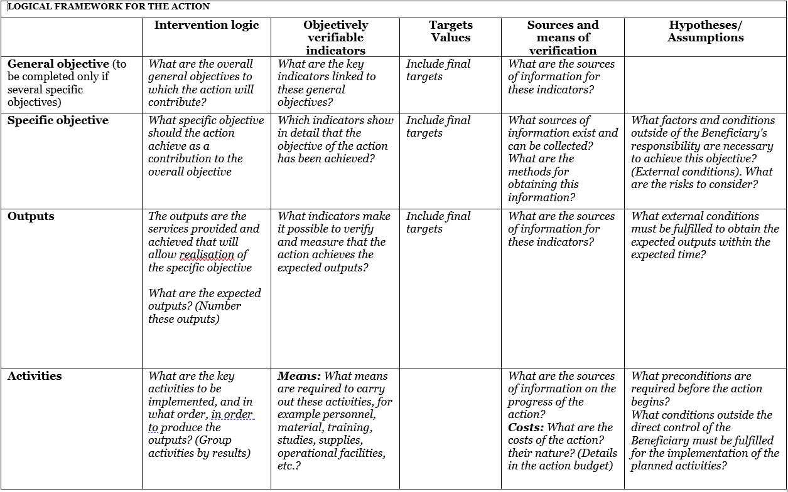
4b. M&E logical framework
Use Annex C: logframe template and explain logic
Notes:
GO: livelihoods
SO: certification & employment

Slide 43
4b. Logical flow
Assumptions & risks
Resources/inputs
Activities
Outputs
Outcome
Impact
Planned work
Intended results
Problem analysis
Stakeholder analysis
Objectives
Risk analysis
Staff
Time
Money
Materials
Equipment
Technology
...
Workshops
Meetings
Field trips
Trainings
Service delivery
...
Number trained, sensitized
Products developed and shared
Equipment distributed
…
Short term
Knowledge/skills acquired
Attitudes changed
Change in behaviour
Decisions made
Actions undertaken
Long term
Social change
Economic change
Environmental change
...

Slide 44
4b. Example Impact/GO
IMPACT - The livelihoods of vulnerable youth, including young women, in Busoga region, are improved and sustained through access to skills development
90% of the graduates are employed (60%self and/or 30% wage employment) six months after the training
Employment = at least UGX 214,000 for 3 consecutive months by the end of the action

Slide 45
4b. Example Outcome/SO
OUTCOME 1- To equip 150 youth (50% female) with vocational and soft skills in selected trades by 2024
80% of the trainees are certified by UVTAB
80% of the trainees successfully complete the training
OUTCOME 2 - To support the establishment of at least 5 new youth-led group businesses by 2024
80% of the graduates utilizing the startup kits 6 month after graduation
In summary ( completion, Certification, utilization of startupkits etc)

Slide 46
4b. Example Output/results
# trainees enrolled / trained
# trainees completing training
# trainees assessed by UVTAB
# companies assessed for WBL
# companies engaged for WBL
# graduates linked to financial services
#Trainees provided with startupkits

Slide 47
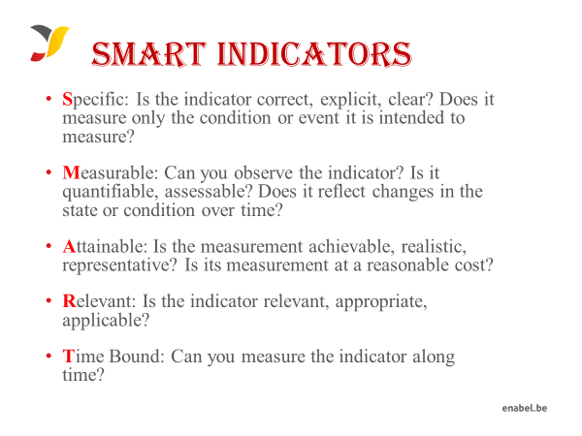
4b. Proposal template M&E

Slide 48
4. Proposal b) Annex C: Logframe

Slide 49
4c. Proposal template budget
The budget need to be coherent with the activities in the narrative & action plan
NUMBERING: Activity 1 in the narrative planning need to be transferred to a budget line for activity 1
TIMING: if you plan activity 1 in quarter 1 only, then you will only foresee a budget in quarter 1 for that activity
CODING: Codes correspond with the Logframe: Specific Objective, 01 Result number one,01 Activity Number one under result no One.A0101.3rd level relates to sub activities e.g A010101,A010102
Budget min 250,000 – max 500,000 euro

Slide 50
4c. Proposal template budget
On a daily basis you will work with UGX, but the official max grant amount is in euro which you cannot exceed, so follow up of execution in euro is needed.
FX rate: grantees can use their own exchange rate (based on a reliable source) to estimate the budget
Exchange rate losses are ineligible costs and should be covered by the grantees themselves (e.g. through structure costs). Additionally, since the purpose of the grant is not to make money, any gains (exchange or interest) made on the funds received from Enabel must be re-used for the activities after Enabel approval.

Slide 51
4c. Proposal template budget
The budget is broken down in 3 cost components;
Operational costs (actual activity costs - general means cost): necessary and indispensable cost for achieving the objectives and results of the action, including the cost for achieving verifiable deliverables
Ex : fees for instructors, consultancy fees, fuel for transporting, workshop costs, training materials, food for trainees, fees for trainees etc.
Management costs (costs to support the management team): identified costs related to management, supervision, coordination, monitoring, control, evaluation and financial audit which specifically originate in the implementation of the action or the justification of the Grant
Ex : Salary for staff, Mid-term evaluation, special audit costs
Structure costs (7% max of eligible operational costs) costs related to the achievement of the social purpose of the beneficiary, which cannot be separated or charged to the budget of this action even though they are affected by the implementation of the action. They are a max of 7% of the eligible operational costs.
Ex: supporting staff (those that cannot be justified under management costs through timesheets e.g., procurement), water & electricity & internet of the office etc.

Slide 52
4c. Proposal template budget
What are the rules concerning structure costs?
The percentage (max.7%) must be justified before signature of the Grant Agreement and correspond to the general structure costs of the grantee
It’s a lump-sum and maximum 7% of operational costs
Once the % has been set and confirmed by the analysis of the grantee’s accounts, no supporting document have to be provided by the grantee. In the reporting, it just appears as a separate line at the end (+ 7%).

Slide 53
4c. Proposal template budget
Ineligible costs (1/2):
Expenses that are included in the ineligible list (see guidelines)
Expenses that are incurred before or after the duration of this grant agreement
Expenses that cannot be identified, verified and are not included in the grantee's accounts
Expenses not in line with applicable legal fiscal and social provisions
Expenses that are not reasonable, justified, not respecting the principle of good financial management, in particular concerning cost efficiency and effectiveness
Expenses not in line with the action plan, not necessary to achieve the results
No contributions in kind are considered

Slide 54
4c. Proposal template budget
Ineligible costs (2/2):
Accounting entries not leading to payments
Provisions for liabilities and charges, losses, debts or possible future debts
Debts and debit interests
Doubtful debts
Currency exchange losses
Loans to third parties
Guarantees and securities;
Costs already financed by another grant
Invoices made out by other organisations for goods and services already subsidized
Subcontracting by means of service or consultancy contracts to personnel members, Board members or General Assembly members of the organisation subsidized
Any sub-letting to oneself
Purchases of land or buildings;
Compensation for damage falling under the civil liability of the organisation
Employment termination compensation for the term of notice not performed
Purchase of alcoholic beverages, tobacco and derived products thereof
Grants to sub-beneficiaries
Salary bonuses
Recoverable taxes like value added taxes

Slide 55
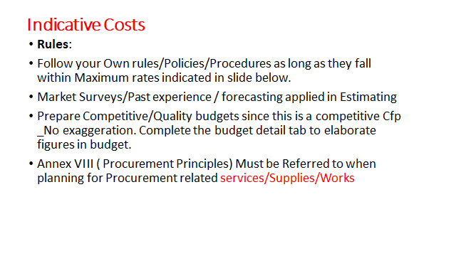
4c. Proposal template budget

Slide 56
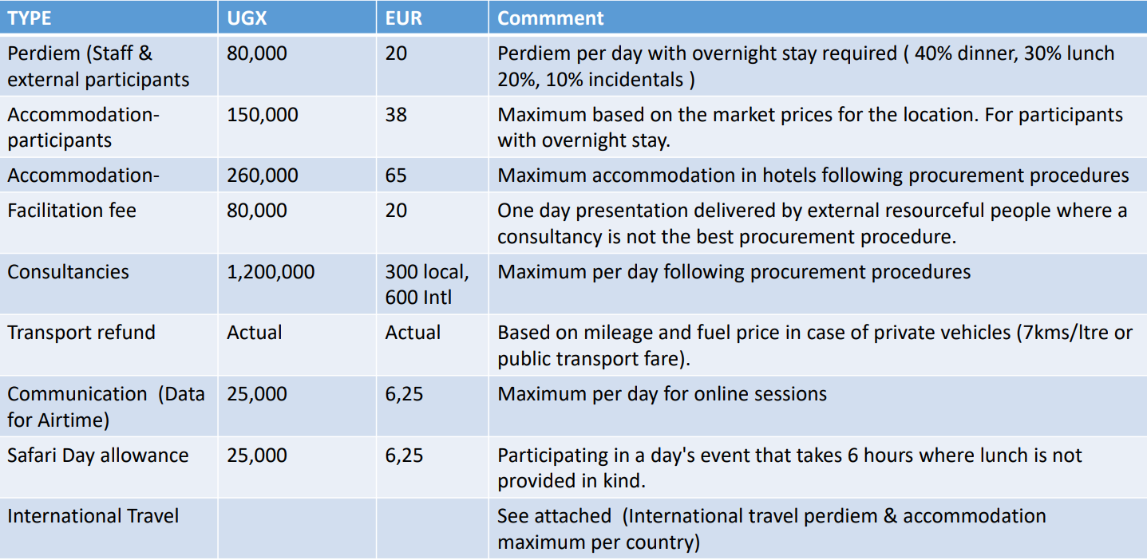
Indicative Costs
4c. Proposal template budget

Slide 57
4c. Proposal template budget DURING IMPLEMENTATION
Modification between results leading to a variation not greater than 15% of amounts initially planned.
Modification between activities of the same result leading to a variation not greater than 25% of the amounts initially planned.
Changes between operational costs (A) and management costs (B) are not allowed without an amendment.
Changes to structure costs (C) are not allowed.

Slide 58
4c. Proposal template budget
Budget presentation in excel (Annex B of the grant agreement)

Slide 59
4. Proposal c) Annex B: budget

Slide 60
5. Application procedure / Next steps
4. Application procedure / Next steps
Use the complete Annex A Grant Application File. Do not use own templates & do not tweak the template
Submission in English only
Provide a detailed budget (annex B) with explanation
Errors or major inconsistencies concerning the points mentioned in the instructions of the form may result in rejection (e.g., content required, pages, …)
Enabel reserves the right to request clarification where the information provided does not enable it to carry out an objective evaluation

Slide 61
5. Application procedure / Next steps
4. Application procedure / Next steps
Deadline for application: 13/06/2025 at 5 PM EAT
!!! Online submission form – ‘Submit’: https://submit.link/3EC
SUBMISSIONS BY EMAIL/POST → AUTOMATIC REJECTION

Slide 62
5. Application procedure / Next steps
4. Application procedure / Next steps
Remaining questions: uga_csc_grants@enabel.be
Subject: reference number + LOT
Questions can be submitted until 23/05
Answers will be published on https://www.enabel.be/grants/ latest by 02/06

Slide 63
5. Application procedure / Next steps
4. Application procedure / Next steps
! Primary source of information
Guidelines, annexes, clarifications (Q&A) and all other communication & updates:
https://www.enabel.be/grants/
Select UGANDA – OPEN CALLS - FILTER
reference number UGA22007-10113

Slide 64
5. Application procedure / Next steps
4. Application procedure / Next steps
Online submission form ‘Submit’: https://submit.link/3EC
Avoid last minute submission; System automatically closes when past deadline
Start working on a draft timely (you can always go back to your draft, it saves automatically)
Get documentation (annexes to the application file) ready on time; you cannot proceed to uploading application file before uploading the annexes)

Slide 65
5. Application procedure / Next steps
4. Application procedure / Next steps
Deadline for clarification requests to the contracting authority | May 25th, 2025 | 5:00 pm
Response to clarification requests are given by the contracting authority | June 2nd, 2025 | 5:00 pm
Deadline for the submission of the proposals | June 13th, 2025 | 5:00 pm
Opening, administrative checks and evaluation of proposals | June 16st – July 31st, 2025* | NA
Request certificates and supporting documents relating to the grounds for exclusion (see 2.1.1 (2)) | August 1st, 2025* | 5:00 pm
Onsite organizational analysis of the successful applicants after technical evaluation | August 7th – 11th 2025* | NA
Receipt of certificates and supporting documents relating to the grounds for exclusion | August 15th, 2025* | 5:00 pm
Notification of the award decision and transmission of signed grant agreement | August 25th, 2025* | NA
Signature of the Agreement by contracting beneficiary | August 30th, 2025* | NA

Slide 66
5. Application procedure / Next steps
Pre-selected applicants will be invited to submit – time = 15 days
Criminal record clearance (Interpol) certificate for the main authorized representatives of your organization (e.g. chairman of the board of directors AND the executive director) those that will sign the grant agreement – Can take 2 weeks, ask timely!!
Tax clearance certificate from Uganda Revenue Authority (URA)
NSSF Clearance Certificate
Documents cannot be older than 2 years

Slide 67
5. Application procedure / Next steps
Organisational assessments
Assessment to confirm whether applicant has the capacity to implement the proposed activities. The purpose is to verify general characteristics, technical capacities, control environment, financial management, audit, procurements and context.
Done by consultant & Enabel
Visits of half a day to 1 day
Can be organized on short notice – be prepared

Slide 68
End

