Slide 1
Call For Proposals SKILLS DEVELOPMENT FOR INCREASED EMPLOYABILITY OF VULNERABLE YOUTH, WOMEN AND GIRLS IN KAMPALA
Information sessions

Slide 2
Presentation outline
Introduction to WeWork and the Call for Proposals
Objectives of the call
Admissibility criteria
Actors
Actions
Costs
Concept note application form
Application and selection procedure

Slide 3
1. Introduction
Enabel, the Belgian development Agency
Vision: Young people and women in Uganda develop into active, economically independent citizens in a sustainable society that respects human rights and ensures quality basic services.
Focus areas:
Employability | Employment & Entrepreneurship | Education | Health
Skills development that offers the prospect of decent and green jobs | Skilled people find decent and green jobs or start a successful business | Quality lower secondary education | Training of health personnel & improved capacity of health centres and hospitals

Slide 4
1. Cn't Introduction
Interventions are funded by:
Belgian government
Employability and Employment: Green and decent jobs for youth “WeWork”
Education: WeLearn
Health: WeCare and WeTrain4Health
and the EU
Employability and Employment: Green and decent jobs for youth “WeWork”
Business: SB4U and SBHR
Gender: G4DU

Slide 5
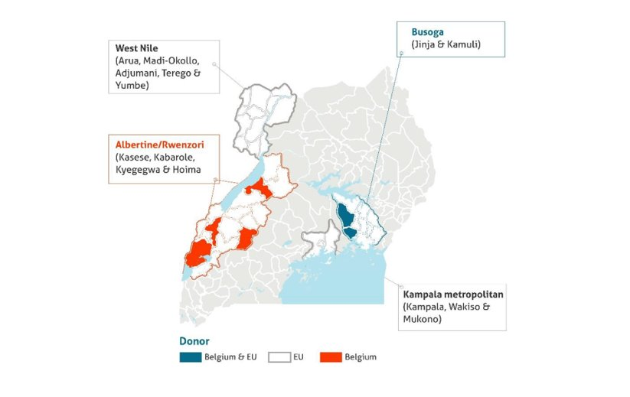
1. Cn't Introduction - WeWork

Slide 6
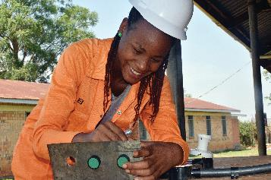
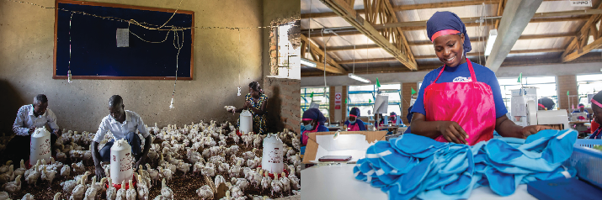
1. WeWork: Green and Decent Jobs for Youth
Results domain 1
Results domain 2
Results domain 3
Improved employability of young people (especially women) through skilling and employment services
Increased gainful self- employment opportunities
through entrepreneurship
Increased productivity &
sustainability of existing
businesses
Focus on agriculture and the green economy

Slide 7
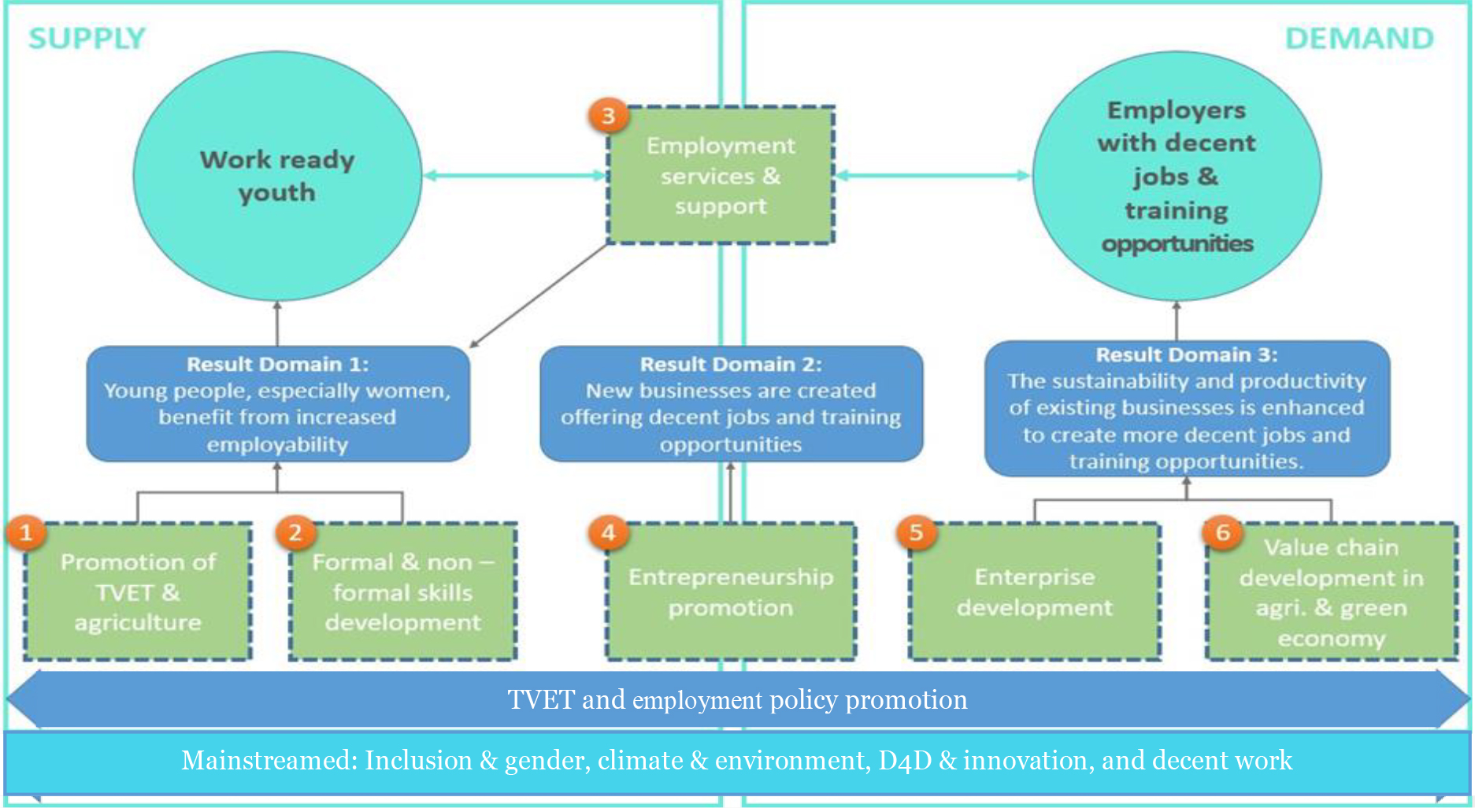

Slide 8
Call for Proposals
Guidelines, annexes, clarifications (Q&A) and all other communication:
www.enabel.be/grants
Call reference number: UGA22003-10008
Call Title: Skills development for increased employability of vulnerable youth, refugees, women and girls in Kampala metropolitan area
Procedure: 2 phased : (1) Concept note stage, (2) proposal stage

Slide 9
2. Call Objectives
General objective
Improve livelihoods of 2000 vulnerable youth through enhanced access to quality, demand-driven skills development and employment support services
Specific objectives
The provision of skills development is more equitable, qualitative, innovative, and labour market-driven for increased employment opportunities

Slide 10
2. Call Objectives
2 phased procedure
- Concept note stage
- Proposal stage

Slide 11
2. SDF basket
Quality non-formal skills development
Skill gaps identified through livelihood and labour market analysis
Meaningful involvement of the (local) private sector in design, implementation and/or assessment of trainings
Holistic approach to skills development by integrating career guidance, 21st century skills development, work-based learning, social inclusion strategies
Intensive and innovative post-training employment support services

Slide 12
2. Call volume and grant amounts
Total call volume is 2,000,000 EUR
Lot 1: Agriculture: indicative allocation: 1,000,000 EUR
Lot 2: Green economy: indicative allocation: 1,000,000 EUR
Grant applications must fall between minimum 150,000 and maximum 500,000 Euro
Reasonable and efficient unit cost, to take into account holistic approach + intensive post training support

Slide 13
2. Different lots
CfP lots
Inclusive/accessible Conducive economical and technical conditions Environmental impact
Lot 1: Agriculture
Coffee
Cocoa
Apiary
Lot 2: green economy
Sustainable tourism
Renewable energy
Sustainable forestry

Slide 14
3. Admissibility criteria
The actors: Eligible applicants
The actions: Admissible actions for grants
The costs: Acceptable types of costs that may be included in grants

Slide 15
3a. The actors: lead applicant
Legal entity
Be a private not for profit entity or foundation;
Be established or represented in Uganda;
National or international NGO, Civil Society or Community-Based Organization, Foundation, Business Membership organisation or a non-profit business development service provider with demonstrated experience in managing quality skills development initiatives and economic empowerment of vulnerable youth and women in the selected value chains
Demonstrated relevant work experience – at least the past 3 years
Active Bank Account for the past 12 months
In-house financial management capacity

Slide 16
3a. The actors: lead applicant
Exclusion grounds:
Annex VII grant agreement – Applicant’s declaration in application form completed and signed (Annex A guidelines)
Supporting documents (upon preselection – 2nd stage):
Criminal record clearances from Interpol
NSSF clearance certificate
Tax clearance certificate

Slide 17
3a. The actors: the applicant and co-applicant(s)
The applicant must mandatorily form a partnership and act with at least one and maximum two co-applicants
The partnership between Lead and co-applicants is to optimize cumulation of complementary expertise.
The selected applicant becomes the contracting-beneficiary and is the main point of contact for the contracting authority. It shall represent its co-applicant and act in their name. It shall design and coordinate implementation of the action.
The co-applicant shall participate in the implementation of the action and the costs that they incur shall be eligible in the same way as those incurred by the lead applicant.

Slide 18
3a. The actors: co-applicants
Legal entity
Be a public entity or private not for profit or legal entity of private law for which profit maximization is not the priority objective
Established or represented in Uganda
Be any of the following types of organization:
Accredited public or private non-profit technical and/or vocational skills training provider
Business Membership Organisation/Association
Non-profit Business Development Services (BDS) provider
A cooperative or social enterprise for which profit maximization is not the priority objective;
NGO, Civil Society or Community-Based Organization, Foundation
Have 3 years demonstrated work experience in participating in quality skills development and/or employment promotion initiatives in the targeted region.
Be registered with relevant authorities and comply with Ugandan legal regulations
Have an operational governance structure and an active bank account for the past 12 months

Slide 19
3a. The actors: co-applicants
Private law for which profit maximization is not the priority objective, conditions:
Social objectives (ie. aimed at improving human, societal and environmental wellbeing) serve the primary purpose of the entity
Generating revenue/profits is not an objective in itself, but a means to achieve social goals; hence the majority of revenue/profits are reinvested back into the company/entity for social purpose OR into actions for social purpose
! This has to be demonstrated through the articles of association, any other legally binding documentation (board/shareholder resolutions) and/or financial statements for the past 3 years.
! This considers the entity’s constitution, any ad hoc resolution merely related to what would happen with potential funding from Enabel is not sufficient
! Double check if this can be sufficiently demonstrated to avoid ineligibility of the application

Slide 20
3a. The actors – Summary types
Organisation type | Lead applicant | Co-applicant
National or international Non-Governmental Organizations (NGOs), Foundations, or Community-Based Organizations (CBOs) | Yes | Yes
Public vocational and/or technical training institutions | No | Yes
Private (not-for-profit) vocational and/or technical training institutions | No | Yes
Non-profit Business Development Services (BDS) provider | Yes | Yes
Business Membership Organizations or associations | Yes | Yes
Cooperatives or social enterprises for which profit maximization is not the priority objective | No | Yes

Slide 21
3a. The actors – Physical presence
Selected applicants are required to be based in the targeted subregions (= eligible districts!) during implementation of the action and hence applicants are to demonstrate in their application how they will ensure their physical presence either through:
an existing office of the applicant;
An existing office any co-applicant;
an office space to be set-up → clear plan to be elaborated in application form!

Slide 22
3a. The actors: Associates
Participate actively in the action but are not eligible for grants and only qualify to receive daily allowances and travelling expenses.
To be specified in part B of the application form. They need not to sign the mandate in proposal stage.

Slide 23
3a. The actors: Contractors
These are contractors for services, works and equipment. These must be sourced through a procurement process using relevant procedures i.e. PPDA (public procurement law) for public entities and annex VIII of the Grant Agreement for private entities

Slide 24
3b. The actions
Duration
Location
Target beneficiaries
Priority sectors and themes
Type of action and eligible activities

Slide 25
3b. The actions: Duration
Action/GA : minimum 18 to maximum 24 months
Training programmes: minimum 6 to maximum 9 months, including minimum 30% WBL
Minimum 6 months post-training employment support for successful graduates

Slide 26
3b. The actions: Location
The actions must be implemented within Uganda in one or more of the following districts:
Kampala
Mukono
Wakiso
The actions may not be implemented in other districts
Target groups/youth must reside in the target districts
Majority of activities take place in target districts

Slide 27
3b. The actions: Target beneficiaries
Vulnerable populations residing in the eligible districts
(different vulnerability categories, to be demonstrated in application)
At least 80% youth between the ages of 15 and 35 years
At least 50% women and girls

Slide 28
3b. The actions: Priority sectors
Agriculture
Green economy
→Trainings in small livestock (poultry and piggery) and other sectors or occupations not listed may also be eligible if applicants can clearly demonstrate and substantiate the relevance of the proposed trainings to the local labour market and employment opportunities for the specific target group(s).

Slide 29
3b. The actions: Priority value chains
Agriculture:
Apiary value chain;
Coffee and cocoa value chains
Green economy:
Sustainable tourism and hospitality value chains;
Sustainable forestry value chains (sustainable timber and non-timber, including agro-forestry);
Renewable energy value chain
Transversal: integration of organic and solid waste management can be considered for all targeted value chains
-> Maximum 5 trades

Slide 30
3b. The actions: Priority value chains – Green economy
Sustainable tourism and hospitality value chains:
! takes full account of its current and future economic, social and environmental impacts, addressing the 3Ps (People, Planet, Profit) = sustainable microbusiness development in leisure and business tourism, while contributing to the conservation of the natural environment and cultural heritage, and inclusion of the local community
Sustainable forestry value chains:
“non-timber forest product” (NTFP) includes “all biological materials other than timber which are extracted from forests for human use. These include foods, medicines, spices, essential oils, resins, gums, latexes, tannins, dyes, ornamental plants, wildlife (products and live animals), fuelwood and raw materials, notably rattan, bamboo, small wood and fibres”

Slide 31
3b. The actions: Priority Themes
To integrate:
Environmental conservation or skills for the green economy
Gender roles and reproductive health awareness
Entrepreneurial skills
Digital literacy or skills for the digital economy
Financial literacy
Other soft skills for enhanced employability: Work-readiness, conflict management, behavior/attitude skills, etc…

Slide 32
3b. The actions: mandatory activities
Labour market analysis in order to identify and engage with private sector entities and establish job profiles defining the skills required for potential job opportunities
Outreach and awareness or sensitization strategies
Social inclusion strategies
Non-formal, short-term skills training programmes in the targeted sectors with a duration of minimum 6 to maximum 9 months
Assessment and certification, adhering to national standards for non-formal training (Directorate of Industrial Training)
Integration of Occupational Health and Safety standards and measures (including materials + protective wear)
Integration of soft skills training and entrepreneurship skills training

Slide 33
3b. The actions: mandatory activities
Involvement of private sector in design, implementation and/or assessment of trainings and minimum 30% of the training duration allocated to Work-Based Learning
Engagement of private sector role models and expertise in mentoring and training
Provision of start-up kits and/or micro business grants, tailored to specific business needs or business plans developed by successful graduates and/or groups opting for self-employment
6 months extensive and innovative post-training employment support services

Slide 34
3b. The actions: Admissible activities
See guidelines, non-exhaustive
Provision of start-up kits, tailored to specific business needs or business plans developed by targeted youth
Maximum 15% of the budget
to provide a strategy on how the kits will effectively promote sustainable business development and not distort the local ecosystem and market
Sub-granting (micro business grants) to vulnerable youth supported under the action to start/develop sustainable micro or small businesses are allowed with application of the specific conditions and restrictions

Slide 35
3b. The actions: Sub-grants to sub-beneficiaries
Optional not mandatory
In 2nd/proposal stage need to elaborate:
1. The description of the objectives and results to be achieved with these sub- grants, the fundamental principles, the key concepts, the mechanisms, the actors and their role in the management process;
2. The criteria and modalities for the allocation of grants, accessibility conditions sub-beneficiaries, conditions for the admissibility of sub-projects, eligibility conditions for activities, costs and expenses;
3. The procedures for examining and awarding applications;
4. The maximum amount that can be allocated by sub-beneficiary;
5. The terms of contractualization with the sub-beneficiary;
6. The procedures and modalities for disbursing resources;
7. The procedures and modalities for technical and financial monitoring;
8. The procedures and modalities of control.

Slide 36
3b. The actions: Sub-grants to sub-beneficiaries
Micro business grants conditions:
The maximum amount for the sub-grants under this category is EUR 250 per supported youth/youth owned business;
Maximum 20% of supported youth/youth-owned businesses under the action can be eligible for a micro business grant;
To be eligible for a micro business grant, supported youth must have successfully completed the training organized under the action, be certified and present a sound and viable business plan/model;
Approval of micro business grants for supported youth/youth-owned businesses will be done by a selection committee which is to include representatives of Enabel, and by applying different evaluation criteria including (but not limited to) the viability of the business plan/model, vision/sound projections, financial need and relevance, technical and economic feasibility, experience and motivation of the applicant, etc.

Slide 37
3b. The actions: Sub-grants to sub-beneficiaries
Micro business grants conditions (2) :
Types of activities eligible for micro business grants include purchase of equipment, raw materials and inventory, marketing and advertising activities, or start-up related costs for newly developed businesses;
The following costs are ineligible for sub-granting: non-business-related costs (e.g. personal expenses or assets) and repayment of existing debts or loans.
Payment modalities cannot include any transfer in cash.

Slide 38
3b. The actions: Other admissible actions
Training, studies, workshops, etc
Training materials
Promotion of social or gender inclusion (e.g., transport arrangements, facilities and procedures that constitute safe learning and work environments, day-care services, counselling or psychosocial support,…)
Capacity building local partners
(Pre-training) career guidance, coaching
Toolkits for WBL
Job fairs, networking or matchmaking activities
…

Slide 39
3b. Number of applications
The applicant may not submit more than one (1) application per lot under this Call for Proposals.
The applicant may not be awarded more than one (1) Grant Agreement per lot under this Call for Proposals.
The applicant may not be at the same time a co-applicant in another application
A co-applicant may not be awarded more than one (1) Grant Agreement under this Call for Proposals

Slide 40
Questions? sdf.grants@enabel.be

Slide 41
3c. Admissible/ Ineligible costs
1) Direct costs
Operational Costs
Management Costs (Direct Administration Costs).
2) Indirect Costs:
Structure Costs (Indirect Administration Costs)
Admissible / Eligible Costs:
Costs that Enabel can subsidize under any Grant Agreement
Two Types:
Directs Costs
Indirect Costs

Slide 42
3c. Admissible/ Eligible costs
ii) Management Costs:
Administration costs directly attributed to the implementation of the actions. This comprise the costs of management, monitoring, equipment, facilities and other costs directly related to the core activity.
Examples:
IT/Computer equipment(Laptops, printers, projectors, Camera etc.)
Furniture and fittings
Audit & Accounting fees
Salary of program staff + other direct staff
Etc.
Direct costs
i) Operational Costs
Activity costs necessary for achieving the results of the action. This comprises the costs of the core activities to be implemented.
Examples:
Training materials
Food for trainees
Transport costs for trainees or attend training workshop
Training fees
Etc.

Slide 43
3c. Admissible/Ineligible costs
Indirect Costs:
Structure Costs: Administration costs not directly attributed to the project, but are necessary for the implementation of the actions.
Max 7% of operational costs, and to be verified.
Examples:
Office rental
Utilities: electricity, water, etc. for project office
Salary of the Executive Director or + other support staff
Office telecommunication cost
Etc.

Slide 44
3c. Admissible/Eligible costs
Reserve for contingencies:
The budget may include a contingency reserve up to a maximum of 5% of the estimated eligible direct costs.
It may only be used with the prior written authorization of Enabel.

Slide 45
3c. Ineligible costs
Accounting entries not leading to payments
Provisions for liabilities and charges, losses, debts or possible future debts
Debts and debit interests
Doubtful debts
Currency exchange losses
Loans to third parties
Guarantees and securities;
Costs already financed by another grant
Invoices made out by other organisations for goods and services already subsidized
Subcontracting by means of service or consultancy contracts to personnel members, Board members or General Assembly members of the organisation subsidized
Any sub-letting to oneself
Purchases of land or buildings;
Compensation for damage falling under the civil liability of the organisation
Employment termination compensation for the term of notice not performed
Purchase of alcoholic beverages, tobacco and derived products thereof

Slide 46
3c. Budget template review
S/NO | Category of expenses | Activity | Budget (in EUR)
1 | Operational costs
 |  | Ex. Activity 1.1: Start up kits | xxxx
 |  | HR: Technical experts
 |  | HR: Support staff
2 | Management costs
 |  | Hr: Admin staff
3 | Contingency 5% - If applicable
4 | Structure costs (maximum 7% of operational costs)
 | Total

Slide 47
Questions?

Slide 48
4. Concept note application
Use the complete Annex A Grant Application File, Part A. Do not use own templates & do not tweak the template
Submission in English only
In the concept note, provide only an estimate of the amount requested. Detailed budget (annex B) is only required in second stage (Amount requested in the proposal may not vary more than 20% in relation to the initial estimate)
Errors or major inconsistencies concerning the points mentioned in the instructions of the form may result in rejection (e.g., content required, pages, …)
Enabel reserves the right to request clarification where the information provided does not enable it to carry out an objective evaluation
Elements defined in the concept note may not be modified by the applicant in the proposal

Slide 49
4. Concept note application annexes
1. The concept note declaration signed by the lead applicant
2. Statutes or articles of association of the lead applicant and any co-applicant(s).
3. MoU with relevant authorities (e.g., OPM/KCCA) to operate in Kampala metropolitan targeting urban refugees - where applicable
4. An external audit report produced by an approved auditor, certifying the lead applicant accounts for the last available financial year – Lead & private applicant only – only if requested amount is above 200,000 EUR
5. A copy of the lead applicant’s most recent approved financial statements (income statement and balance sheet for the last closed financial year) – Lead applicant only; not applicable where the accounts are in practice the same documents as the external audit report of point 4
6. The legal entity file (see Annex D of these guidelines) duly completed and signed by the applicant and any co-applicant(s), along with the supporting documents requested

Slide 50
5. Application procedure
Guidelines, annexes, clarifications (Q&A) and all other communication:
https://www.enabel.be/grants/
Uganda – Open calls:
Kampala metropolitan: reference number UGA22003-10008

Slide 51
5. Application procedure
Remaining questions: sdf.grants@enabel.be
Subject: reference number + name

Slide 52
5. Submission concept notes
Deadline for application: 05/09/2024 at 5 PM EAT
!!! Online submission form – ‘Submit’: https://submit.link/2O5
SUBMISSIONS BY EMAIL/POST → AUTOMATIC REJECTION

Slide 53
5. Submission concept notes
Online submission form – ‘Submit’: https://submit.link/2O5
Demo
Avoid last minute submission; System automatically closes when past deadline
Start working on a draft timely (you can always go back to your draft, it saves automatically)
Get documentation (annexes to the application file) ready on time; you cannot proceed to uploading application file before uploading the annexes)

Slide 54
5. Submission concept notes
Timely
Complete (guide + declaration + annexes)
and following the procedure (use the template!)

Slide 55
5. Evaluation and selection procedure – Concept notes
Deadline for clarification requests to the contracting authority Sdf.grants@enabel.be | 15/08/2024 | 5:00 pm
Response to clarification requests are given by the contracting authority https://www.enabel.be/content/enabel-grants | 23/08/2024 | 5:00 pm
Submission deadline for concept notes | 05/09/2024 | 5:00 pm
Opening, administrative and admissibility checks of concept notes (stage 1) | 9/09/2024* | N/A
Evaluation of concept notes | 16/09/2024* | N/A
Invitations to submit the proposals | 14/10/2024* | 5:00 pm
Orientation sessions proposals | 18/10/2024* | N/A

Slide 56
5. Evaluation and selection procedure – Proposals
Deadline for clarification requests to the contracting authority | 24/10/2024* | 5:00 pm
Response to clarification requests are given by the contracting authority | 3/11/2024* | 5:00 pm
Deadline for the submission of the proposals | 14/11/2024* | 5:00 pm
Opening, administrative and admissibility checks of proposals (stage 1) | 18/11 /2024* | N/A
Evaluation of proposals |  | N/A
Request certificates and supporting documents relating to the grounds for exclusion (see 2.1.1 (2)) | 6/01/2025* | 5:00 pm
Receipt of certificates and supporting documents relating to the grounds for exclusion | 21/01/2025* | 5:00 pm
Onsite organizational analysis of the successful applicants after technical evaluation | 6/01-31/06/2025* | N/A-
Notification of the award decision and transmission of signed grant agreement | 1/02/2025* | N/A
Signature of the Agreement by contracting beneficiary | 2/02/2025* | N/A

Slide 57
Thank you! Q&A sdf.grants@enabel.be

