Slide 1
Call For Proposals
SKILLS DEVELOPMENT FOR INCREASED EMPLOYABILITY OF VULNERABLE YOUTH, WOMEN AND GIRLS IN RWENZORI/ALBERTINE REGION
Information sessions

Slide 2
Presentation outline
Introduction
Objectives of the call
Admissibility criteria
  Actors
  Actions
  Costs
Vulnerability criteria
Concept note application form
Application and selection procedure

Slide 3
1. Introduction
Enabel, the Belgian development Agency
Vision: Young people and women in Uganda develop into active, economically independent citizens in a sustainable society that respects human rights and ensures quality basic services.
Focus areas:
Employability | Employment & Entrepreneurship | Education | Health
Skills development that offers the prospect of decent and green jobs | Skilled people find decent and green jobs or start a successful business | Quality lower secondary education | Training of health personnel & improved capacity of health centres and hospitals

Slide 4
1. Cn't Introduction
Interventions are funded by:
Belgian government
  Employability and Employment: Green and decent jobs for youth “WeWork”
  Education: WeLearn
  Health: WeCare and WeTrain4Health
and the EU
  Employability and Employment: Green and decent jobs for youth “WeWork”
  Business: SB4U and SBHR
  Gender: G4DU

Slide 5
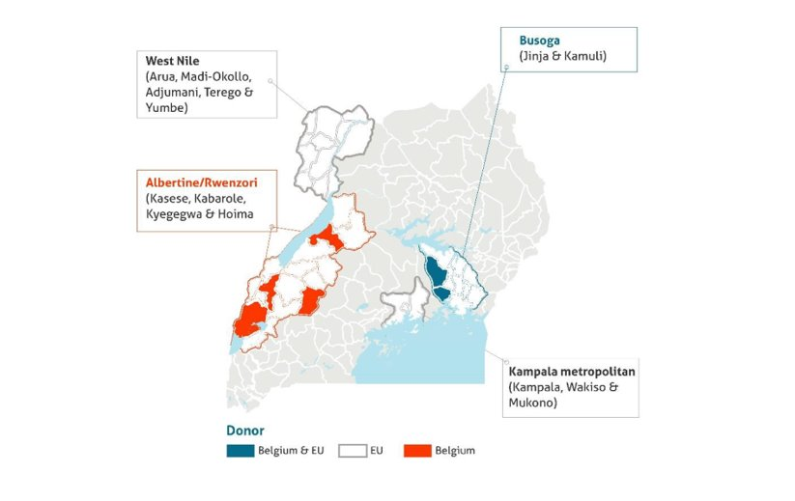
1. Cn't Introduction

Slide 6
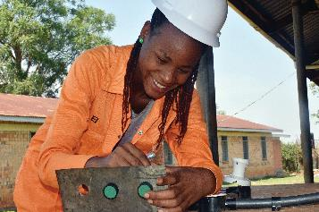
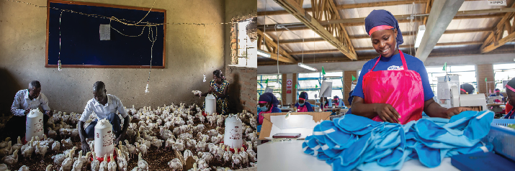
1. WeWork: Green and Decent Jobs for Youth
Results domain 1
Results domain 2
Results domain 3
Improved employability of young people (especially women) through skilling and employment services
Increased gainful self- employment opportunities
through entrepreneurship
Increased productivity &
sustainability of existing
businesses
Focus on agriculture and the green economy

Slide 7
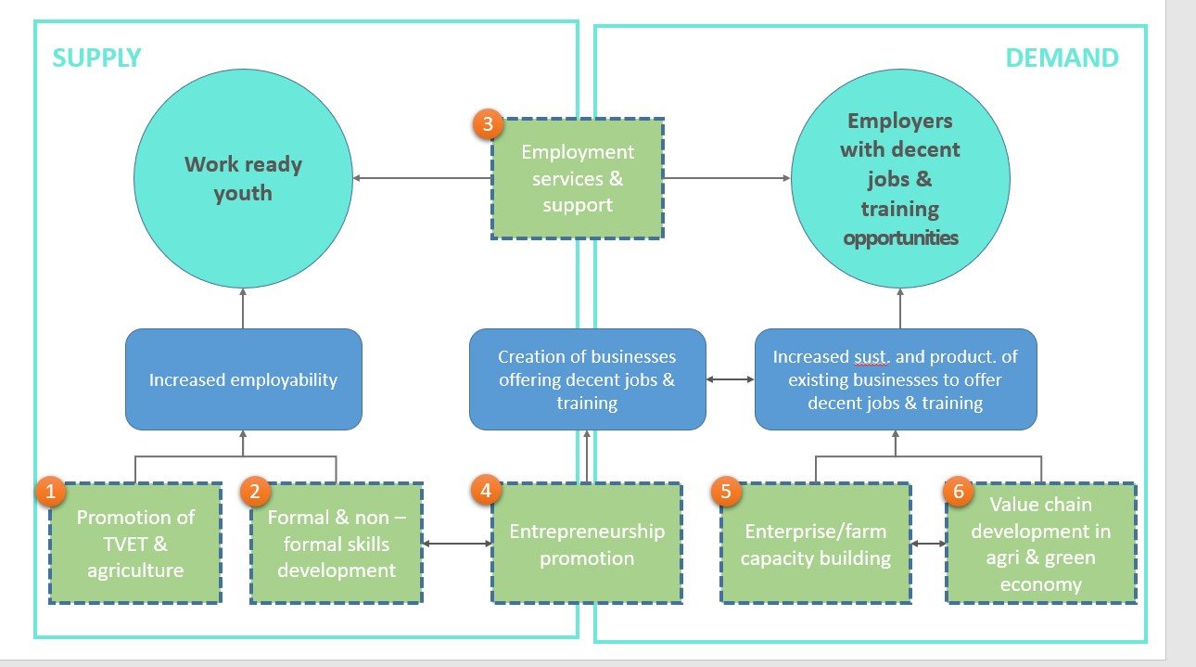

Slide 8
2. Objectives of the call
Guidelines, annexes, clarifications (Q&A) and all other communication:
https://www.enabel.be/grants/
Call reference number: UGA22005-10036
Call Title: SKILLS DEVELOPMENT FOR INCREASED EMPLOYABILITY OF VULNERABLE YOUTH, WOMEN AND GIRLS IN RWENZORI/ALBERTINE REGION

Slide 9
2. Call Objectives
General objective
Improve livelihoods of 2000 vulnerable youth through enhanced access to quality, demand-driven skills development and employment support services
Specific objectives
The provision of skills development is more equitable, qualitative, innovative, and labour market-driven for increased employment opportunities

Slide 10
2. Call Objectives
2 phased procedure
- Concept note stage
- Proposal stage

Slide 11
2. SDF basket
Quality non-formal skills development
Skill gaps identified through livelihood and labour market analysis
Meaningful involvement of the (local) private sector in design, implementation and/or assessment of trainings
Holistic approach to skills development by integrating career guidance, 21st century skills development, work-based learning, social inclusion strategies
Intensive and innovative post-training employment support services

Slide 12
2. Call volume and grant amounts
Total call volume is 2,000,000 EUR
Lot 1: Agriculture: indicative allocation: 1,000,000 EUR
Lot 2: Green economy: indicative allocation: 1,000,000 EUR
Grant applications must fall between minimum 150,000 and maximum 500,000 Euro
Reasonable and efficient unit cost, to take into account holistic approach + intensive post training support

Slide 13
2. Different lots
CfP lots
Inclusive/accessible Conducive economical and technical conditions Environmental impact
Lot 1: Agriculture
Small livestock (poultry, piggery)
Horticulture
Apiary
Lot 2: green economy
Sustainable tourism
Renewable energy (solar)
Green construction

Slide 14
3. Admissibility criteria
The actors: Eligible applicants
The actions: Admissible actions for grants
The costs: Acceptable types of costs that may be included in grants

Slide 15
3a. The actors: lead applicant
Legal entity
Be a public entity or private not for profit or legal entity of private law for which profit maximization is not the priority objective
Established or represented in Uganda
National or international NGO, Civil Society or Community-Based Organization, Foundation, Business Membership organisation or a non-profit business development service provider with demonstrated experience in managing quality skills development initiatives and economic empowerment of vulnerable youth and women in the selected value chains
Demonstrated relevant work experience – at least the past 2 years
Active Bank Account for the past 12 months
In-house financial management capacity

Slide 16
3a. The actors: lead applicant
Exclusion grounds:
Annex VII grant agreement – Applicant’s declaration in application form completed and signed (Annex A guidelines)
Supporting documents (upon preselection – 2nd stage):
Criminal record clearances from Interpol
NSSF clearance certificate
Tax clearance certificate

Slide 17
3a. The actors: the applicant and co-applicant(s)
The applicant must mandatorily form a partnership and act with at least one and maximum two co-applicants
The partnership between Lead and co-applicants is to optimize cumulation of complementary expertise.
The selected applicant becomes the contracting-beneficiary and is the main point of contact for the contracting authority. It shall represent its co-applicant and act in their name. It shall design and coordinate implementation of the action.
The co-applicant shall participate in the implementation of the action and the costs that they incur shall be eligible in the same way as those incurred by the lead applicant.

Slide 18
3a. The actors: co-applicants
Legal entity
Be a public entity or private not for profit or legal entity of private law for which profit maximization is not the priority objective
Established or represented in Uganda
Be any of the following types of organization:
  Accredited public or private non-profit technical and/or vocational skills training provider
  Business Membership Organisation/Association
  Non-profit Business Development Services (BDS) provider
  Non-profit private sector business cooperative or enterprise;
  NGO, Civil Society or Community-Based Organization, Foundation
Have 3 years demonstrated work experience in participating in quality skills development and/or employment promotion initiatives in the targeted region.
Be registered with relevant authorities and comply with Ugandan legal regulations
Have an operational governance structure and an active bank account for the past 12 months

Slide 19
3a. The actors – Summary types
Organisation type | Lead applicant | Co-applicant
National or international Non-Governmental Organizations (NGOs), Foundations, or Community-Based Organizations (CBOs) | Yes | Yes
Public vocational and/or technical training institutions | No | Yes
Private (not-for-profit) vocational and/or technical training institutions | No | Yes
Non-profit Business Development Services (BDS) provider | Yes | Yes
Business Membership Organizations or associations | Yes | Yes
Non-profit business cooperatives or enterprises | No | Yes
Any application shall involve at least one organization based within the region where the activity will be implemented (acting either as lead or co-applicant).

Slide 20
3a. The actors: Associates
Participate actively in the action, but are not eligible for grants and only qualify to receive daily allowances and travelling expenses.
To be specified in part B of the application form. They need not to sign the mandate in proposal stage.

Slide 21
3a. The actors: Contractors
These are contractors for services, works and equipment. These must be sourced through a procurement process using relevant procedures i.e. PPDA (public procurement law) for public entities and annex VIII of the Grant Agreement for private entities

Slide 22
3b. The actions
Duration
Location
Target beneficiaries
Priority sectors and themes
Type of action and eligible activities

Slide 23
3b. The actions: Duration
Action/GA : minimum 18 to maximum 24 months
Training programmes: minimum 6 to maximum 9 months, including minimum 30% WBL
Minimum 6 months post-training employment support for successful graduates

Slide 24
3b. The actions: Location
The actions must be implemented in Uganda, Rwenzori and Albertine region in at least one of the following districts:
Kasese
Kabarole
Hoima
kyegegwa
The actions may not be implemented in other districts.

Slide 25
3b. The actions: Target beneficiaries
Vulnerable populations residing in the eligible districts
  Guideline vulnerability criteria Annex H
At least 80% youth between the ages of 15 and 35 years
At least 50% women and girls

Slide 26
3b. The actions: Priority sectors
Agriculture
Green economy
→Non-priority sectors or trades to be substantiated relevance of the proposed trainings to the local labour market and employment opportunities for the specific target group(s)
→Maximum 5 trades

Slide 27
3b. The actions: Priority sectors agriculture
Under the green (climate-smart) agriculture sector, Enabel promotes an economic sector,
market-oriented approach that effectively integrates environmental and climate change considerations through the promotion of more sustainable, green and climate-resilient agricultural practices that foster food and nutritional security, (green) job creation and entrepreneurship, as well as livelihood improvement.
Social, environmental, economic and technical benefits were used for the selection of priority value chains through which Enabel aims to support the creation of decent (green) jobs.

Slide 28
3b. The actions: Priority sectors agriculture
Horticulture | Piggery | Poultry
Horticulture farmer/producer Vegetable farmer Fresh vegetable supply chain manager Agro-food processor Greenhouse operator/manager Nursery operator Agro-vet inputs dealer Digital agricultural extension worker | Pig farmer Agro-food processor (Pork value addition) Agro-vet inputs dealer Digital agricultural extension worker. Pig feeds producer/mixer | Poultry breeder Poultry farmer/producer Poultry agro-food processor (value addition) Poultry feed producer/mixer Agro-vet inputs dealer- poultry Digital agricultural extension worker. Poultry equipment producer
Apiary
Honey producer Honey processor Bee keeper/farmer Digital agricultural extension worker | Apiary extension service provider Apiary equipment producer Value addition for apiary products (beewax & honey)

Slide 29
3b. The actions: Priority sectors green economy
Renewable Energy (Solar)
Solar technician / Installer Solar sales agent / Entrepreneur Solar education and awareness coordinator Solar product assembly technician Solar maintenance technician Solar entrepreneur Solar water system & pump technician Solar energy community outreach worker

Slide 30
3b. The actions: Priority sectors green economy
Green Construction Skills development and employment promotion actions in green construction are to integrate green building and resource efficiency skills and promote the use of green construction materials (e.g. bamboo, eco-bricks, recycled materials). Applicants can include traditional occupations (i.e. welder, plumber, electrician, bricklayer) that are equally relevant for the green transition in construction, as long they clearly demonstrate that the trainings meet the high quality/standards demanded in the green construction sector and access to employment.
ISSB block maker/builder Green construction mason Machine operator (greening systems) Carpenter (with focus on integration of sustainable materials, e.g. bamboo) Sustainable timber producer (i.e. eco-certified timber) | Sustainable timber processor Bamboo producer Bamboo processor Bamboo craftsman/artisan Bamboopole treatment assistant

Slide 31
3b. The actions: Priority sectors green economy
Sustainable tourism The sustainable tourism and hospitality value chain takes full account of its current and future economic, social and environmental impacts, addressing the needs of visitors, the industry, the environment and host communities. In this regard, the Call promotes actions that address skill gaps and promote employment opportunities for youth in leisure and business tourism, while contributing to the conservation and restoration of the natural environment and cultural heritage, and inclusion of the local community. The Call for Proposals focuses on occupations within the following segments of the tourism value chain: (1) Sustainable attractions and tourist activities: sustainable nature-based experiences, ie. wildlife/natural parks, sustainable agri-tourism and adventure and recreative tourism (hiking, (trail)running, cycling, rafting, kayak, canoeing, trekking or climbing, bird watching), and community-based cultural tourism (culture and heritage experiences, sustainable crafts). (2) Sustainable accommodation: eco-friendly hotels, lodges, guesthouses, hostels, cottages, tented camps and camp grounds, community-based accommodation establishments (bandas), homestays. (3) Food and beverages: organic and locally sourced food production, processing or preparation for visitors and tourism facilities by youth community groups, restaurants, pubs, bakeries, catering services, and on-farm (agri-tourism).

Slide 32
3b. The actions: Priority sectors green economy
Sustainable tourism
• Tour guides (with attention for specialization as per the focus of experience); • Tourism activity/attraction managers; • Track/trail designers and maintainers; • Bicycle mechanics; • Safety kayakers; • Potters (mountaineering); • Occupations relating to sale or rental of adventure or recreative tourism gears/equipment; • Occupations relating to sustainable crafts making • Hotel managers; • Front desk operators; | • Housekeeping management and operational staff (housekeepers, florists, laundry and room attendants); • Cooks, chefs, bakers; • Store keepers; • Tea and coffee brewers; • Caterers, catering managers, conference or banqueting managers or attendants; • Farm housekeepers; • Waiters and waitresses, bar tenders, baristas; • Maintenance and security service providers; • Spa and health club managers, attendants and service providers.

Slide 33
3b. The actions: Priority Themes
To integrate:
Environmental conservation or skills for the green economy
Gender roles and reproductive health awareness
Entrepreneurial skills
Digital literacy or skills for the digital economy
Financial literacy
Other soft skills for enhanced employability: Work-readiness, conflict management, behavior/attitude skills, etc…

Slide 34
3b. The actions: mandatory activities
Labour market analysis in order to identify and engage with private sector entities and establish job profiles defining the skills required for potential job opportunities
Outreach and awareness or sensitization strategies
Social inclusion strategies
Non-formal, short-term skills training programmes in the targeted sectors with a duration of minimum 6 to maximum 9 months
Assessment and certification, adhering to national standards for non-formal training (Directorate of Industrial Training)
Integration of Occupational Health and Safety standards and measures (including materials + protective wear)
Integration of soft skills training and entrepreneurship skills training

Slide 35
3b. The actions: mandatory activities
Involvement of private sector in design, implementation and/or assessment of trainings and minimum 30% of the training duration allocated to Work-Based Learning
Engagement of private sector role models and expertise in mentoring and training
Capacity enhancement of co-applicant(s) based on an Organisational Capacity Assessment
Provision of start-up kits, tailored to specific business needs or business plans developed by successful graduates and/or groups opting for self-employment
6 months extensive and innovative post-training employment support services

Slide 36
3b. The actions: Other admissible actions
Training, studies, workshops, etc
Training materials
Promotion of social or gender inclusion (e.g., transport arrangements, facilities and procedures that constitute safe learning and work environments, day-care services, counselling or psychosocial support,…)
Capacity building local partners
(Pre-training) career guidance, coaching
Toolkits for WBL
Job fairs, networking or matchmaking activities
…

Slide 37
3b. Number of applications
The applicant may not submit more than one (1) application per lot under this Call for Proposals.
The applicant may not be awarded more than one (1) Grant Agreement per lot under this Call for Proposals.
The applicant may not be at the same time a co-applicant in another application
A co-applicant may not be awarded more than one (1) Grant Agreement under this Call for Proposals

Slide 38
Questions? sdf.grants@enabel.be

Slide 39
3c. Admissible/Ineligible costs
ii) Management Costs:
Administration costs directly attributed to the implementation of the actions. This comprise the costs of management, monitoring, equipment, facilities and other costs directly related to the core activity.
Examples:
IT/Computer equipment(Laptops, printers, projectors, Camera etc.)
Furniture and fittings
Audit & Accounting fees
Salary of program staff+ other direct staff
Etc.
Direct costs
i) Operational Costs
Activity costs necessary for achieving the results of the action.
This comprises the costs of the core activities to be implemented.
Examples:
Training materials
Food for trainees
Transport costs for trainees or attend training workshop
Training fees
Etc.

Slide 40
3c. Admissible/Ineligible costs
Indirect Costs:
Structure Costs (max 7% of operational costs)-to be verified. Administration costs not directly attributed to the project, but are necessary for the implementation of the actions
Examples:
Office rental
Utilities: electricity, water, etc. for project office
Salary of the Executive Director or + other support staff
Office telecommunication cost
Etc.

Slide 41
3c. Admissible/Ineligible costs
Reserve for contingencies
The budget may include a contingency reserve up to a maximum of 5% of the estimated eligible direct costs. It may only be used with the prior written authorisation of Enabel.

Slide 42
3c. Ineligible costs
Accounting entries not leading to payments
Provisions for liabilities and charges, losses, debts or possible future debts
Debts and debit interests
Doubtful debts
Currency exchange losses
Loans to third parties
Guarantees and securities;
Costs already financed by another grant
Invoices made out by other organisations for goods and services already subsidized
Subcontracting by means of service or consultancy contracts to personnel members, Board members or General Assembly members of the organisation subsidized
Any sub-letting to oneself
Purchases of land or buildings;
Compensation for damage falling under the civil liability of the organisation
Employment termination compensation for the term of notice not performed
Purchase of alcoholic beverages, tobacco and derived products thereof
Grants to sub-beneficiaries

Slide 43
3c. Budget template review
ANNEX B_Budget template.xls
S/NO | Category of expenses | Activity |  | Budget (in EUR)
1 | Operational costs
2 | Management costs
3 | Structure costs (maximum 7% of operational costs)
 | Total

Slide 44
Questions?

Slide 45

Contn
Be innovative and realistic !
Go for it!

Slide 46
Annex H: guideline for vulnerability selection criteria
Level of vulnerability
a) Low vulnerability 0-15
b) Moderate 15-20
c) High / Critical 20-30
The call prioritises targeting moderate and high levels of vulnerability (individuals scoring above 15 out of 30). However, in applications, alternative criteria can be proposed based on specific regions and contexts.

Slide 47
Vulnerability domains/indicators
Youth (15-35 years)
Female
Refugee
School drop out/unskilled/unemployed
Orphans with no support
Orphans heading households with no support
Disadvantaged children
Youth with disabilities
Child/Female headed households with no support

Slide 48
Vulnerability domains/indicators
Child mother/early teenage pregnancy
Chronic illness like HIV/AIDS
Unaccompanied children / Youth/Separated child
Gender based violence victims
Bad living conditions
No assets

Slide 49
5. Concept note application
Use the complete Annex A Grant Application File, Part A. Do not use own templates & do not tweak the template
Submission in English only
In the concept note, provide only an estimate of the amount requested. Detailed budget (annex B) is only required in second stage (Amount requested in the proposal may not vary more than 20% in relation to the initial estimate)
Errors or major inconsistencies concerning the points mentioned in the instructions of the form may result in rejection (e.g., content required, pages, …)
Enabel reserves the right to request clarification where the information provided does not enable it to carry out an objective evaluation
Elements defined in the concept note may not be modified by the applicant in the proposal

Slide 50
5. Concept note application
Complete application = including complete Annex A part A plus applicant’s signed declaration and required annexes
1. The concept note declaration signed by the lead applicant
The mandate signed by the co-applicant (required in second stage only)
2. Statutes or articles of association of the lead applicant and any co-applicant(s).
3. Permit to operate in the targeted refugee settlement(s) - where applicable

Slide 51
5. Concept note application
4. An external audit report produced by an approved auditor, certifying the lead applicant accounts for the last available financial year – Lead & private applicant only – only above 200k
5. A copy of the lead applicant’s most recent approved financial statements (income statement and balance sheet for the last closed financial year) – Lead applicant only; not applicable where the accounts are in practice the same documents as the external audit report of point 4
6. The legal entity file (see Annex D of these guidelines) duly completed and signed by the applicant and any co-applicant(s), along with the supporting documents requested
7. An official document(s) confirming the designation of the authorized representative(s) of the organization – Lead applicant only

Slide 52
6. Application procedure
Guidelines, annexes, clarifications (Q&A) and all other communication:
https://www.enabel.be/grants/
Uganda – Open calls:
Busoga: reference number 22007-10045
Rwenzori/Albertine: reference number 22005-10036

Slide 53
6. Submission concept notes
Deadline for application: 04/06/2024 at 5 PM EAT
Submitted in electronic version in one file (pdf format) containing grant application documents and email: sdf.grants@enabel.be
    Acknowledgement of receipt = successful submission
    Compressed files in case of bouncing e-mails
The email subject line must bear the Call for Proposals reference number (), Call for Proposals title and full name of the applicant

Slide 54
6. Submission concept notes
Timely
Complete (guide + declaration + annexes)
and following the procedure

Slide 55
6. Evaluation and selection procedure – Concept notes
Deadline for clarification requests to the contracting authority Sdf.grants@enabel.be | 14/05/2024 | 5:00 pm
Response to clarification requests are given by the contracting authority https://www.enabel.be/content/enabel-grants | 24/05/2024 | 5:00 pm
Submission deadline for concept notes | 4/06/2024 | 5:00 pm
Opening, administrative and admissibility checks of concept notes (stage 1) | 4-7/06/2024* | N/A
Evaluation of concept notes | 10-18/06/2024* | N/A
Invitations to submit the proposals | 21/06/2024* | 5:00 pm
Orientation sessions proposals | 26-28/06/2024* | N/A

Slide 56
6. Evaluation and selection procedure – Proposals
Deadline for clarification requests to the contracting authority | 1/07/2024* | 5:00 pm
Response to clarification requests are given by the contracting authority | 11/07/2024* | 5:00 pm
Deadline for the submission of the proposals | 22/07/2024* | 5:00 pm
Opening, administrative and admissibility checks of proposals (stage 1) | 23-26/07/2024* | N/A
Evaluation of proposals | 30/07-09/08/2024* | N/A
Request certificates and supporting documents relating to the grounds for exclusion (see 2.1.1 (2)) | 13/08/2024* | 5:00 pm
Receipt of certificates and supporting documents relating to the grounds for exclusion | 28/08/2024* | 5:00 pm
Onsite organizational analysis of the successful applicants after technical evaluation | 13-30/08/2024* | N/A-
Selection Committee meeting | 27-28/09/2024* | N/A
Notification of the award decision and transmission of signed grant agreement | 7/10/2024* | N/A
Signature of the Agreement by contracting beneficiary | 10/10/2024* | N/A

Slide 57
Thank you!
Q&A sdf.grants@enabel.be

