Slide 1
Call For Proposals
Incubation and acceleration support for green business growth
Information session – proposal stage

Slide 2
Presentation outline
Introduction & objectives - RECAP of the CfP
Concept note selection process summary
Proposal template
  Annex A; part B, proposal
  M&E logical framework, Indicators
  Discussion on budgeting (Budget template)
Application procedure/next steps

Slide 3
Call Objectives
1. Introduction & objectives - RECAP of the CfPs
General objective
Enhanced contribution to the Ugandan private sector in realising sustainable development for green growth and decent jobs
Specific objective
Unlocked growth potential of at least 70 innovative start-ups and scale-ups in the Green and Circular Economy (CGE) through incubation and acceleration support and resulting in the creation of at least 250 new, decent jobs

Slide 4
Call objectives - outputs
1. Introduction & objectives - RECAP of the CfPs
At least 50 early-stage businesses in the CGE are supported to successfully launch their business in the market and realise growth through incubation (lot 1)
At least 20 scale-ups in the GCE are supported to scale their business models through acceleration (lot 2)

Slide 5
Call Objectives – KPI for business growth
1. Introduction & objectives - RECAP of the CfPs
- Lot 1: At least 20% revenue growth at the end of the action for enterprises participating in incubation programmes; and on average 3 new, direct or indirect decent jobs created per enterprise at the end of the action;
- Lot 2: At least 50% revenue growth at the end of the action for businesses participating in acceleration programmes; and on average 5 new, direct or indirect decent jobs created per enterprise at the end of the action.

Slide 6
CN (stage 1) selection process
2. Concept note selection process summary
41 concepts were received (26 lot 1, 15 lot 2)
30 applications failed at admissibility (20 lot 1, 10 lot 2), while 11 proceeded to technical evaluation (6 lot 1, 5 lot 2)
6 shortlisted concept notes invited for 2nd stage (3 each lot, absorbing 300% of total call volume per lot)
Deadline submission proposals = Monday May 26, 5PM

Slide 7
Evaluation - Concept note vs Proposals
2. Concept note selection process summary
Focus CN → RELEVANCE of proposed action
Focus Proposals
  RELEVANCE of proposed methodology/strategic approaches
  EFFECTIVENESS & FEASIBILITY
  CAPACITY/EXPERIENCE

Slide 8
Content - Concept note vs Proposals
2. Concept note selection process summary
No substantial changes to the initial CN
Requested contribution cannot vary more than 20% from initial estimate + must remain between the min and max that can be requested
lot 1: 150,000 – 300,000 EUR ; 15 – 24 months*
lot 2: 450,000 – 900,000 EUR ; 15 – 33 months*

Slide 9
a) Annex A; part B proposal
3. Proposal template
a) Annex A; part B proposal
Detailed description of the action & methodology
  6 sections (description, strategic approach, methodology (who/what/when/how), action plan, risks & assumption, sustainability)
  log frame
  budget
Administrative data and information for lead and co-applicant(s)
  The lead applicant’s experience for similar and other actions
    Capacity to manage and perform actions (experience in the sectors)
    Resources (financial data, source of financing, number of people employed)
  The co-applicant(s)’ experience for similar and other actions
    History of cooperation with lead applicant
    Capacity to manage and implement actions (experience in the sectors)
  The associates (if any) - participate actively in the action, but are not eligible for grants and only qualify to receive daily allowances and travelling expenses)
Mandate for each co-applicant and associates signed
Declaration for lead applicant signed
*any sub-grants must be indicated under methodology

Slide 10
Target groups RECAP
RECAP of the CfPs
Young, innovative and dynamic enterprises in the Green and Circular Economy (CGE), i.e. with potential to grow/scale, and, as such, contribute to job creation.
Lot 1 – Incubation:
- Have basic proof of concept (PoC) and initiated market testing/exploration;
- Aligned with and show the potential for innovation in the GCE
- Market-driven and demonstrating potential for scalability (even if they have not
yet proven market viability)
- Have a product prototype and/or are undergoing product testing or research and
development and are looking to launch in the market.

Slide 11
Target groups RECAP
RECAP of the CfPs
Young, innovative and dynamic enterprises in the Green and Circular Economy (CGE), i.e. with potential to grow/scale, and, as such, contribute to job creation.
Lot 2 – Acceleration:
Have a market-ready solution and are looking to scale their solution; Validated MVP
Aligned with and show the potential for innovation in the GCE
Demonstrate market traction, such as revenue, customer acquisition, strategic
Partnerships, financial sustainability and showing readiness for scaling regionally or globally;
Demonstrate growth realized, in terms of number of staff and a minimum annual turnover of 20,000 EUR;
Motivated and committed teams

Slide 12
! Attention points !
Detail/elaborate approaches/methodology of different elements of the action (what, who, how, how long etc)
Clarifying approaches to develop/scale market driven solutions and innovations
Approaches to clearly demonstrate relevance of technical assistance to the specific needs of the target group (incubation vs acceleration support needs, needs for scaling innovations, addressing barriers specific to GCE start-ups, customized access to finance strategies etc)
Holistic approaches to market access (market entry, entry in new markets, sales partnerships etc)
Lot 1: attention for market/customer validation

Slide 13
! Attention points !
Attention for strategies to promote decent job creation and inclusion
Clarify clearly the role of (and/or engagement with) each stakeholder in implementation:
  applicant, any co-applicant(s), any sub-grantee, any associate
  External stakeholders: community, local govt, private sector
Ensure Logical flow between activities & structuring between different phases (eg. Inception, baseline, implementation, end-line)
Ensure 100% alignment of structure between narrative, activity plan, budget & logframe

Slide 14
3b. Sub-grants to sub-recipients (optional)
Restricted to specific categories (other categories → inadmissible)
Lot 1 – Incubation : Seed grants
Lot 2 – Acceleration : matching grants or loan-matching grants
Restricted to conditions per category

Slide 15
3b. Sub-grants to sub-recipients
Applicants selected to go to 2nd/proposal stage need to elaborate:
  1. The description of the objectives and results to be achieved with these sub- grants, the fundamental principles, the key concepts, the mechanisms, the actors and their role in the management process;
  2. The criteria and modalities for the allocation of grants, accessibility conditions sub-beneficiaries, conditions for the admissibility of sub-projects, eligibility conditions for activities, costs and expenses;
  3. The procedures for examining and awarding applications;
  4. The maximum amount that can be allocated by sub-beneficiary;
  5. The terms of contractualization with the sub-beneficiary;
  6. The procedures and modalities for disbursing resources;
  7. The procedures and modalities for technical and financial monitoring;
  8. The procedures and modalities of control.
  Make sure to clarify clearly all 8 points!

Slide 16
3b. Conditions sub-grants lot 1 = Seed grants
Maximum 30% of the total budget of the action
Max EUR 5000 per selected enterprise;
Any seed grants must be non-refundable;
Supported enterprises must have successfully completed the incubation programme organized under the action and developed/refined the necessary documents as defined and guided by the applicant (eg. business plans, investments proposals, financial projections, ...);
Approval of seed grants for supported businesses will be done by a selection committee which is to include representatives of Enabel, and by applying key selection/awarding criteria (competitive)

Slide 17
3b. Conditions sub-grants lot 1 = Seed grants
Eligible costs for seed grants:
  Business set-up costs (equipment, raw materials, working capital etc)
  Marketing, market research and market testing activities;
  Technology adoption;
  Product research and development activities;
  Compliance with legal and regularity requirements (costs for legal services to secure licenses, product or service copy rights, product certifications, licenses and permits to operate legally);
  Fundraising costs such as travel costs to investor events in preparation for investment readiness;
  Other activities that are be linked to the launch and growth of an enterprise.
  Non-business-related costs (e.g. personal expenses or assets) and repayment of existing debts or loans cannot be eligible for seed funding.

Slide 18
3b. Conditions sub-grants lot 2 - Acceleration
Matching grants to enterprises supported under the action
  Eligible enterprises must contribute a minimum of 50% of the required investment (1:1 ratio);
AND/OR
Loan-matching grants to financiers providing credit to the enterprises supported under the action to repay a % of the loan
  new and regulated loan/investment during participation in the acceleration for investments linked to growth strategy.
  Loan-matching grants cannot exceed 30% of the loan amount raised by an enterprise (and cannot exceed EUR 30,000).
  To be paid to the financier (as a formalized re-imbursement on the borrower account).

Slide 19
3b. Conditions sub-grants lot 2 - Acceleration
Maximum 40% of the total budget of the action
Max EUR 30,000 per selected enterprise;
Any matching grants or loan-matching grants must be non-refundable;
Approval of (loan-)matching grants for supported businesses will be done by a selection committee which is to include representatives of Enabel, and by applying key selection/awarding criteria

Slide 20
3b. Conditions sub-grants lot 2 - Acceleration
Eligible costs for (loan-)matching grants:
Market expansion and acquisition activities; eg. market research, marketing, branding and advertising activities or materials;
Product or service development and diversification; eg product research and development to enhance quality and/or diversify to enhance market access;
Technology adoption;
Implementation of sustainability initiatives;
Investment in working capital;
Acquisition of the essential equipment;
Activities/costs aimed at obtaining certification to be able to access regional and global markets;
Other Initiatives that are linked to the growth of an enterprise.

Slide 21

3. Proposal template a) Annex A; part B proposal

Slide 22
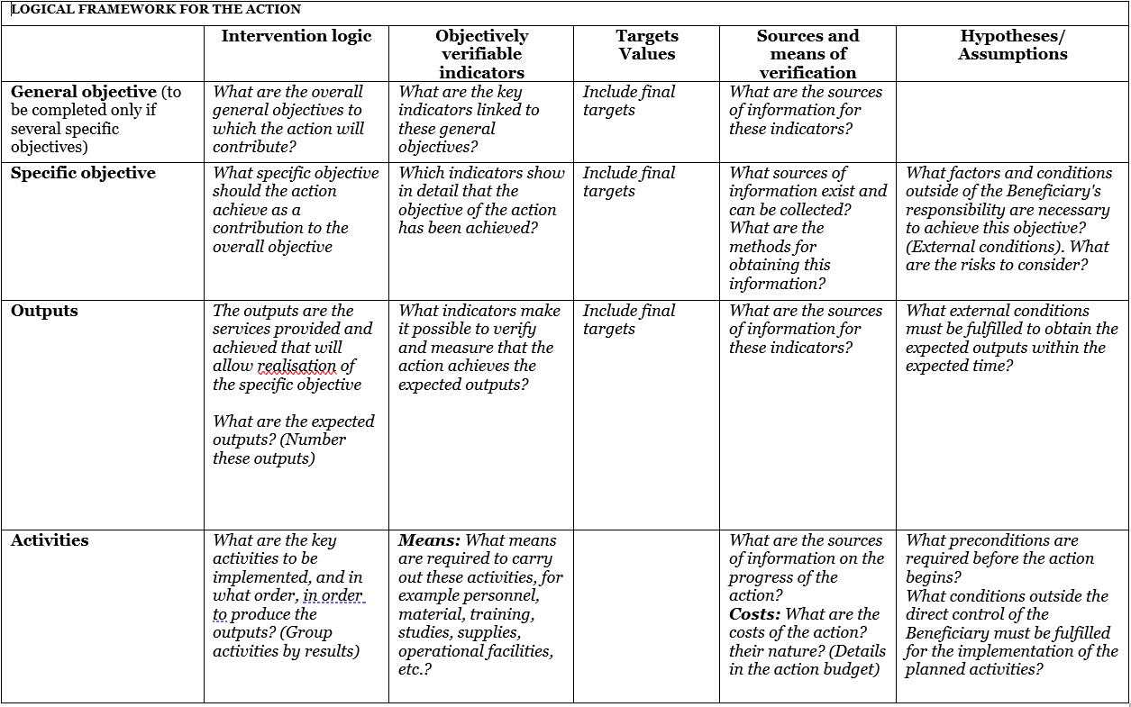
b) M&E logical framework, indicators
3. Proposal template
b) M&E, framework, indicators
Use Annex C: logframe template and explain logic
Notes:
GO: livelihoods
SO: certification & employment

Slide 23
Logical flow
Assumptions & risks
Resources/inputs
Activities
Outputs
Outcome
Impact
3. Proposal template
b) M&E, framework, indicators
Planned work
Intended results
Problem analysis
Stakeholder analysis
Objectives
Risk analysis
Staff
Time
Money
Materials
Equipment
Technology
...
Workshops
Meetings
Field trips
Trainings
Service delivery
...
Number trained, sensitized
Products developed and shared
Equipment distributed
…
Short term
Knowledge/skills acquired
Attitudes changed
Change in behaviour
Decisions made
Actions undertaken
Long term
Social change
Economic change
Environmental change
...
Participant is object
Participant is subject

Slide 24
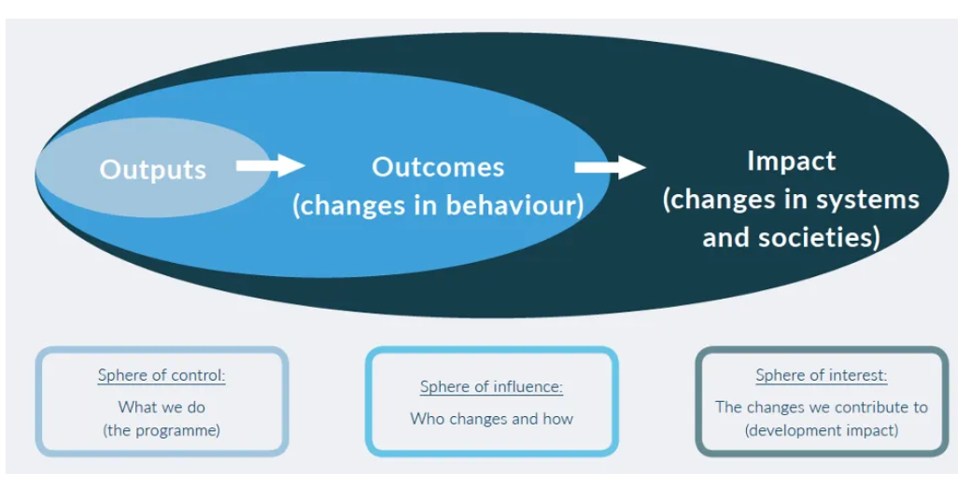
3. Proposal template
b) M&E, framework, indicators

Slide 25
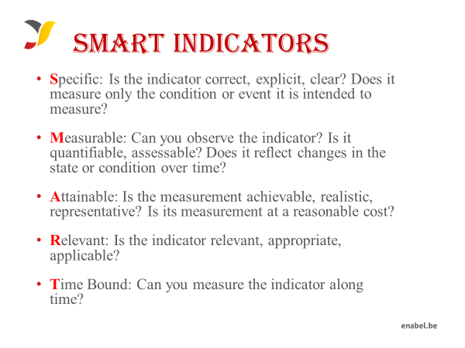
3. Proposal template
b) M&E, framework, indicators

Slide 26
Example Impact/GO
3. Proposal template
b) M&E, framework, indicators
IMPACT - Enhanced contribution to the Ugandan private sector in realising sustainable development for green growth and decent jobs
X% of project participants have increased turnover of at least 20%/50% by the end of the action
X% of project participants have created X number of new, decent jobs
X% of project participants have improved staff working conditions in at least one or more key dimensions of decent work
X% of project participants have raised capital by the end of the action

Slide 27
Example Outcome/SO
3. Proposal template
b) M&E, framework, indicators
OUTCOME - Unlocked growth potential of at least X innovative start-ups/scale-ups in the GCE through incubation/acceleration support
X% of project participants have a validated MVP by the end of the action/ X% of project participants that have successfully launched a new green/circular product service (lot 1)
% of enterprises demonstrating improved financial management practices, as measured by business diagnostics or follow-up assessments
X% of project participants reporting increased customer base or market reach

Slide 28
Example Output/results
3. Proposal template
b) M&E, framework, indicators
X # of start-ups/scale-ups supported to XXX
= service delivery

Slide 29
3. Proposal template b) M&E, framework, indicators

Slide 30
c) Proposal template - Budget
The budget need to be coherent with the activities in the narrative & action plan
NUMBERING: Activity 1 in the narrative planning need to be transferred to a budget line for activity 1
TIMING: if you plan activity 1 in quarter 1 only, then you will only foresee a budget in quarter 1 for that activity
CODING: Codes correspond with the Logframe: Specific Objective, 01 Result number one,01 Activity Number one under result no One.A0101.3rd level relates to sub activities e.g A010101,A010102

Slide 31
c) Proposal template - Budget
On a daily basis you will work with UGX, but the official max grant amount is in euro which you cannot exceed, so follow up of execution in euro is needed.
FX rate of UGX 4000: 1 EUR (grantees can use their own exchange rate (based on a reliable source) to estimate the budget).
Exchange rate losses are ineligible costs and should be covered by the grantees themselves (e.g. through structure costs). Additionally, since the purpose of the grant is not to make money, any gains (exchange or interest) made on the funds received from Enabel must be re-used for the activities after Enabel approval.

Slide 32
c) Proposal template - Budget
The budget is broken down in 3 cost components;
Operational costs (actual activity costs - general means cost): necessary and indispensable cost for achieving the objectives and results of the action, including the cost for achieving verifiable deliverables
    Ex : fees for instructors, consultancy fees, fuel for transporting, workshop costs, training materials, food for trainees, fees for trainees etc.
Management costs (costs to support the management team): identified costs related to management, supervision, coordination, monitoring, control, evaluation and financial audit which specifically originate in the implementation of the action or the justification of the Grant
  Ex : Salary for staff, Mid-term evaluation, special audit costs
Structure costs (7% max of eligible operational costs) costs related to the achievement of the social purpose of the beneficiary, which cannot be separated or charged to the budget of this action even though they are affected by the implementation of the action. They are a max of 7% of the eligible operational costs.
      Ex: supporting staff (those that cannot be justified under management costs through timesheets e.g., procurement), water & electricity & internet of the office etc.

Slide 33
c) Proposal template - Budget
What are the rules concerning structure costs?
The percentage (max.7%) must be justified before signature of the Grant Agreement and correspond to the general structure costs of the grantee
It’s a lump-sum and maximum 7% of operational costs
Once the % has been set and confirmed by the analysis of the grantee’s accounts, no supporting document have to be provided by the grantee. In the reporting, it just appears as a separate line at the end (+ 7%).

Slide 34
c) Proposal template - Budget
Ineligible costs (1/2):
Expenses that are included in the ineligible list (see guidelines)
Expenses that are incurred before or after the duration of this grant agreement
Expenses that cannot be identified, verified and are not included in the grantee's accounts
Expenses not in line with applicable legal fiscal and social provisions
Expenses that are not reasonable, justified, not respecting the principle of good financial management, in particular concerning cost efficiency and effectiveness
Expenses not in line with the action plan, not necessary to achieve the results
No contributions in kind are considered

Slide 35
c) Proposal template - Budget
Ineligible costs (2/2):
Accounting entries not leading to payments
Provisions for liabilities and charges, losses, debts or possible future debts
Debts and debit interests
Doubtful debts
Currency exchange losses
Loans to third parties
Guarantees and securities;
Costs already financed by another grant
Invoices made out by other organisations for goods and services already subsidized
Subcontracting by means of service or consultancy contracts to personnel members, Board members or General Assembly members of the organization subsidized
Any sub-letting to oneself
Purchases of land or buildings;
Compensation for damage falling under the civil liability of the organization
Employment termination compensation for the term of notice not performed
Purchase of alcoholic beverages, tobacco and derived products thereof

Slide 36
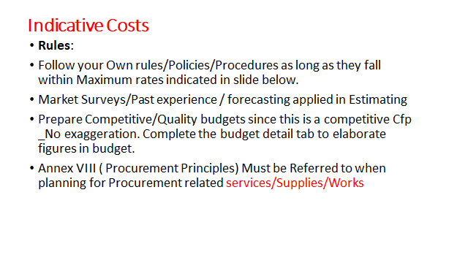
c) Proposal template - Budget

Slide 37
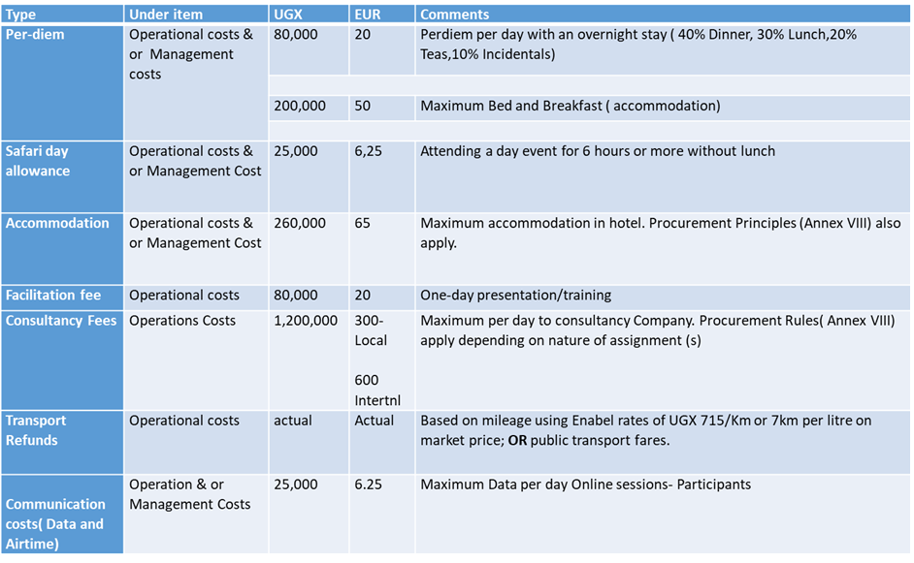
Indicative Costs
c) Proposal template - Budget

Slide 38
c) Proposal template - Budget

Slide 39
4. Application procedure / Next steps
4. Application procedure / Next steps
Use the complete Annex A Grant Application File, Part B. Do not use own templates & do not tweak the template
Submission in English only
Provide a detailed budget (annex B)- Amount requested in the proposal may not vary more than 20% in relation to the initial estimate
Errors or major inconsistencies concerning the points mentioned in the instructions of the form may result in rejection (e.g., content required, pages, …)
Enabel reserves the right to request clarification where the information provided does not enable it to carry out an objective evaluation

Slide 40
Submission proposal
4. Application procedure / Next steps
Deadline for application: 26/05/2025 at 5 PM EAT
!!! Online submission form ‘Submit’: https://submit.link/3Fw
SUBMISSIONS BY EMAIL/POST → AUTOMATIC REJECTION

Slide 41
Application procedure
4. Application procedure / Next steps
Remaining questions: uga_csc_grants@enabel.be
Subject: reference number- UGA22003 -10040
Questions can be submitted until 5th May
Answers will be published on https://www.enabel.be/grants/ latest by 15th May

Slide 42
Application procedure
4. Application procedure / Next steps
! Primary source of information
Guidelines, annexes, clarifications (Q&A) and all other communication & updates:
https://www.enabel.be/grants/
Select UGANDA – OPEN CALLS - FILTER
reference number UGA22003 -10040

Slide 43
Submission proposal
4. Application procedure / Next steps
Online submission form ‘Submit’: https://submit.link/3Fw
Avoid last minute submission; System automatically closes when past deadline
Start working on a draft timely (you can always go back to your draft, it saves automatically)
Get documentation (annexes to the application file) ready on time; you cannot proceed to uploading application file before uploading the annexes)

Slide 44
NEXT STEPS
4. Application procedure / Next steps
Invitations to submit the proposals | April 24th, 2025* | NA
Deadline for clarification requests to the contracting authority | May 5th, 2025 | 5:00 pm
Response to clarification requests are given by the contracting authority | May 15th, 2025* | 5:00 pm
Deadline for the submission of the proposals | May 26th 2025 | 5:00 pm
Opening, administrative checks and evaluation of proposals | May 27th – June 13th, 2025* | NA
Request certificates and supporting documents relating to the grounds for exclusion (see 2.1.1 (2)) | June 18th, 2025* | 5:00 pm
Onsite organizational analysis of the successful applicants after technical evaluation | June 18th – June 25th, 2025* | NA
Receipt of certificates and supporting documents relating to the grounds for exclusion | July 2nd, 2025* | 5:00 pm
Notification of the award decision and transmission of signed grant agreement | July 9th, 2025* | NA
Signature of the Agreement by contracting beneficiary | July 11th, 2025* | NA

Slide 45
4. Application procedure / Next steps

