Slide 1
Call For Proposals INCUBATION AND ACCELERATION SUPPORT FOR GREEN BUSINESS GROWTH
Information sessions

Slide 2
Presentation outline
Introduction to WeWork and the Call for Proposals
Objectives of the call
Admissibility criteria
Actors
Actions
Costs
Concept note application form
Application and selection procedure

Slide 3
Call for Proposals
Guidelines, annexes, clarifications (Q&A) and all other communication:
www.enabel.be/grants
Call reference number: UGA22003-10040
Call Title: Incubation and acceleration support for Green Business Growth
Procedure: 2 phased : (1) Concept note stage, (2) proposal stage

Slide 4
Enabel Country Portfolio
Overall Objective
General objectives
Young people and women in Uganda develop into active, economically independent citizens in a sustainable society that respects human rights and ensures quality basic services
Pillar 1
WeWork – Green and Decent Jobs for Youth
Young people, especially young women, acquire skills and find decent jobs or entrepreneurship opportunities in agriculture and the green and sustainable economy
Pillar 2
The right to safe and quality education and health care is more transparently ensured, in particular for vulnerable groups including children, girls and women, and refugees

Slide 5
WeWork – Green and Decent jobs for Youht
Overall Objective
Contribute to sustainable economic growth and decent job creation in Uganda
Specific Objective
Increase the employability of youth, women and men, supply of qualified workers, and access to decent employment

Slide 6
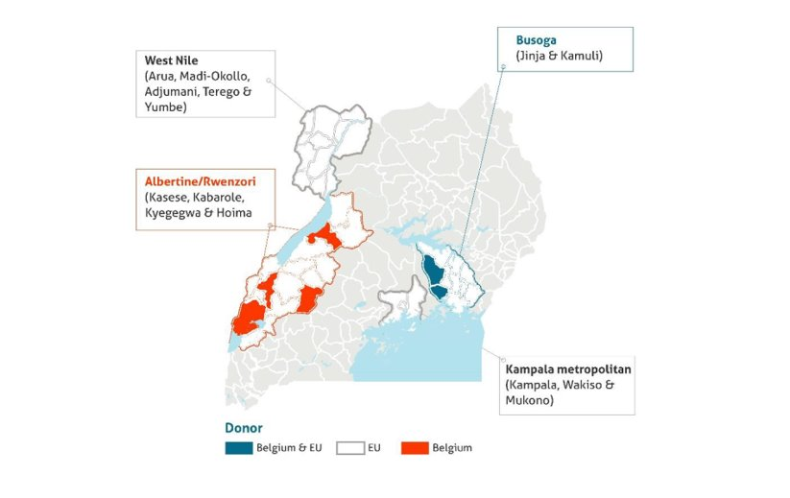
1. WeWork – Geographical focus

Slide 7
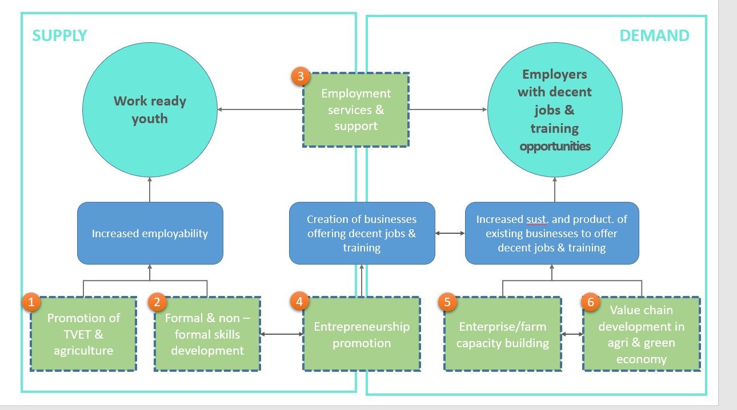

Slide 8
WeWork– Business support
R4/OP2.1 Sustainable micro- & small business devt (resilience track) | R5/OP2.3 SME growth tracks (decent job creaton, greening) | OP 2.2 Ideation, incubation & acceleration of young enterprises(growth, innovation)
3500 youth supported to start or grow sustainable micro- or small business | 115 SMEs supported to unlock growth and decent job creation potential Technical assistance track Greening track (UCPC) | 100 dynamic and innovative young enterprises supported to launch and scale
+ strengthening of the start-up ecosystem (structures)

Slide 9
2. Call Objectives
General objective
To contribute to the Ugandan private sector in realising sustainable development for green growth and decent jobs.
Specific objective
To unlock the growth potential of at least 70 innovative start-ups and scale-ups in the Green and Circular Economy (CGE) through incubation and acceleration support and resulting in the creation of at least 250 new, decent jobs.

Slide 10
2. Call Objectives – outputs (overall)
At least 50 early-stage businesses in the CGE are supported to successfully launch their business in the market and realise growth through incubation = lot 1
At least 20 scale-ups in the GCE are supported to scale their business models through acceleration = lot 2

Slide 11
2. Call objectives – Outputs (overall)
Lot 1 - Incubation
Call output 1 (lot 1):
At least 50 early-stage businesses in Green and Circular Economy are supported to successfully launch their business in the market and realise growth through incubation
Minimum results lot 1 (“business growth):
At least 20% revenue growth at the end of the action for enterprises participating in incubation programmes
On average 3 new, direct or indirect decent jobs created per enterprise at the end of the action

Slide 12
2. Call objectives – Results (overall)
Lot 2 – Acceleration
Call output 2 (lot 2):
At least 20 scale-ups in the GCE are supported to scale their business models through acceleration
Minimum results lot 2 (“business growth):
At least 50% growth in turnover
On average 5 new, direct or indirect decent jobs created per enterprise at the end of the action

Slide 13
2. Call volume and grant amounts
The overall amount available for this call is EUR 1,200,000 allotted as below;
Lot 1: Incubation = EUR 300,000
Minimum requested amount = EUR 150,000
Maximum requested amount = EUR 300,000.
Lot 2: Acceleration = EUR 900,000
Minimum requested amount = EUR 450,000
Maximum requested amount = EUR 900,000.

Slide 14
3. Admissibility criteria – 3 levels
The actors: Admissible applicants
The actions: Admissible actions for grants
The costs: Admissible types of costs that may be included in grants

Slide 15
3a. The actors: (lead) applicant
Be a legal entity;
Be a Public entity or a private not for profit entity or foundation;
Be established or represented in Uganda (= registered in Uganda!);
Be a national or international non-profit Business Development Service Provider OR a semi-autonomous Business Development Service Provider in case of public entities;
Be directly responsible for the preparation and management of the action with the co-applicant (where applicable) and not be acting as an intermediary;
Have demonstrated local expertise and experience in managing and delivering quality business development initiatives for incubation (lot 1) or acceleration (lot 2) of dynamic, young enterprises in the Green and Circular Economy in Uganda, for – at least – the past 2 years;
For applications under lot 2 only: Have an existing collaboration or partnership with financiers or investment funds and/or demonstrated records of raising funds for SMEs (to be demonstrated for the (lead) applicant OR any co-applicant);
Have an active Bank Account for the past 12 months;
Have in-house financial management capacity.

Slide 16
3a. The actors: (lead) applicant
Exclusion grounds:
Annex VII grant agreement – Applicant’s declaration in application form completed and signed (PART A application form – Annex A)
Supporting documents (upon preselection – 2nd stage only):
Criminal record clearances from Interpol
NSSF clearance certificate
Tax clearance certificate

Slide 17
3a. The actors: Co-applicants
The applicant may act individually or form a partnership and act with one and maximum two co-applicants (not obligatory!)
The partnership between lead and co-applicants is to optimize cumulation of complementary expertise.
The selected applicant becomes the contracting-beneficiary and is the main point of contact for the contracting authority. It shall represent its co-applicant and act in their name. It shall design and coordinate implementation of the action.
The co-applicant shall participate in the implementation of the action and the costs that they incur shall be eligible in the same way as those incurred by the lead applicant.
Any co-applicants must sign a mandate in 2nd/proposal stage (Annex A, part B)
→ Same admissibility criteria as for (lead) applicants

Slide 18
3a. The actors: Associates
Participate actively in the action, but are not eligible for grants and only qualify to receive daily allowances and travelling expenses.
To be specified in part B of the application form (annex A). They need not to sign the mandate in 2nd/proposal stage.

Slide 19
3a. The actors: Contractors
These are contractors for services, works and equipment. These must be sourced through a procurement process using relevant procedures i.e. PPDA (public procurement law) for public entities and annex VIII of the Grant Agreement for private entities

Slide 20
Questions?

Slide 21
3b. The actions
An action comprises a series of activities that are necessary to achieve the results and contribute to the specific(s) objective(s) pursued by the application
Duration
Geographical coverage
Sector themes
Target groups
Type of action and eligible activities

Slide 22
3b. The actions: Duration
Action duration = grant agreement/project duration
Lot 1 – Incubation
Minimum 15 to maximum 24 months (excluding 3 months grant closure)
Lot 2 – Acceleration
Minimum 15 to maximum 33 months (excluding 3 months grant closure)

Slide 23
3b. The actions: Target groups & sector
Young, innovative, dynamic and demand-driven enterprises in the Green and Circular Economy (CGE), i.e.. with potential to grow/scale, and, as such, contribute to job creation
Green and Circular Economy (CGE)
Contribution to healthy and sustainable eco-systems
Reduction of carbon emissions, pollution and waste in production and consumption;
Promotion of energy efficiency, saving of natural resources, and regenerative systems; and/or
Production of green goods and services.

Slide 24
3b. The actions: Target groups & sector
Lot 1 - Incubation
Early-stage entrepreneurs looking to refine their business ideas and develop innovative, green solutions
basic proof of concept (PoC) and initiated market testing/exploration;
potential for innovation in the Green and Circular Economy;
market-driven and demonstrate potential for scalability;
Have a product prototype and/or are undergoing product testing or research and development.

Slide 25
3b. The actions: Target groups & sector
Lot 2 – Acceleration
More mature enterprises and scale-ups that have a market-ready solution and are looking to scale their solutions
validated Minimum Viable Product (MVP) or beyond;
potential for innovation in the Green and Circular Economy;
demonstrate market traction, have a track record of financial sustainability and ability to absorb (additional) finance, and showing readiness for scaling regionally or globally;
demonstrate growth realized, in terms of number of staff and a minimum annual turnover of 20,000 EUR;
highly motivated and committed teams willing to learn and ready to take action on the business insights learned.

Slide 26
3b. The actions: Geographical coverage
Lot 1 – Incubation
The actions under lot 1 must target enterprises/entrepreneurs operating in Uganda, in the following subregions: Kampala metropolitan area, Busoga and West Nile, and in the following priority districts (incl cities):
During implementation:
Selected applicants are expected to actively source participant enterprises in all 3 subregions during implementation, aiming for 70% KLA & 30% BUS&WN
Selected applicants may consider as well supporting enterprises in other districts within the subregions of focus, if envisioned outcomes in terms of growth and decent job creation are significant and well-justified, and if there are opportunities for market linkages or employment creation in the prioritized districts
Kampala Metropolitan | Busoga | West Nile
Kampala Wakiso Mukono | Kamuli Jinja | Madi-Okollo Terego Adjumani Arua Yumbe Kiryandongo

Slide 27
3b. The actions: Geographical coverage
Lot 2 – Acceleration
The actions under lot 2 must target enterprises operating in Uganda, in the following subregions: Kampala metropolitan area, Busoga and/or West Nile.
Selected applicants might consider as well supporting enterprises operating in other, surrounding subregions, if envisioned outcomes in terms of growth and decent job creation are significant and well-justified, and if there are opportunities for market linkages or employment creation in the prioritized sub-regions.

Slide 28
3b. The actions: Types of actions
Lot 1 : Incubation programmes
Lot 2: Acceleration programmes (holistic)
Other types of actions = inadmissible

Slide 29
3b. Strategies promoted = evaluation criteria
Lot 1 – Incubation
Business development training and tailored technical assistance and mentorship;
Entrepreneurial soft skills development;
Access to well-equipped co-working spaces and technology that allow pitching, networking and prototyping activities;
Engagement and partnerships with private sector actors to leverage existing business knowledge and expertise in the CGE in training, mentoring/coaching or peer-to-peer learning + facilitate development of business relationships (ie. integration in business networks, facilitation of B2B partnerships, facilitation of sales or distribution agreements etc);
Strategies to enhance access to affordable finance and capital, along with support in pitching for; grants/seed funding, preparing for investment readiness, matchmaking with formal or non-formal credit opportunities.

Slide 30
3b. Strategies promoted = evaluation criteria
Lot 2– Acceleration
Tailored technical assistance and mentorship
Strategies to support access to new (local or international) markets, eg. access to market research, legal advice and guidance on compliance with regulatory frameworks and environmental standards, support to achieve certifications (e.g. eco-labels, EUDR or ISO environmental certifications) etc;
Sector-specific technical support in product development and/or diversification focusing on sustainability and innovation, including adoption of new, green technologies;
Engagement and partnerships with private sector actors eg to leverage business knowledge and sector-specific expertise, promote B2B, sales agreements etc;
Strategies to enhance access to affordable finance and capital, ie. building investment readiness, matchmaking with financiers who are looking to invest in sustainable, scalable businesses;
Strategies to promote adherence to decent work principles.

Slide 31
3b. Strategies promoted = evaluation criteria
Both lots
Outreach & awareness activities and proper selection procedures;
Inclusion strategies (mainstreaming* and/or promoting equal access to decent employment)
Innovative approaches, good practices, new technologies
Adherence to quality standards
M&E and knowledge mgmt.

Slide 32
3b. Sub-grants to sub-recipients
Optional, not mandatory (but strong value for money and alternative strategies if not included)
Restricted to specific categories (other categories → inadmissible)
Lot 1 – Incubation : Seed grants
Lot 2 – Acceleration : matching grants or loan-matching grants
Restricted to conditions per category

Slide 33
3b. Conditions sub-grants lot 1 = Seed grants
Maximum 30% of the total budget of the action
Max EUR 5000 per selected enterprise;
Any seed grants must be non-refundable;
Supported enterprises must have successfully completed the incubation programme organized under the action and developed/refined the necessary documents as defined and guided by the applicant (eg. business plans, investments proposals, financial projections, ...);
Approval of seed grants for supported businesses will be done by a selection committee which is to include representatives of Enabel, and by applying key selection/awarding criteria (competitive)

Slide 34
3b. Conditions sub-grants lot 1 = Seed grants
Eligible costs for seed grants:
Business set-up costs (equipment, raw materials, working capital etc)
Marketing, market research and market testing activities;
Technology adoption;
Product research and development activities;
Compliance with legal and regularity requirements (costs for legal services to secure licenses, product or service copy rights, product certifications, licenses and permits to operate legally);
Fundraising costs such as travel costs to investor events in preparation for investment readiness;
Other activities that are be linked to the launch and growth of an enterprise.
Non-business-related costs (e.g. personal expenses or assets) and repayment of existing debts or loans cannot be eligible for seed funding.

Slide 35
3b. Conditions sub-grants lot 2 - Acceleration
Matching grants to enterprises supported under the action
Eligible enterprises must contribute a minimum of 50% of the required investment (1:1 ratio);
AND/OR
Loan-matching grants to financiers providing credit to the enterprises supported under the action to repay a % of the loan
new and regulated loan/investment during participation in the acceleration for investments linked to growth strategy.
Loan-matching grants cannot exceed 30% of the loan amount raised by an enterprise (and cannot exceed EUR 30,000).
To be paid to the financier (as a formalized re-imbursement on the borrower account).

Slide 36
3b. Conditions sub-grants lot 2 - Acceleration
Maximum 40% of the total budget of the action
Max EUR 30,000 per selected enterprise;
Any matching grants or loan-matching grants must be non-refundable;
Approval of (loan-)matching grants for supported businesses will be done by a selection committee which is to include representatives of Enabel, and by applying key selection/awarding criteria

Slide 37
3b. Conditions sub-grants lot 2 - Acceleration
Eligible costs for (loan-)matching grants:
Market expansion and acquisition activities; eg. market research, marketing, branding and advertising activities or materials;
Product or service development and diversification; eg product research and development to enhance quality and/or diversify to enhance market access;
Technology adoption;
Implementation of sustainability initiatives;
Investment in working capital;
Acquisition of the essential equipment;
Activities/costs aimed at obtaining certification to be able to access regional and global markets;
Other Initiatives that are linked to the growth of an enterprise.

Slide 38
3b. The actions: Admissible activities
Sub grants – Eligibility of the costs under sub grants
For Both Lot 1 and 2;
The description of the objectives and results to be achieved with these sub- grants, the fundamental principles, the key concepts, the mechanisms, the actors and their role in the management process;
The criteria and modalities for the allocation of grants, accessibility conditions sub-beneficiaries, conditions for the admissibility of sub-projects, eligibility conditions for activities, costs and expenses;
The procedures for examining and awarding applications;
The maximum amount that can be allocated by sub-beneficiary;
The terms of contractualization with the sub-beneficiary;
The procedures and modalities for disbursing resources;
The procedures and modalities for technical and financial monitoring;
The procedures and modalities of control.

Slide 39
3b. Sub-grants to sub-recipients
Applicants selected to go to 2nd/proposal stage need to elaborate:
1. The description of the objectives and results to be achieved with these sub- grants, the fundamental principles, the key concepts, the mechanisms, the actors and their role in the management process;
2. The criteria and modalities for the allocation of grants, accessibility conditions sub-beneficiaries, conditions for the admissibility of sub-projects, eligibility conditions for activities, costs and expenses;
3. The procedures for examining and awarding applications;
4. The maximum amount that can be allocated by sub-beneficiary;
5. The terms of contractualization with the sub-beneficiary;
6. The procedures and modalities for disbursing resources;
7. The procedures and modalities for technical and financial monitoring;
8. The procedures and modalities of control.

Slide 40
3b. Number of applications
The applicant cannot submit more than one (1) application per Lot under this Call for Proposals.
The applicant cannot be awarded more than one (1) Grant Agreement per Lot under this Call for Proposals.
The applicant cannot be at the same time a co-applicant in another application
A co-applicant cannot be awarded more than one (1) Grant Agreement per Lot under this Call for Proposals

Slide 41
Questions?

Slide 42
3c. Admissible/ Ineligible costs
1) Direct costs
Operational Costs
Management Costs (Direct Administration Costs).
2) Indirect Costs:
Structure Costs (Indirect Administration Costs)
Admissible / Eligible Costs:
Costs that Enabel can subsidize under any Grant Agreement
Two Types:
Directs Costs
Indirect Costs

Slide 43
3c. Admissible/ Eligible costs
ii) Management Costs:
Administration costs directly attributed to the implementation of the actions. This comprise the costs of management, monitoring, equipment, facilities and other costs directly related to the core activity.
Examples:
IT/Computer equipment(Laptops, printers, projectors, Camera etc.)
Furniture and fittings
Audit & Accounting fees
Salary of program staff + other direct staff
Etc.
Direct costs
i) Operational Costs
Activity costs necessary for achieving the results of the action. This comprises the costs of the core activities to be implemented.
Examples:
Training materials
Food for trainees
Transport costs for trainees or attend training workshop
Training fees
Etc.

Slide 44
3c. Admissible/Ineligible costs
Indirect Costs:
Structure Costs: Administration costs not directly attributed to the project, but are necessary for the implementation of the actions
Max 7% of operational costs, and to be verified
Examples:
Office rental
Utilities: electricity, water, etc. for project office
Salary of the Executive Director or + other support staff
Office telecommunication cost
Etc.

Slide 45
3c. Admissible/Eligible costs
Reserve for contingencies:
The budget may include a contingency reserve up to a maximum of 5% of the estimated eligible direct costs
It may only be used during implementation with the prior written authorization of Enabel

Slide 46
3c. Ineligible costs
Accounting entries not leading to payments
Provisions for liabilities and charges, losses, debts or possible future debts
Debts and debit interests
Doubtful debts
Currency exchange losses
Loans to third parties
Guarantees and securities;
Costs already financed by another grant
Invoices made out by other organizations for goods and services already subsidized
Subcontracting by means of service or consultancy contracts to personnel members, Board members or General Assembly members of the organization subsidized
Any sub-letting to oneself
Purchases of land or buildings;
Compensation for damage falling under the civil liability of the organization
Employment termination compensation for the term of notice not performed
Purchase of alcoholic beverages, tobacco and derived products thereof
Salary bonuses

Slide 47
3c. Indicative Costs
Rule: Apply OWN policies and procedures – BUT within Limits below:
TRAVEL ALLOWANCES_LDPG Policy + Country Manual apply:
Perdiem per Overnight UGX 80,000 (40% Dinner, 30% Lunch,20% Teas, 10% Incidentals)
Accommodation ( Bed & Breakfast) Maximum UGX 150,000* For Kla metro,Jinja,Fortportal,Mbarara,Gulu,Arua, AND other districts 100k
Full day overnight Allowance maximum UGX 230,000 (80k+150k)
SDA UGX 25,000 ( Work outside duty station >6hours)
Transport Refund : Based on Mileage rate, currently 715/km and 7km per Litre, google maps, or Actual Public Means rates, Air Tickets & Visas, Actual rates.

Slide 48
3c. Indicative costs Cont`d
Honorarium / professional fees to own staff /government Officials _Not allowed. Being Reviewed.
Consultancy Fees ( Company): Procurement Rules apply depending on assignments: usually <= Eur 300 per day_ Covering all costs for Local Consultancies, and <=Eur 600 for international consultancies.
Facilitation fees – Individuals - Presentation of Papers / Training, per day ;UGX 80,000
Communications : )Airtime and Data/ Internet)
Participants – Online sessions >2hrs Max 30,000 per day, below 2hrs max 15,000
Staff : Per Month ; Support & Operations ( Max 110k)

Slide 49
3c. Other considerations:
Efficiency: Ratio Management Costs to Operational Costs: >=70%:<=30%
Budget for CfP only at high level: Ops Costs, Mgmt, & structure costs
Aligned to : Log frame and Operational planning
Treasury Management (Transactional Exchange rates, Forex Gains and losses) is the responsibility of partner.

Slide 50
3c. Budget estimation
S/NO | Category of expenses | Activity |  | Budget (in EUR)
1 | Operational costs
2 | Management costs
3 | Structure costs (maximum 7% of operational costs)
 | Total

Slide 51
Questions?

Slide 52
4. Concept note application
Use the complete Annex A Grant Application File, Part A. Do not use own templates & do not tweak the template
Submission in English only
In the concept note, provide only an estimate of the amount requested. Detailed budget (annex B) is only required in second stage (Amount requested in the 2nd stage may not vary more than 20% in relation to the initial estimate)
Errors or major inconsistencies concerning the points mentioned in the instructions of the form may result in rejection (e.g., content required, pages, …)
Enabel reserves the right to request clarification where the information provided does not enable it to carry out an objective evaluation
Elements defined in the concept note may not be modified by the applicant in the proposal

Slide 53
4. Concept note application annexes
1. The concept note declaration signed by the applicant (Annex A, Part A)
2. Statutes or articles of association of the lead applicant and any co-applicants.
3. An external audit report produced by an approved auditor, certifying the lead applicant accounts for the last available financial year (and not older than 2023) where the total grant amount requested is above EUR 200,000 (not applicable to public beneficiary-contractors)
4. A copy of the lead applicant’s most recent approved financial statements (income statement and balance sheet for the last two closed financial years). This does not apply where the accounts are in practice the same documents as the external audit report already provided pursuant to point 3.
5. The legal entity file (see Annex D1 or D2 of these guidelines) duly completed and signed by the applicant and any co-applicant, along with the supporting documents requested (= official registration documents)
6. For applications under lot 2 only: Supporting documents to proof existing partnerships with financiers or investment funds and/or records of raising funds for SMEs (eg. MoUs or partnership agreements with financiers or investment funds, and/or MoUs or partnership agreements of supported SMEs and documents demonstrating funds raised by supported SMEs), either for the (lead) applicant or any co-applicant.

Slide 54
4. Application procedure
! Primary source of information
Guidelines, annexes, clarifications (Q&A) and all other communication & updates:
https://www.enabel.be/grants/
Select UGANDA – OPEN CALLS - FILTER
reference number 22003-10040

Slide 55
5. Application procedure
Remaining questions: uga_csc_grants@enabel.be
Subject: reference number + name

Slide 56
5. Submission concept notes
Deadline for application: 17/01/2025 at 5 PM EAT
!!! Online submission form – ‘Submit’:
https://submit.link/37h
SUBMISSIONS BY EMAIL/POST → AUTOMATIC REJECTION

Slide 57
5. Submission concept notes
Online submission form – ‘Submit’ https://submit.link/37h
:
Demo
Avoid last minute submission; System automatically closes when past deadline -→ You will not see the link!
Start working on a draft timely (you can always go back to your draft, it saves automatically)
Get documentation (annexes to the application file) ready on time; you cannot proceed to uploading application file before uploading the annexes)

Slide 58
5. Submission concept notes
Timely
Complete (guide + declaration + annexes)
and following the procedure (use the template!)

Slide 59
5. Evaluation and selection procedure – Concept notes
Activity | Date | Time
Publication of Call for Proposals | 3rd/12/2024 | NA
Information meetings | 5th & 6th /12/2024 | See 2.2.4
Deadline for clarification requests to the contracting authority | 27th /12/2024 | 5:00 pm
Last date on which clarifications are given by the contracting authority | 7th /01/2025 | 5:00 pm
Submission deadline for concept notes | 17th /01/ 2025 | 5:00 pm
Opening, administrative checks and evaluation of concept notes | 17th /January – 4th February 2025 | NA

Slide 60
5. Evaluation and selection procedure – Proposals
Invitations to submit the proposals | 14th /02/2025* | NA
Deadline for clarification requests to the contracting authority | 23rd /02/2025* | 5:00 pm
Response to clarification requests are given by the contracting authority | 5th /03/ 2025* | 5:00 pm
Deadline for the submission of the proposals | 17th /03/2025* | 5:00 pm
Opening, administrative checks and evaluation of proposals | 17 March – 10 April 2025* | NA
Request certificates and supporting documents relating to the grounds for exclusion (see 2.1.1 (2)) | 14 April, 2025* | 5:00 pm
Onsite organizational analysis of the successful applicants after technical evaluation | 14 April – 29 April, 2025* | NA
Receipt of certificates and supporting documents relating to the grounds for exclusion | 29 April, 2025* | 5:00 pm
Notification of the award decision and transmission of signed grant agreement | 12 May, 2025* | NA
Signature of the Agreement by contracting beneficiary | 20 May, 2025* | NA

Slide 61
Thank you! Q&A

